Slide 1
Pressure Injury
Problem Statement Workshop
ARIIA – Data Literacy Project
Emma Burke – Manager, Strategic Projects
30 Sep 2025

Slide 2

ARIIA Data Literacy Project
About the Project:
Led by ARIIA, an independent organisation funded by the Australian Government to support aged care staff, and delivered through the Aged Care Collaborative. Residential and home care providers across Australia are working together to improve care through better use of data.
Purpose: Help aged care staff use existing data to improve care for residents.
Focus:
Build staff skills in using data for pressure injuries and wound care
Use routinely collected data to guide better care decisions
Data Context:
Residential care: National Quality Indicator for pressure injuries

Slide 3

Workshop Purpose
The purpose of this workshop is to:
Review current Pressure Injury (PI) reporting processes and workflows
Understand challenges frontline staff face in identifying, staging, and reporting PIs
Explore what data is useful for daily resident care and how it should be accessed
Highlight how current processes and data use inform clinical governance and continuous improvement
Co-create insights to support drafting a problem statement

Slide 4
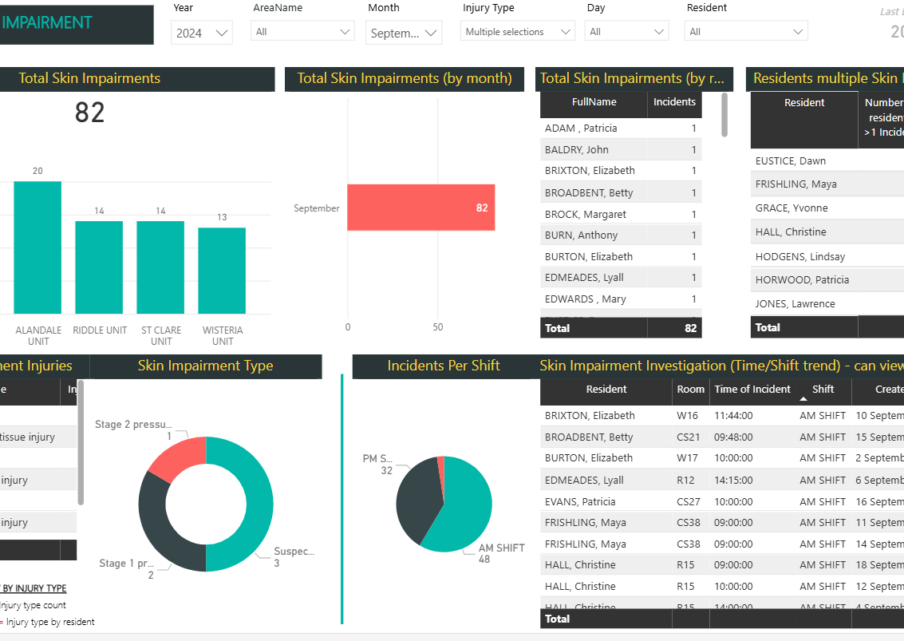
Documentation
Residential Services Incident Management Policy
Residential Services Incident Reporting and Management Process
Pressure Injury Management Process
Wound Management Process
iCare Incident Form
iCare Wound Chart
Power BI NQI and Incident Dashboards

Slide 5

Process Mapping Activity
Identify where and how data is currently captured (tools, forms, systems)
Discuss how often data is collected and in what format
Map out the actual process frontline staff follow
Highlight bottlenecks, pain points, and gaps
Aim: Build a shared flow chart of the “real” data journey

Slide 6

Brainstorming (10 mins)
What data do you use or need each day to support residents?
e.g., wound care notes, incident reports, handover sheets, digital records
How often is pressure injury data collected?
Where is it stored?
How often to you refer to it to direct care needs?

Slide 7

Process Mapping
(20 mins)
Start with the resident/client care interaction.
Walk through step by step how they record pressure injuries.
Place notes in sequence to form the flow (use different colours):
  Action
  Person
  System

Slide 8
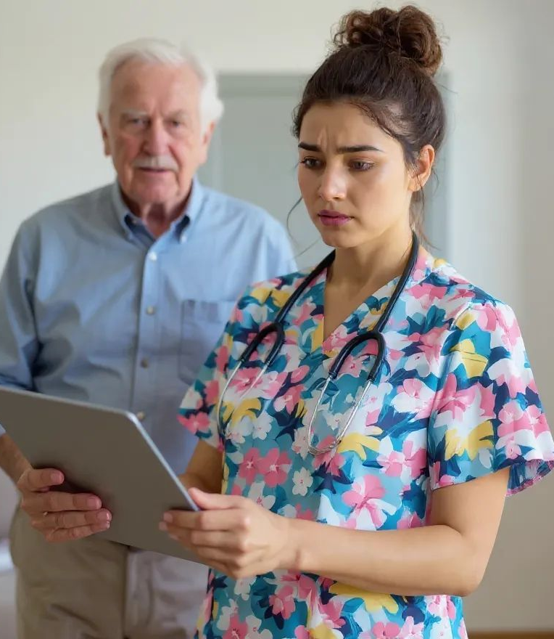
Identify Challenges (15 mins)
Where are the bottlenecks? (e.g., duplicate entry, waiting for approvals)
Where do errors or inconsistencies occur?
What difficulties do you experience in identifying or staging PIs?
Are there points where the process is confusing or duplicated?
Quality Team – what are some of the common mistakes or missing data?

Slide 9

Group Reflection (10 mins)
Review the mapped flow.
Highlight priority pain points that most affect quality or efficiency.
Confirm agreement: Does this reflect reality?

Slide 10

Data for Daily Care (10 min)
What information do you need to make care decisions?
How would you like to access it? (e.g., mobile device, handovers, dashboard)
How often would you need this updated? (e.g., every shift, weekly, as incidents occur)

Slide 11

Identify Themes (10 mins)
Workflow bottlenecks
Challenges in identifying/staging pressure injuries
Data access & usability needs
Gaps that impact daily resident care

Slide 12

Problem Statements (15 min)
“Frontline staff face difficulties…”
“Current processes create challenges in…”
“There is a gap in…”

Slide 13
Thank You

