Slide 1
Pressure Injury
Data Review & Triangulation
Workshop
ARIIA – Data Literacy Project
Emma Burke – Manager, Strategic Projects
15 Oct 2025

Slide 2

Workshop Purpose & Aims
Review and analyse 12 months of Pressure Injury data Fin Year Jul 24-Jun 25
Apply 5-step triangulation method to ensure accuracy and insight
Build shared understanding across ICT, Clinical, and Quality teams
Produce validated insights
Develop Data Review Statement

Slide 3
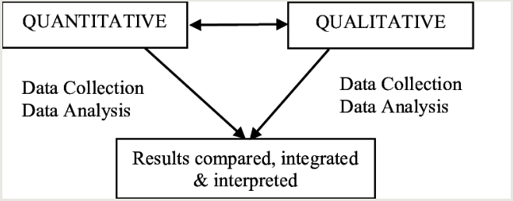
Five Steps of
Data Triangulation
1. Understand the Data
What are we measuring?
Where did it come from?
What period does it cover?
2. What’s the Story?
What trends or patterns are visible?
Does the information make sense?
3. Dig into the Data
Break down results by categories (location, severity, demographics).
Look deeper for anomalies and possible drivers.
4. Validate the Data
Cross-check with other sources and clinical insights.
Confirm accuracy, completeness, and consistency.
5. So-What?
Interpret validated results.
What do they mean for quality of care?
What actions or next steps are required?

Slide 4

Understand the Data
Data sources:
  incident reports
  wound charts
  12 months Power BI Reports
  audits
  governance reports
Definitions:
  staging
  inclusion/exclusion rules
  reporting frequency
Scope:
  12 months last fin year across all facility areas
Known limitations or caveats?
Discussion: Do we fully understand what is being measured?

Slide 5

What’s the Story
Present 12-month trends
Identify visible patterns
Prompt questions:
  Does this story make sense clinically/operationally?
  Are there unexpected results?
  What actions have been reported to Clinical Governance Committee?

Slide 6

Dig into the Data
Break down by:
Stage/severity of injuries
Facility area
Reporting sources (audit vs incident reporting)
Explore anomalies or spikes
What causes have been reported in the Quarterly Performance Reports
Group discussion: Possible operational/clinical drivers?

Slide 7

Validate the Data
Accuracy: Verify that the data correctly reflects clinical reality and patient records.
Completeness: Check that all required fields and records are present and fully documented.
Consistency: Ensure data is uniform across systems and free from duplicates or conflicts.
Timeliness: Confirm that data is entered promptly and reflects events in a current timeframe.
Usability: Assess whether the data is structured and clear enough to support analysis and reporting.
Chose 5 records randomly to check each of these data quality measures (5 x 5)

Slide 8

Data Validation: Accuracy
Are staging and categorisation clinically correct?
Do records align with clinical notes?
Are timelines and outcomes clinically plausible?
Use 5 random wound charts and incident reports check accuracy

Slide 9

Data Validation: Completeness
Are mandatory fields filled (dates, stages etc.)?
Any missing records across the 12 months? – refer to audits
Are monthly counts consistent with expectations?
Use 5 random wound charts and incident reportscheck completeness
Review annual PI audit for omissions noted

Slide 10

Data Validation: Consistency
Do records match across systems (wound chart vs incident reports)?
Do Clinical Governance Reports match Quarterly Performance Reports?
Any duplicate entries or conflicting details?
Is staging/terminology applied uniformly?
Use 5 random wound charts and check data matches the corresponding incident reports
Compare Clinical Governance and Quarterly Performance Reports

Slide 11
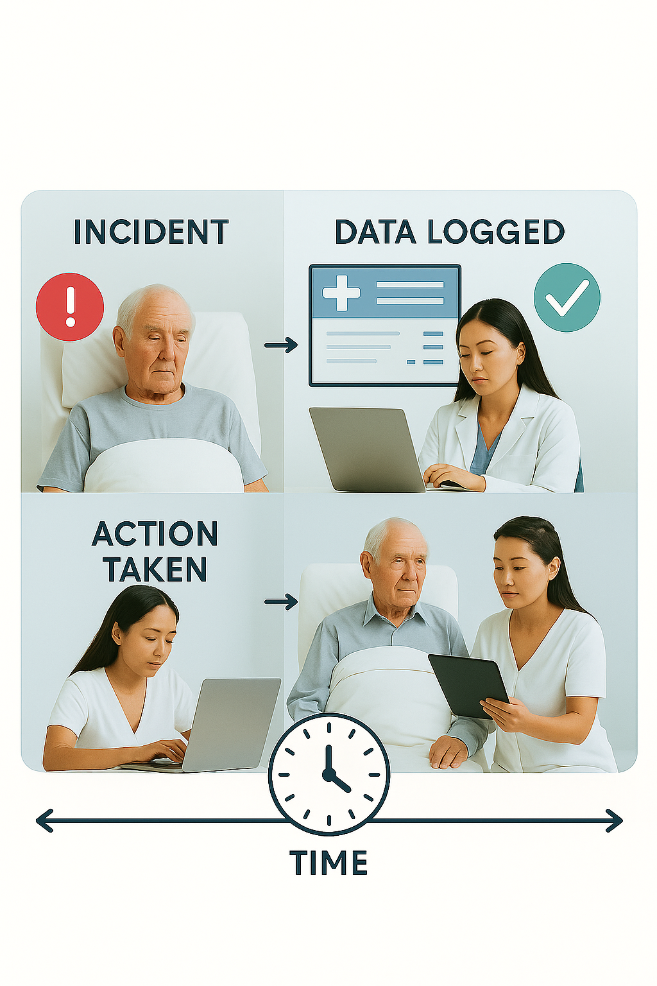
Data Validation: Timeliness
Compare incident occurrence vs incident report entry date and wound chart completion
Identify lags or delays in data entry
Assess whether reporting is current and up to date
Use 5 random wound charts, incident reports and care plans comment on timeliness of reporting and interventions

Slide 12
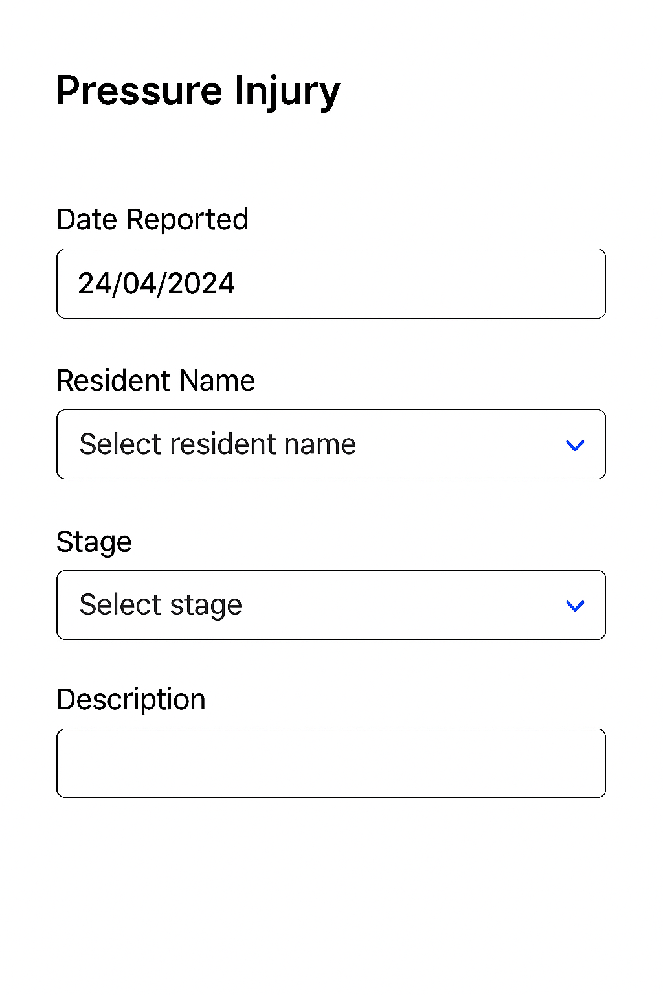
Data Validation: Usability
Is data structured for easy analysis (drop downs vs free text)?
Are definitions standardised and interpretable?
Any records unclear or ambiguous?
Use 5 random wound charts and incident reports report on usability of reporting forms

Slide 13

So What?
Interpret validated findings:
Quality of care implications
Where to investigate further
What actions or next steps are required?
Link findings to quality improvement priorities
Draft 2–3 group “so-what” statements

Slide 14

Data Review Statement
Review:
Key findings from data review
Validation outcomes confirmed
Trends, patterns, and insights identified
Agreed actions / next steps
Develop Data Review Statement summarising findings

Slide 15
Thank You

