Slide 1
Pressure Injury
Workshop - Carers
ARIIA – Data Literacy Project
Emma Burke – Manager, Strategic Projects
22 Oct 2025

Slide 2

ARIIA Data Literacy Project
About the Project:
Led by ARIIA, an independent organisation funded by the Australian Government to support aged care staff, and delivered through the Aged Care Collaborative. Residential and home care providers across Australia are working together to improve care through better use of data.
Purpose: Help aged care staff use existing data to improve care for residents.
Focus:
Build staff skills in using data for pressure injuries and wound care
Use routinely collected data to guide better care decisions
Data Context:
Residential care: National Quality Indicator for pressure injuries

Slide 3

Workshop Purpose
The purpose of this workshop is to:
Understand Carers’ definition of Pressure Injuries (PI)
Understand Carers’ reporting process
Explore what data is useful for daily resident care and how it should be accessed
Identify barriers to accessing data
Outline PI care interventions
Identify barriers to care interventions

Slide 4

What is a Pressure Injury? (5 mins)
What do you think causes a pressure injury?
What are early signs you look for?
How do you explain PIs to residents or families?

Slide 5

Reporting Pressure Injuries (10 mins)
Step through how you report a new PI or a skin concern.
Who do you tell first?
What forms or systems are used?
What works well / what’s frustrating?

Slide 6

Using Data in
Daily Care (10 mins)
What kind of information helps you deliver Pressure Injury care?
Where do you currently find that information? (handover, charts, reports?)
How often do you actually check it?

Slide 7
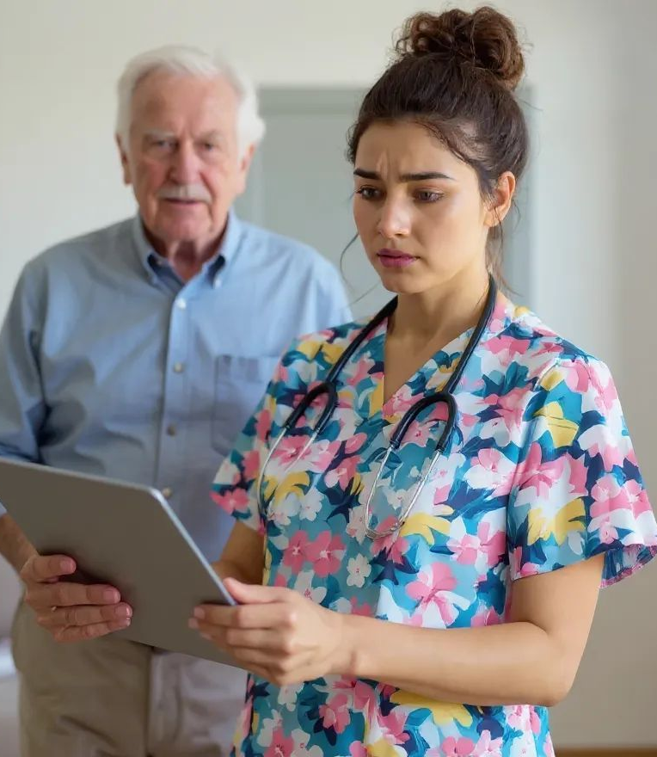
Barriers to Accessing Data (5 mins)
Identify what makes it hard to use or find data.
What gets in the way of finding or using resident information?

Slide 8

PI Care Interventions (10 mins)
What do you do each day to prevent or manage PIs?
Examples:
  Repositioning
  Skin checks
  Equipment use (e.g., cushions, mattresses)
  Hygiene
  Nutrition

Slide 9
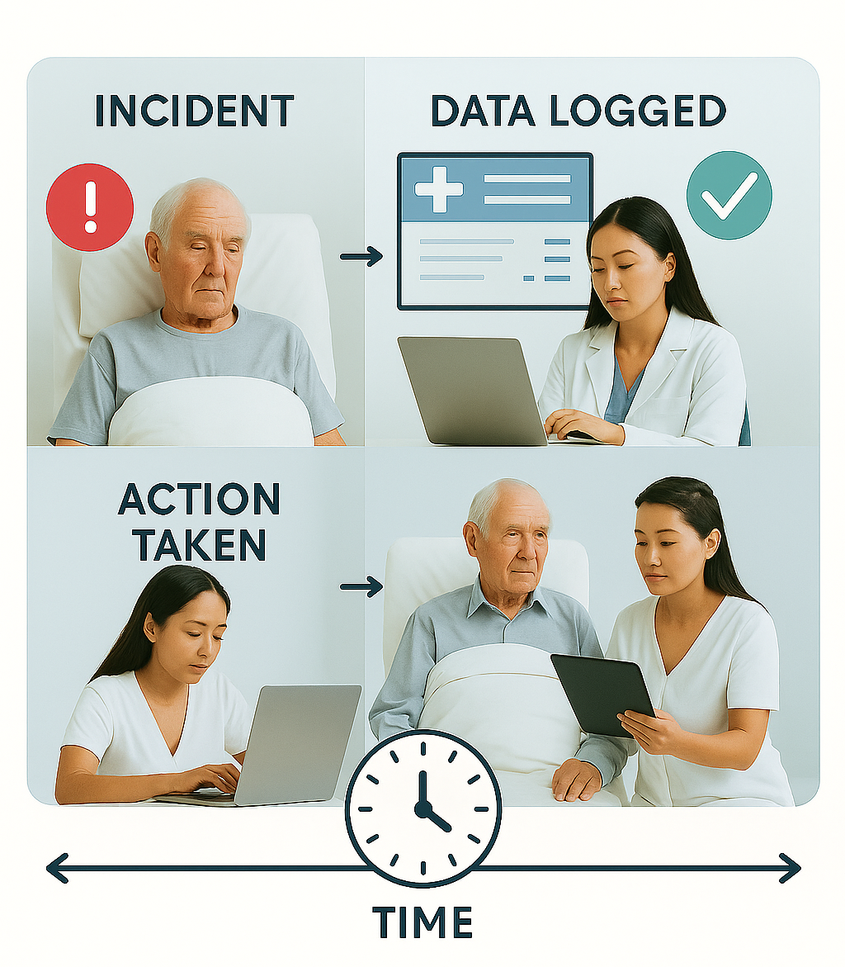
Barriers to Interventions
(5 mins)
What makes it hard to carry out these care steps?

Slide 10
Thank You

