Slide 1
Pressure Injury
Co-Design Workshop One
ARIIA – Data Literacy Project
Emma Burke – Manager, Strategic Projects
23 Jan 2026

Slide 2

ARIIA Data Literacy Project
About the Project:
Led by ARIIA, an independent organisation funded by the Australian Government to support aged care staff, and delivered through the Aged Care Collaborative. Residential and home care providers across Australia are working together to improve care through better use of data.
Purpose: Help aged care staff use existing data to improve care for residents.
Focus:
Build staff skills in using data for pressure injuries and wound care
Use routinely collected data to guide better care decisions
Data Context:
Residential care: National Quality Indicator for pressure injuries

Slide 3

Project Background
Data review showed inconsistent pressure injury assessment and follow-up
Resident survey revealed gaps in awareness and prevention practices
Staff workshops identified communication and visibility challenges
Nurses and carers proposed two key solutions:
  High-Risk Register
  Visual Indicators
Today’s session refines these staff-driven ideas into practical tools

Slide 4

Workshop Purpose
The purpose of this workshop is to:
Co-design practical tools for early pressure injury identification and monitoring
Determine key information for the High-Risk Resident Register
Decide register storage, access, and update responsibilities
Design the Visual Indicator system – look, placement, and maintenance
Agree on next steps for testing and finalisation

Slide 5

High-Risk Resident Register (10 mins)
What is its purpose?
Why do we need it?
Why is it important?
Who will use it?

Slide 6

Risk Register – User Stories (10 mins)
Activity: Write user stories for the High-Risk & Pressure Injury Register
Format: “As a ___, I want ___ so that ___.”
Consider:
What information you need
What actions you take
What problems the register should solve
What helps during busy shifts
What keeps information accurate and up to date
What improves communication across roles

Slide 7

Format and Access
(10 mins)
Digital vs Paper
One register vs per area
Where to be stored
Accessibility for staff vs privacy for residents
Vote on preferred format

Slide 8

Information to Include (10 mins)
Write one item per sticky note (e.g., resident name, risk level).
Post on flip chart labelled 'Possible Register Fields'.
Vote using dots:
  Colour - Essential
  Colour - Nice to have
Group similar ideas and discuss top voted essentials.

Slide 9
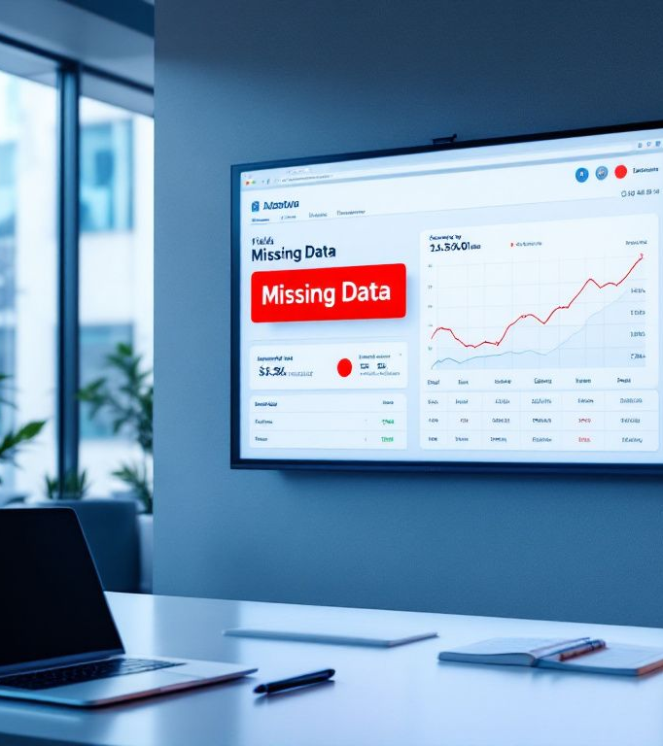
Maintenance and Accountability (10 mins)
Who updates the register and how often?
Agree on practical ownership and oversight.
Who will be responsible for checking accuracy?
Vote on preferred responsibility options.

Slide 10

Design Brainstorming
(10 mins)
Use flip chart to mock up register examples.
Consider essential fields, colours, layout.
Drop down lists vs free text.
Vote on preferred design

Slide 11
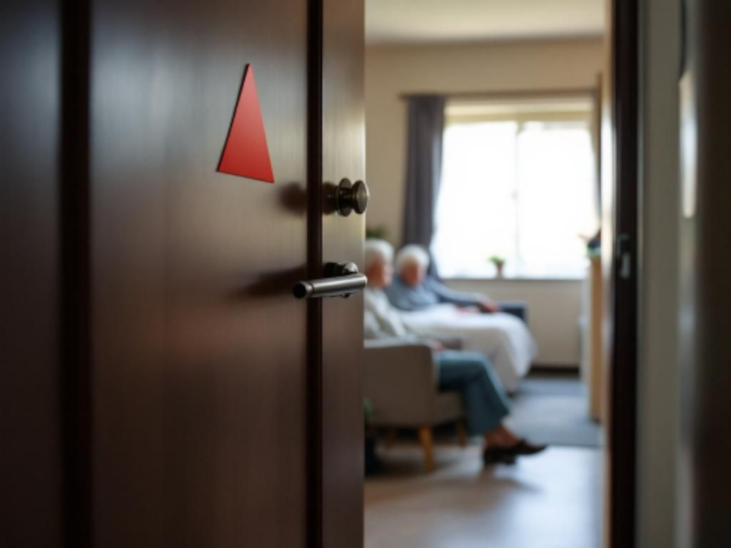
Visual Indicators
(10 mins)
What is its purpose?
Why do we need it?
Why is it important?
Who will use it?
What are our design principles? ie respectful for residents

Slide 12

Design Brainstorming (15 mins)
Sketch or describe ideas for what indicators could look like.
Consider colours, symbols, shapes, and placement.
Different for High Risk vs Active PI?
Vote on preferred design and placement ideas.

Slide 13
Implementation and Maintenance (10 min)
Who is responsible for placing and updating indicators?
When are changes made (after reassessment, wound healing)?
Agree on process for consistency across shifts.

Slide 14
Wrap-Up and
Next Steps (10 min)
Review key design for tools
Draft templates will be created
Templates will be piloted
Feedback received
Tools finalized
Tools launched
Monitor use of tools

Slide 15
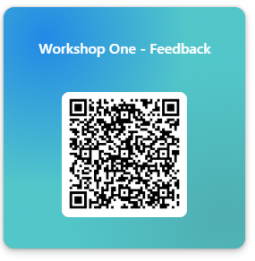

Slide 16
Thank You

