Slide 1
Pressure Injury
Co-Design Workshop Two
ARIIA – Data Literacy Project
Emma Burke – Manager, Strategic Projects
29 Jan 2026

Slide 2

ARIIA Data Literacy Project
About the Project:
Led by ARIIA, an independent organisation funded by the Australian Government to support aged care staff, and delivered through the Aged Care Collaborative. Residential and home care providers across Australia are working together to improve care through better use of data.
Purpose: Help aged care staff use existing data to improve care for residents.
Focus:
Build staff skills in using data for pressure injuries and wound care
Use routinely collected data to guide better care decisions
Data Context:
Residential care: National Quality Indicator for pressure injuries

Slide 3

Project Background
Data review showed inconsistent pressure injury assessment and follow-up
Resident survey revealed gaps in awareness and prevention practices
Staff workshops identified communication and visibility challenges
Nurses and carers proposed solution:
  PI Handover Checklist

Slide 4

Workshop Purpose
The purpose of this workshop is to:
Co-design a practical checklist
Identify key PI tasks to track each shift
Confirm essential checklist fields
Decide how to show completed vs handover items
Define roles and responsibilities
Map how the checklist fits into handover

Slide 5
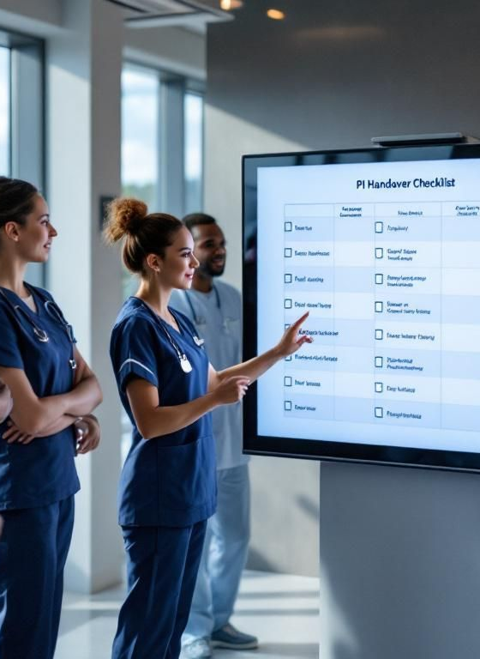
PI Handover Checklist
(10 mins)
What is its purpose?
Why do we need it?
Why is it important?
Who will use it?

Slide 6

Risk Register – User Stories (10 mins)
Activity: Write user stories for the High-Risk & Pressure Injury Handover Checklist Format: “As a ___, I want ___ so that ___.”
Consider:
What information you need
What actions you take
What problems the checklist should solve
What helps during busy shifts
What keeps information accurate and up to date
What improves communication across roles

Slide 7

Format and Access
(15 mins)
Digital vs Paper vs Whiteboard
One checklist per resident vs per area
One page per shift vs 24 hour format
Where to be stored
Accessibility for staff vs privacy for residents
Vote on preferred format

Slide 8

Essential PI Tasks
(15 mins)
What must be done every shift?
Repositioning
Skin/heel checks
Equipment checks
Wound care tasks
Escalations & follow-up

Slide 9

Information to Include (15 mins)
Write one item per sticky note (e.g., resident name, action etc).
Post on flip chart labelled 'Possible Checklist Fields'.
Vote using dots:
  Colour - Essential
  Colour - Nice to have
Group similar ideas and discuss top voted essentials.

Slide 10
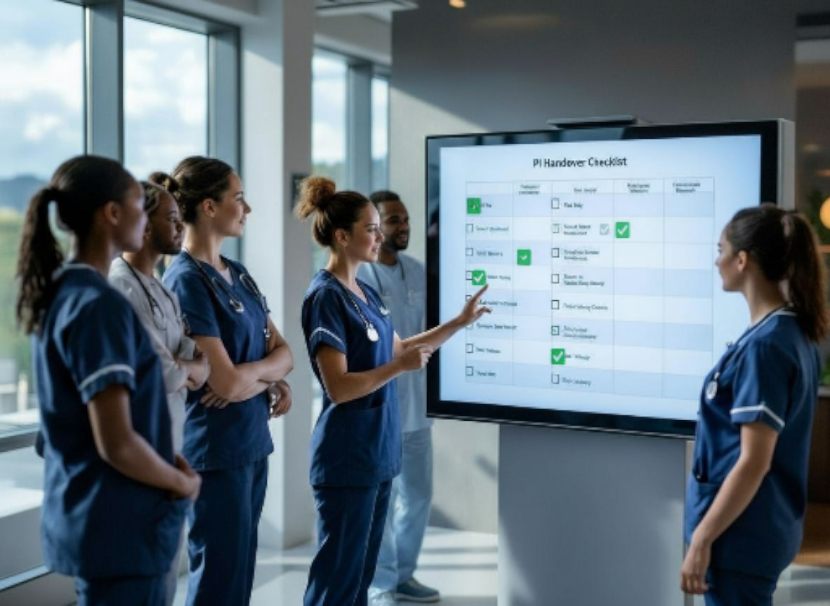
Completion and Handover
(10 mins)
At-a-glance indicators
Clear outstanding items
Optional follow-up box
Supports verbal handover

Slide 11

Maintenance and Accountability (10 mins)
Agree on practical ownership and oversight.
Who completes during shift?
Who will be responsible for checking accuracy at end of shift?
Escalation pathway for incomplete tasks
Whether RNs validate or sign off

Slide 12

Design Brainstorming (10 mins)
Sketch ideas for what the checklist could look like.
Consider essential fields, colours, layout.
Drop down lists vs free text.
How to show completed vs outstanding tasks
Vote on preferred design.

Slide 13
Integration with Handover (10 min)
Who verbalises outstanding items in handover
Where in the handover will checklist be reviewed
Outstanding tasks highlights
Links to High-Risk Register

Slide 14
Wrap-Up and
Next Steps (15 min)
Review key design for tools
Draft templates will be created
Templates will be piloted
Feedback received
Tools finalized
Tools launched
Monitor use of tools

Slide 15
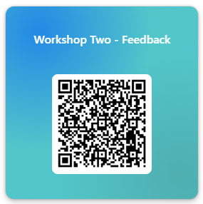

Slide 16
Thank You

