Slide 1
Pressure Injury
Co-Design Workshop Three
ARIIA – Data Literacy Project
Emma Burke – Manager, Strategic Projects
2 Feb 2026

Slide 2

ARIIA Data Literacy Project
About the Project:
Led by ARIIA, an independent organisation funded by the Australian Government to support aged care staff, and delivered through the Aged Care Collaborative. Residential and home care providers across Australia are working together to improve care through better use of data.
Purpose: Help aged care staff use existing data to improve care for residents.
Focus:
Build staff skills in using data for pressure injuries and wound care
Use routinely collected data to guide better care decisions
Data Context:
Residential care: National Quality Indicator for pressure injuries

Slide 3

Project Background
Data review showed inconsistent pressure injury assessment and follow-up
Resident survey revealed gaps in awareness and prevention practices
Staff workshops identified communication and visibility challenges
Nurses and carers proposed solution:
  Enhanced PI Dashboard

Slide 4

Workshop Purpose
The purpose of this workshop is to:
Co-design a practical dashboard
Validate indicators, data sources
Refine layout, filters and visualisations
Confirm workflows and next steps

Slide 5

PI Dashboard
(10 mins)
What is its purpose?
Why do we need it?
Why is it important?
Who will use it?

Slide 6

Incident Report Form Review
(10 mins)
Key PI-related fields
Identify which fields will feed dashboard measures
Map data source → dashboard indicator

Slide 7
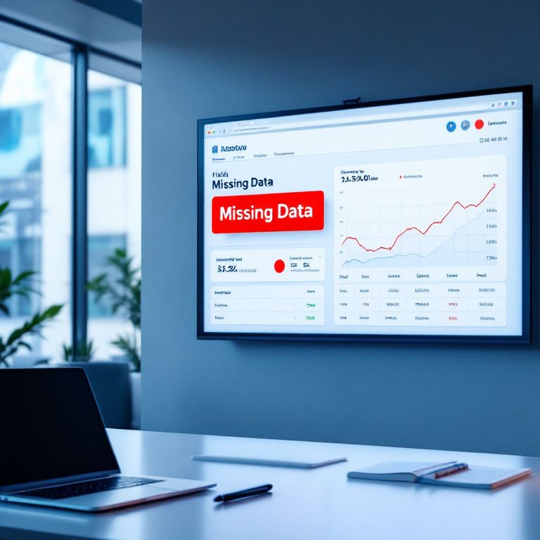
Proposed Indicators
(15 mins)
New and existing PI counts
Severity and body location
Facility area trends
Individual Resident details
Validation checks – missing data

Slide 8

Design Brainstorming (25 mins)
Sketch ideas for what the dashboard could look like.
Consider essential fields, colours, layout.
Summary metrics panel
Trend graphs
Resident drill-downs
Risk grouping

Slide 9

Maintenance and Accountability (10 mins)
Agree on practical ownership and oversight.
Who will use the information and when?
How often will it be refreshed?
What levels of access will be given?
How often will data validation reviews be undertaken?

Slide 10

Integration with Workflow (10 min)
How often will it be used?
Governance and reporting
Training and communication needs

Slide 11
Wrap-Up and
Next Steps (15 min)
Review key design for tools
Draft templates will be created
Templates will be piloted
Feedback received
Tools finalized
Tools launched
Monitor use of tools

Slide 12
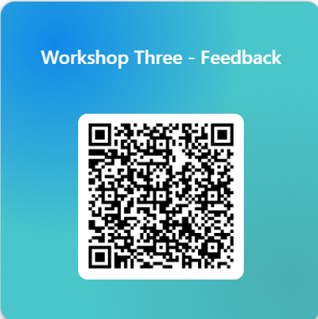

Slide 13
Thank You

