Slide 1
Pressure Injury
Co-Design Workshop Four
ARIIA – Data Literacy Project
Emma Burke – Manager, Strategic Projects
5 Feb 2026

Slide 2

ARIIA Data Literacy Project
About the Project:
Led by ARIIA, an independent organisation funded by the Australian Government to support aged care staff, and delivered through the Aged Care Collaborative. Residential and home care providers across Australia are working together to improve care through better use of data.
Purpose: Help aged care staff use existing data to improve care for residents.
Focus:
Build staff skills in using data for pressure injuries and wound care
Use routinely collected data to guide better care decisions
Data Context:
Residential care: National Quality Indicator for pressure injuries

Slide 3

Project Background
Data review showed inconsistent pressure injury assessment and follow-up
Resident survey revealed gaps in awareness and prevention practices
Staff workshops identified communication and visibility challenges
Nurses and carers proposed solution:
  Enhanced PI Dashboard

Slide 4

Workshop Purpose
The purpose of this workshop is to:
Finalise design for each tool
Identify practical implementation requirements
Outline clear actions, owners, and timelines

Slide 5

PI Risk Register
(25 mins)
Confirm:
  Final design layout
  Fields to be included
  Ownership and updating responsibility
  Accessibility
Agree:
  System to be used
  Equipment requirements
  Implementation actions, owners and due dates

Slide 6

Visual Indicators
(10 mins)
Confirm:
Final design
Placement
Ownership and updating responsibility
Agree:
Stock numbers required
Implementation actions, owners and due dates

Slide 7

PI Handover Checklist (25 mins)
Confirm:
Final checklist layout and content
Format and location
Ownership and shift-to-shift accountability
Agree:
Equipment requirements
Stock numbers required
Implementation actions, owners and due dates

Slide 8

PI Dashboard
(25 mins)
Confirm:
Final dashboard content
Access and audience groups
Ownership and governance
Data sources and system requirements
Agree:
Implementation actions, owners and due dates

Slide 9

Final Action Plan (15 mins)
Review all actions across the four tools
Confirm owners and due dates
Identify dependencies or risks
Confirm process for progress tracking
Select pilot area

Slide 10
Wrap-Up and
Next Steps (15 min)
Draft templates will be created
Templates will be piloted
Feedback received
Tools finalised
Tools launched
Monitor use of tools

Slide 11
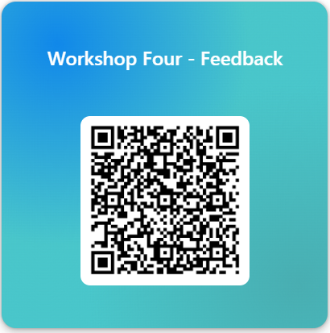

Slide 12
Thank You

