Slide 1

Wound management and clinical excellence
Piloting a digital assistant (CQI)

Slide 2

The project team
Enter your information here.

Slide 3
Introduction to project
Enter your information here.

Slide 4
Co-Design
We are a co-design group
People of different perspectives, roles and experiences to decide or develop something
Group expectations:
  Attend two co-design sessions and a training session
  Complete small surveys
  Pilot a new app on our phones while working as usual for 2 weeks
  Provide honest feedback - Feedback is anonymous and will not be seen by a manager or anyone outside the room
A

Slide 5
About the project
Trialling a new phone application (CQI Assistant)
The application is a digital assistant that informs us about the actions we can take to improve residents’ lives
The actions can be seen on our phones if we’re logged in
Not intended to add more tasks or more workload, but to reprioritise focus when needed
  For example, some months we have a lot of wounds and pressure injuries in the facility – during those months we should take more action to prevent wounds and treat them
  Even better if we received - via phone - educational tips and suggested actions we can take to better prevent wounds and treat them
A

Slide 6
How the application will help
The CQI Assistant helps focus attention to areas that need it at that time.
For example, some months you would receive educational tips and suggested actions for improving wound prevention, other months for improving weight management or infection management etc.
The CQI Assistant assists to:
understand what we can do to help
empower more staff to get involved in achieving continuous improvement goals
For the pilot, we’ll focus only on wound prevention and wound correction actions.

Slide 7
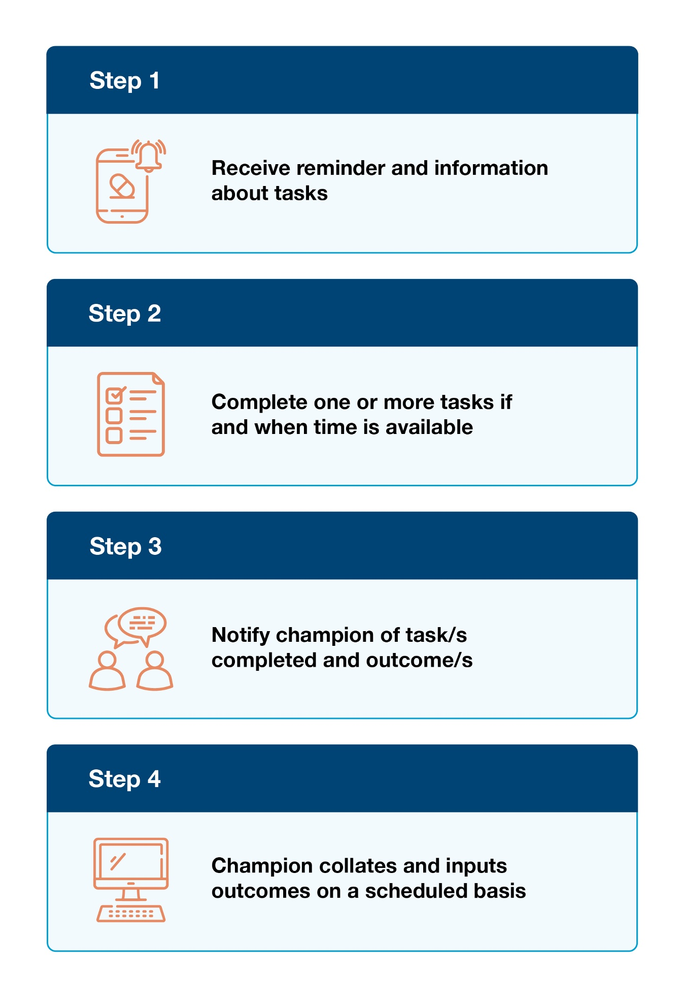
CQI process

Slide 8
Workload
More information about your role and tasks undertaken will help you understand where the digital assistant might fit best.
How many PCWs (non-agency) are on morning shift usually? Afternoon? Night?
How many Nurses (non-agency) are on morning shift usually? Afternoon? Night?
Which shift is the busiest for staff? Which 3 hours?
Which two hours each day is the least busy?
What are the two most difficult tasks PCWs complete every week?
What are the two most difficult tasks Nurses complete every week?
Which two tasks require the most time for staff?
  How much time?

Slide 9
Time allocation and relevance
Do PCWs undertake any tasks that are clinical or semi-clinical (e.g., infections, pressure injuries, falls, wounds, medication admin etc.)?
What percentage of the working day contributes to preventing clinical issues (e.g., encouraging mobility, nutrition, hydration, preventing falls, pressure injuries, weight loss, wounds etc.)?
What percentage of the working day contributes to correcting or treating clinical issues (e.g., treating wounds, treating injuries from falls, medication administration etc.)?
What percentage of the working day involves developing caring relationships with residents (e.g., socialising with residents, facilitating activities for them)?
What percentage of the working day involves documentation?
Fill in this information on the next slide.

Slide 10
Time allocation and relevance

Slide 11
Documentation
Documentation includes:
  documenting changes in resident’s condition (had a fall, aggressive incident, infection)
  documenting outcomes about the tasks you complete? (e.g., repositioned Michael at 2 PM, provided Panadol to Susan at 11 AM)
  any other type of documentation
Fill in this information below:
Type of Documentation | Time Spent Daily | Where it is Documented
Changes in resident’s condition | PCWs: Nurses:
Outcomes about tasks completed | PCWs: Nurses:
Other documentation | PCWs: Nurses:

Slide 12
Involvement in PI management
Sometimes the facility needs to focus on pressure injuries instead of other clinical issues (e.g., infections) – does the facility do a good job of informing you why the priorities changed? (very often, often, sometimes, rarely, not often at all)
What are some actions you’ve taken in the facility to prevent residents from getting wounds?
  How often are you reminded to complete actions to prevent wounds? (very often, often, sometimes, rarely, never)
What are some actions you’ve taken in the facility to treat or correct wounds?
  How often are you reminded to undertake actions to treat or correct wounds?

Slide 13
Improvements
Are there improvements that can be made to how your time is allocated?
For example, the amount of time you spend preventing clinical issues vs correcting clinical issues vs developing caring relationships vs documentation
Are there improvements that can be made to how we deal with wounds and pressure injuries?
Are there improvements that can be made to how we document outcomes?
Are there improvements that can be made to how we remind staff of important issues?
Are there any other obstacles or barriers preventing us from doing better?
Anything else you’d like to share with the project team

Slide 14
Next steps
Short survey (10-15 mins) – include link here
Training session for phone – include date here
Login details to access CQI functionality – include access date here
  Explore the system when you receive your login details
Undertake actions in the app to see how they fit in your existing workload
  Continue completing actions until date
  Keep note of any difficulties– this feedback will be crucial
Brief the champion on actions completed and outcomes
For example: How did the resident respond? Did it help them?
Second co-design session with the project team to provide feedback – include date here
After pilot – assist colleagues to adopt the system

Slide 15

For any questions email
comms@fronditha.org

