Slide 1
Alwyndor Pressure Injury Prevention and Detection Project
ARIIA – Data Literacy Project
Emma Burke – Manager, Strategic Projects
11 February 2026

Slide 2
Alwyndor
1 Residential Site
134 Residential Rooms
10 Short Stay Rooms
Support at Home
On Site Allied Health

Slide 3

Evidence Collection
Evidence Collection
Process Mapping
Problem Statement Workshops
Data Review
Carer Workshop
Resident Survey
Clinical Guidelines
Mind Map
Current Reporting Methods
SWOT Analysis

Slide 4

Evidence Collection
Problem Statement Workshop
Attendees:
Residential Clinical Management
ICT management
Quality Nurse
Wound Nurse
CNs/RNs – front line staff
Questions:
What data do you use each day?
Who uses it?
How is it accessed?
What is it used for?
What are the data challenges?

Slide 5

Data Review Workshop
Attendees:
Residential Clinical Management
ICT Management
Wound Nurse
Review:
  Identify data sources
  Data Triangulation:
      Understand the Data
      What’s the Story?
      Dig into the Data
      Validate the Data:
          Accuracy
          Completeness
          Consistency
          Timeliness
          Usability
      So What?

Slide 6

Evidence Collection
Carers Workshop
Attendees:
Residential Clinical Management
Residential Carers – front line staff
Questions:
Understand of a PI and causes
Understanding of Prevention and Management techniques
How do you report a PI?
What works, what doesn’t?
What data do you use?
Barriers to data access

Slide 7

Resident Engagement
Survey Questions:
Understanding about PIs
Satisfaction with current PI management
Involvement with current PI management
Resident priorities for PI care
Interest in learning more about PI prevention and care

Slide 8
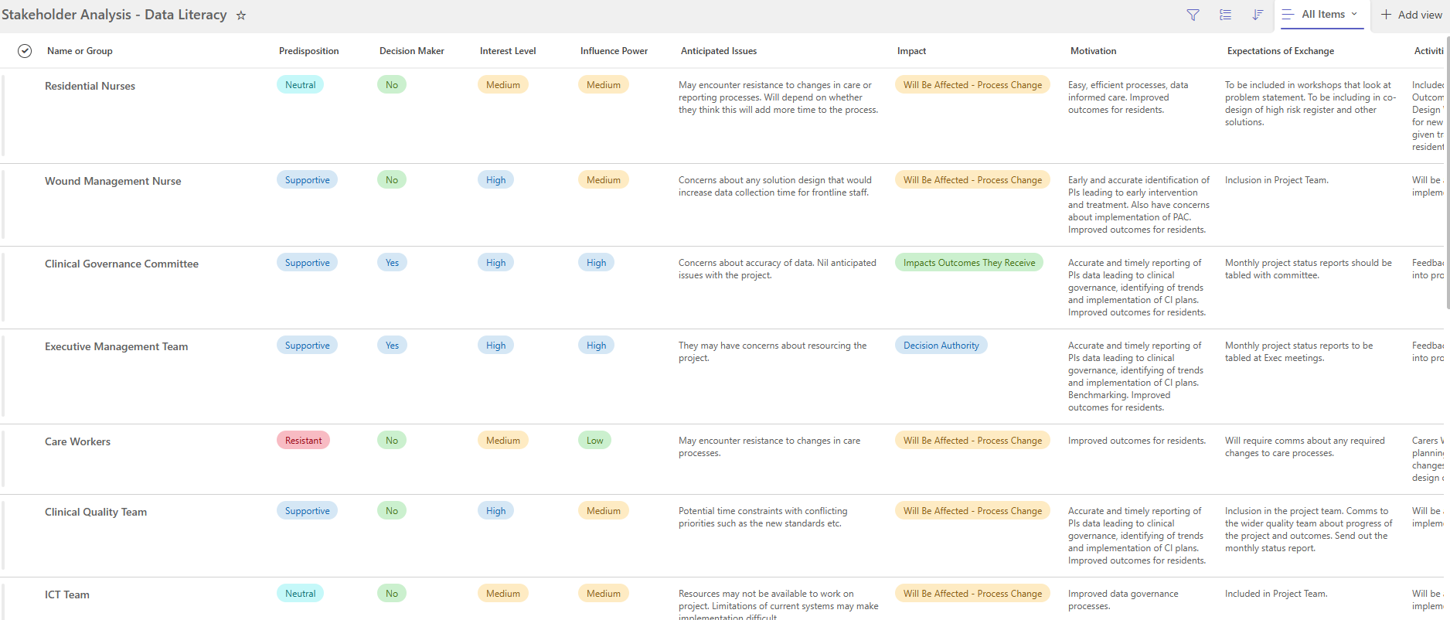
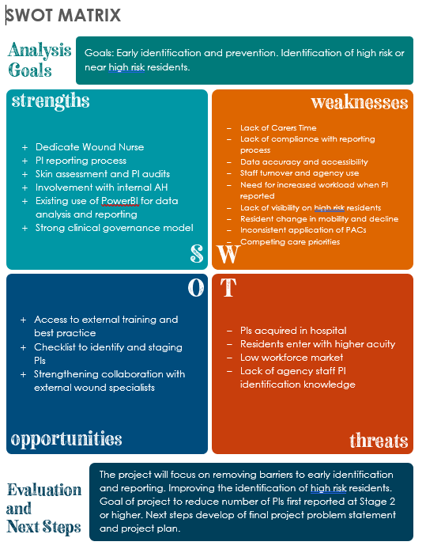
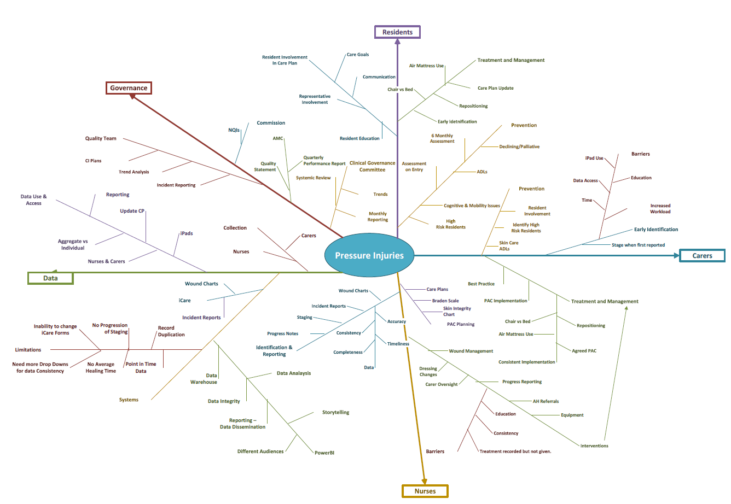
Evidence Collection
Bringing it Together

Slide 9

Problem Statement
Findings:
Inconsistent reporting & staging
Limited visibility of high-risk residents
Fragmented communication
Problem Statement:
Limited visibility and inconsistent reporting of pressure injuries reduces our ability to prevent and manage them effectively.

Slide 10

Early Intervention & Prevention:
  High-risk residents and new PIs
Carer & Nurse Education:
  Confidence in staging and reporting
Resident Engagement:
  Inclusion in care planning
Data Validation:
  Early detection & reporting accuracy
Project Focus

Slide 11
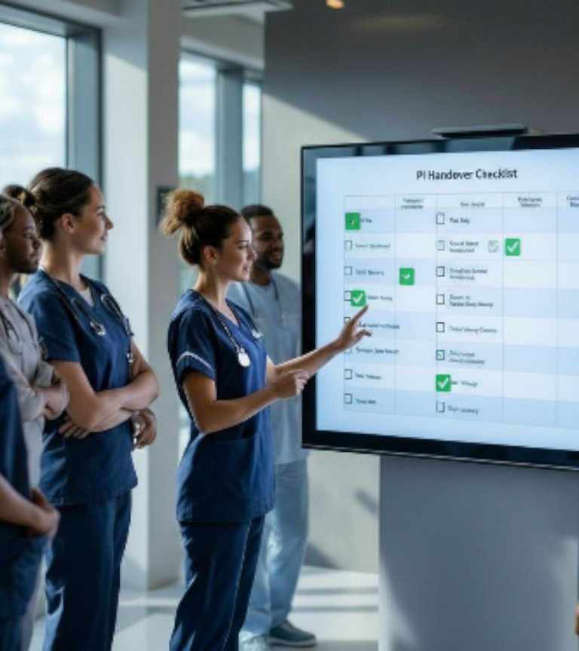
Project Objectives
Increase Early Identification
Increase Accuracy - Staging & Reporting
Improve PI Management
Identify High Risk Residents
Empower Residents
Improve Prevention Methods

Slide 12

Solution Design
  High-Risk Resident Register
  PI Handover Checklist
  Point of Care Visual Indicators
  Staff Training on Prevention & Staging
  Resident PI Discussion Training
  PI Dashboard:
    Stage at first report
    New vs Existing
    Internally vs Externally Acquired

Slide 13
Questions

