Slide 1
Pressure Injury
Champions Training
Emma Burke – Manager, Strategic Projects
2 & 4 June 2026

Slide 2
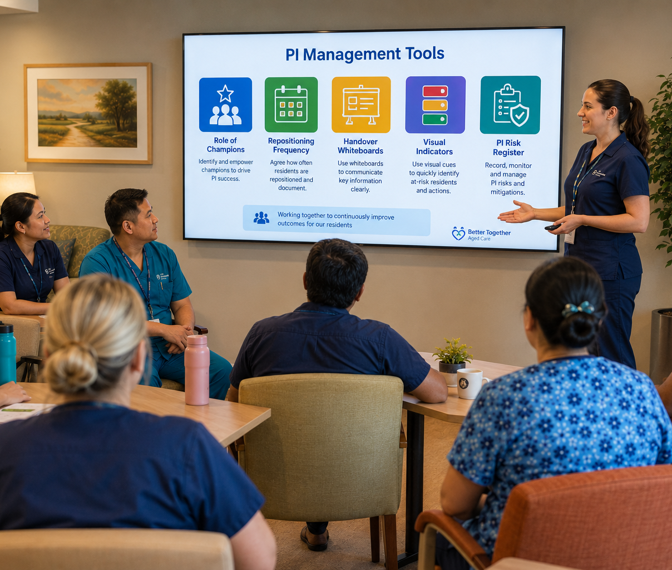
Today’s Session
Role of Champions
Repositioning Frequency
Handover Whiteboards
Visual Indicators
PI Risk Register

Slide 3

Pressure Injury Champions
Nurses
Anisha Adhikari
Bindu Mali
Bishnu Shyanbo
Dikshya Rai
Jin Song
Kanchan Mahat
Purum Go
Seema Malla
Johua Jang
Amita Joshi
Carers
Manisha Kandel
Ritika Khatri
Tania Blundell
Joyce Manero
Greg White

Slide 4
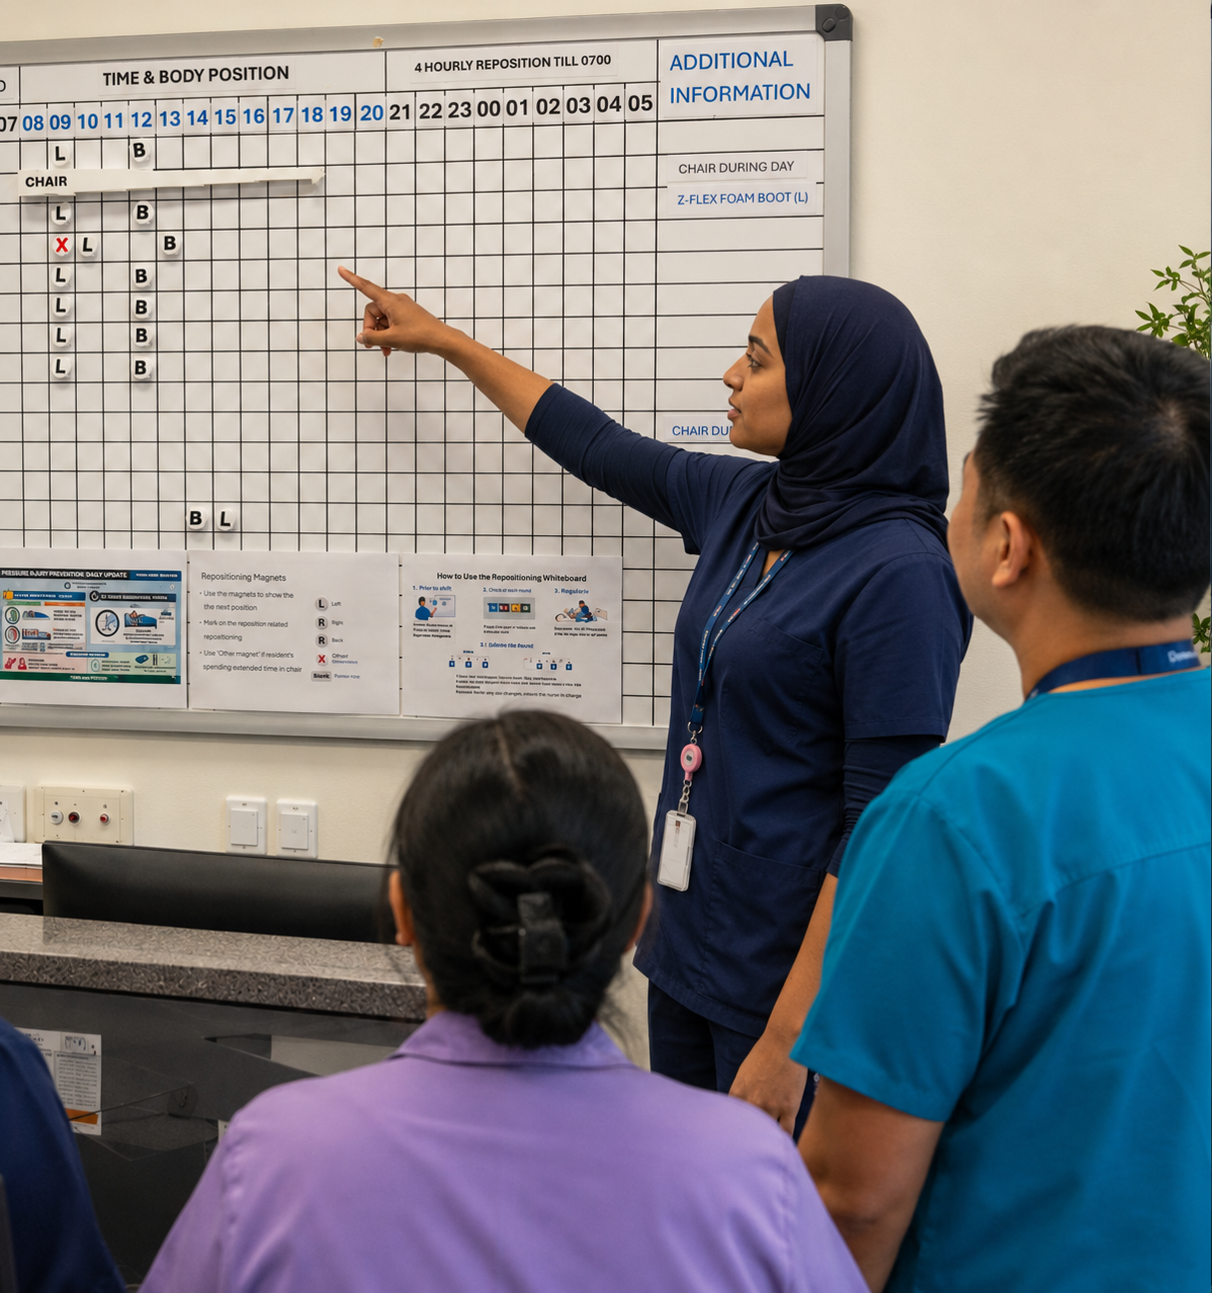
Role of Champions
Advanced PI Management Knowledge
Assisting staff with:
  Identification
  Staging
  Choosing intervention strategies
Ensure PI Management Tools are used correctly and effectively
Providing PI Management Tool training and ongoing coaching
Encourage resident engagement

Slide 5
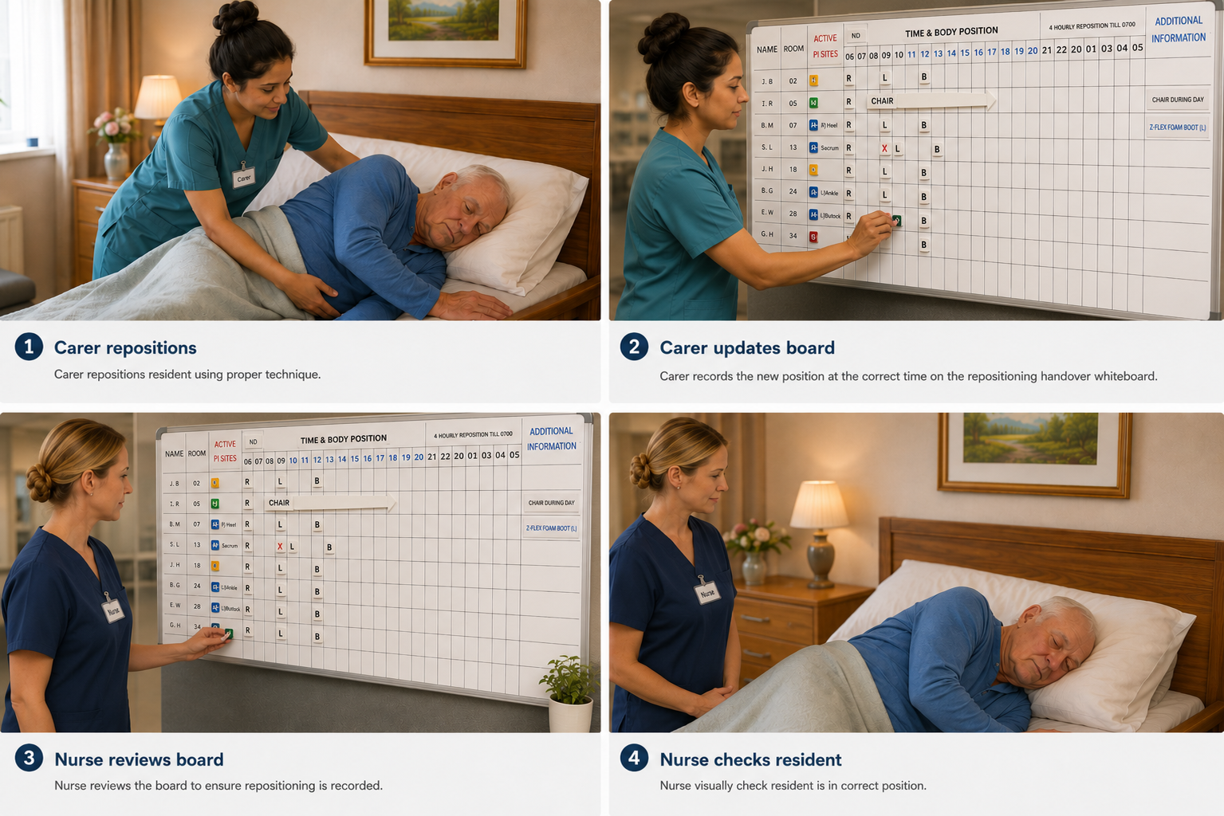
Oversight and Monitoring
Active Nurse Supervision:
PAC and repositioning adherence relies on continuous clinical leadership.

Slide 6

Resident Engagement
Communication with residents and NOKs
PI care needs
PI risks and causes
Risk of declining care
Self management

Slide 7



Indivisualised Reposition Plan
During The Day (0700-2100)
Up to 3 hours lying on healthy sides on air mattress
Limit to 2 hours on active pressure sites, unless advised to avoid completely by WNC
During the night (2100-0700)
Up to 4 hours unless specific regime prescribed by WNC/RNs

Slide 8

Sitting in a Chair with PI Risk
3 hour Rule : Residents should not sit for more than 3 hours at a time without a full "pressure relief" break (returning to bed or a standing transfer)
The “1- hour Micro-Shift": Every hour, staff should assist the resident to tilt the chair back further or adjust their position slightly to shift where the weight is concentrated.
Use Heel Protectors IF heels are in contact to the surface of chair.

Slide 9
PI Handover Whiteboards
Displays residents with Active PIs or at risk of PI
Provides clear, shift-to-shift visual prompt for consistent care
Updated by carers as soon as possible after each reposition
Carers move the magnets to reflect completed care
All care staff share responsibility for keeping it current
Keep three magnets on board at all times
Refer to Checklist at shift handover discussion
Nurse in charge oversees accuracy each shift

Slide 10
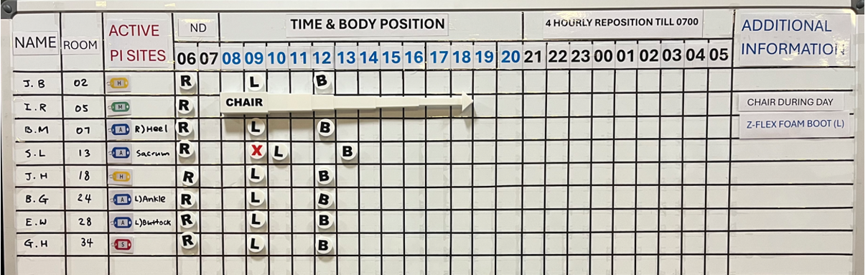
PI Handover Whiteboards - Layout

Slide 11
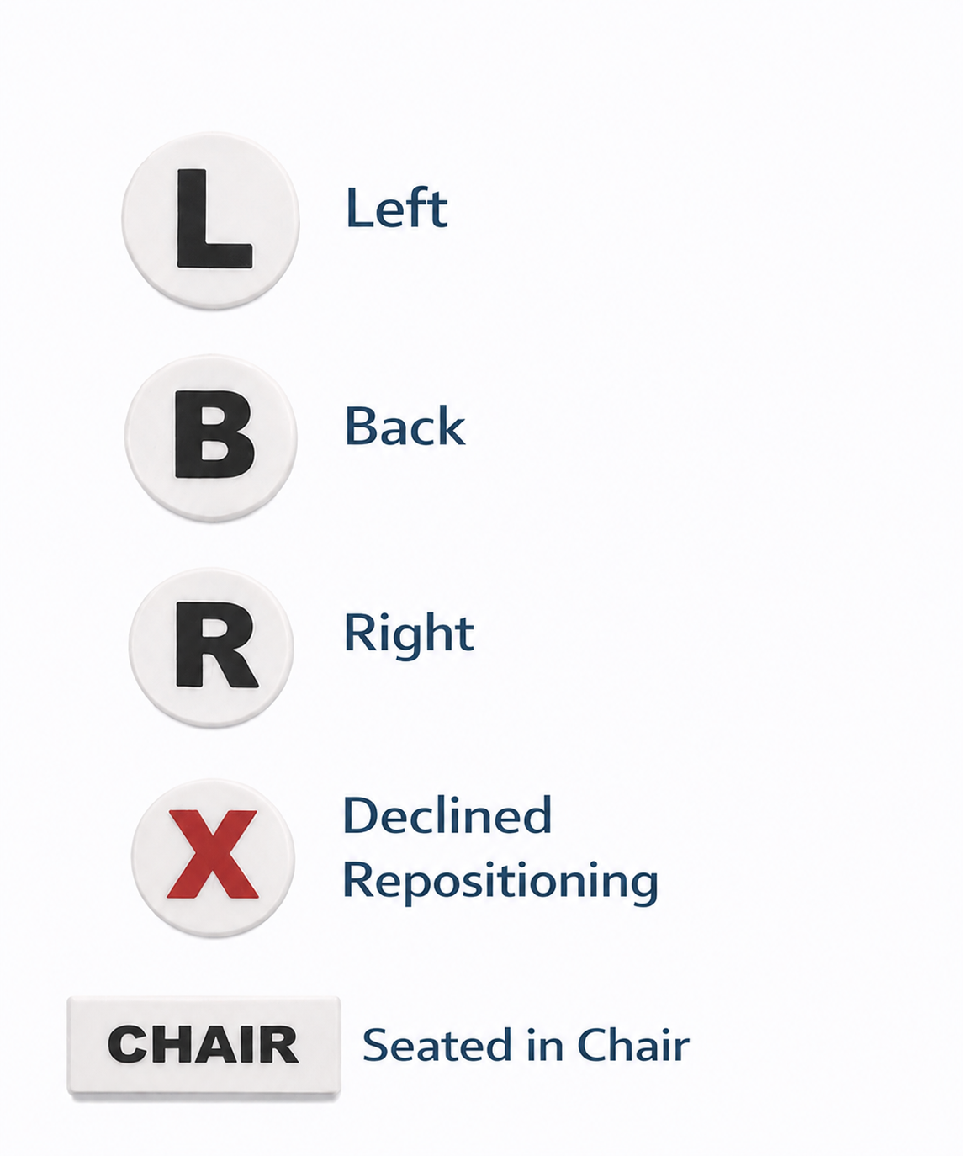
Repositioning Magnets
Show last 3 positions
Mark if the resident declined repositioning
Use Chair magnet if resident spending extended time in chair

Slide 12

Adding Residents to Whiteboard
Whiteboard needs to show residents:
  requiring staff to reposition
  risk rating moderate and above
  active PI
Nurse responsibilities:
  compare whiteboard with PI Risk Register each shift
  update whiteboard with any changes to resident PI status and risk rating
  Add any residents missing from board
If resident is able to self reposition they do not go on the whiteboard
Notes:
Air mattress: photo in the slide
Other Interventions: Bed cradle, Dermasaver heel elevator, Z-flex foam boot, Pillow, Dressings
Moisture and Skin barrier: Molicare Barrier cream, Sudocrem, Continence pads
Medical Devices: Urinary catheter, Nasal spec/prong for oxygen

Slide 13
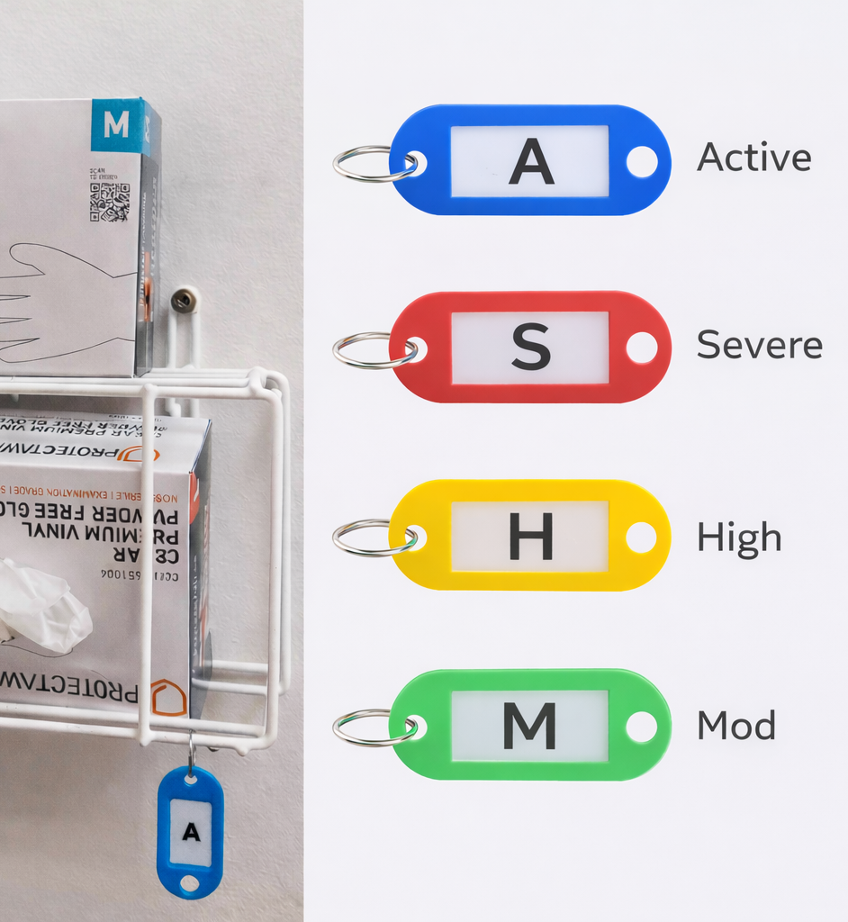
PI Visual Indicators
Colour coded tag displayed at resident’s room
Viewed when donning gloves
Provides visual cue of pressure injury status/risk
Reinforces information shown on the whiteboard
Supports prompt, consistent repositioning
All care staff escalate if tag does not match handover whiteboard
Nurse responsible for ensuring correct tag is in place

Slide 14
PI Risk Register
Electronic overview of all residents with a PI or identified risk in your area
Assessable via touch screen monitor in nurses station – no login required
Automatically updated from iCare data (incident reports, wound charts, skin assessments)
Refreshes every 2 hours
Provides detailed care information to support daily practice
Includes stage, location, pressure area care, equipment and dressing needs
Used by nurses and carers to guide consistent, individualised care
Nurses responsible to ensure information remains current and accurate

Slide 15
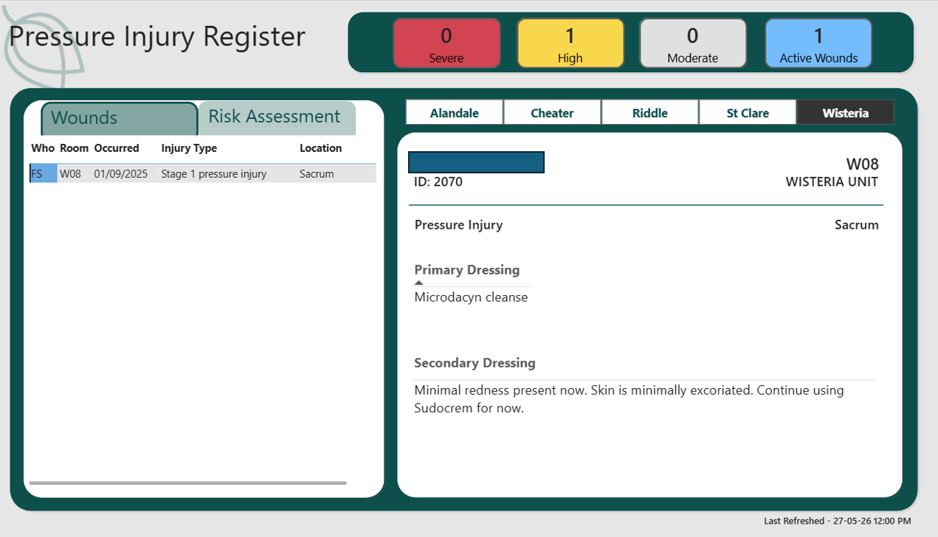

Slide 16
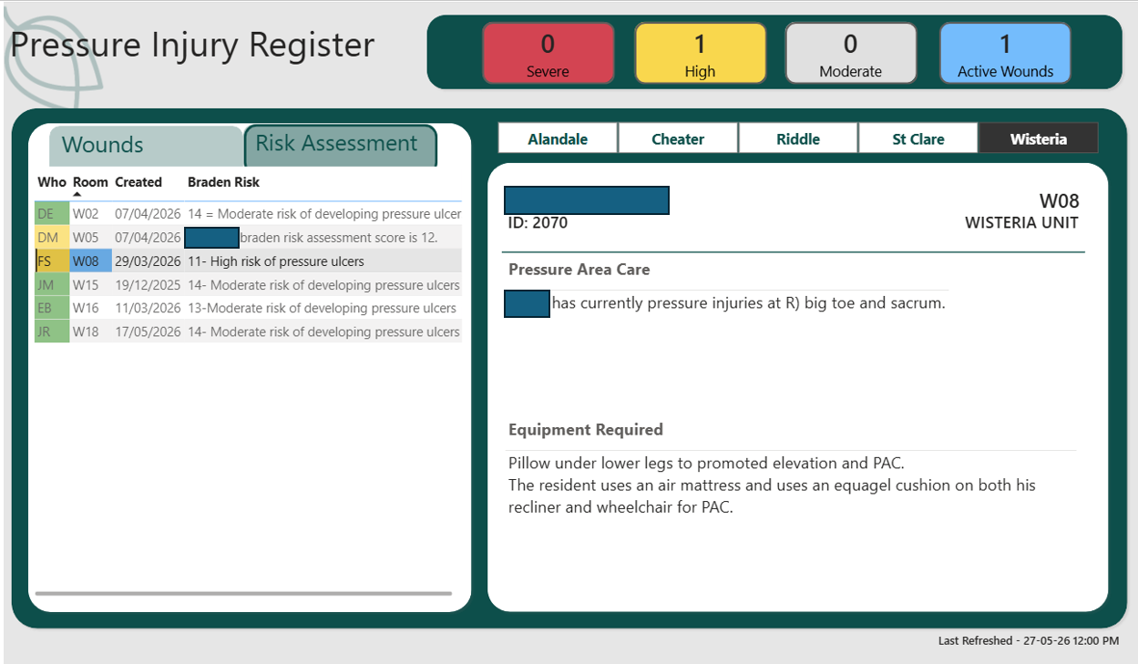

Slide 17
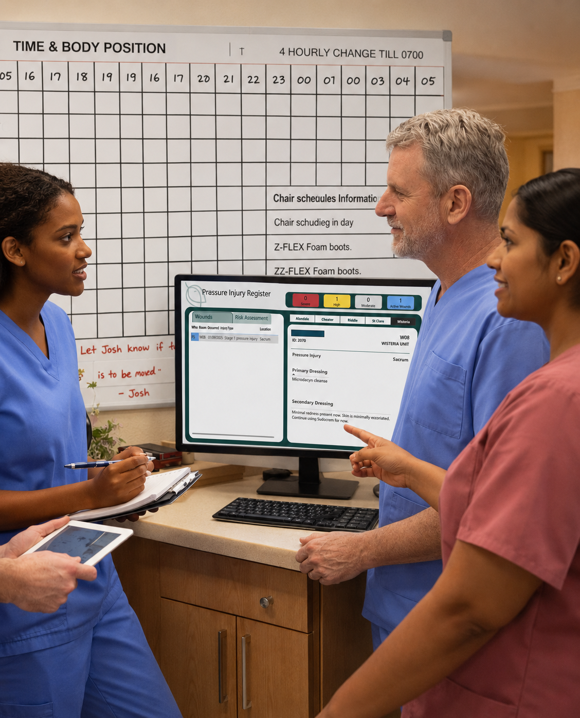
Next Steps
PI Risk Register Touch Screen installed in nurses station
PI Champions to show staff how to use Risk Register
Audits will compare Risk Register and Whiteboard
Feedback from staff on Risk Register
Incorporate Risk Register and Whiteboard in handover

Slide 18
Thank You

