Slide 1
Pressure Injury Training - Nurses

Slide 2
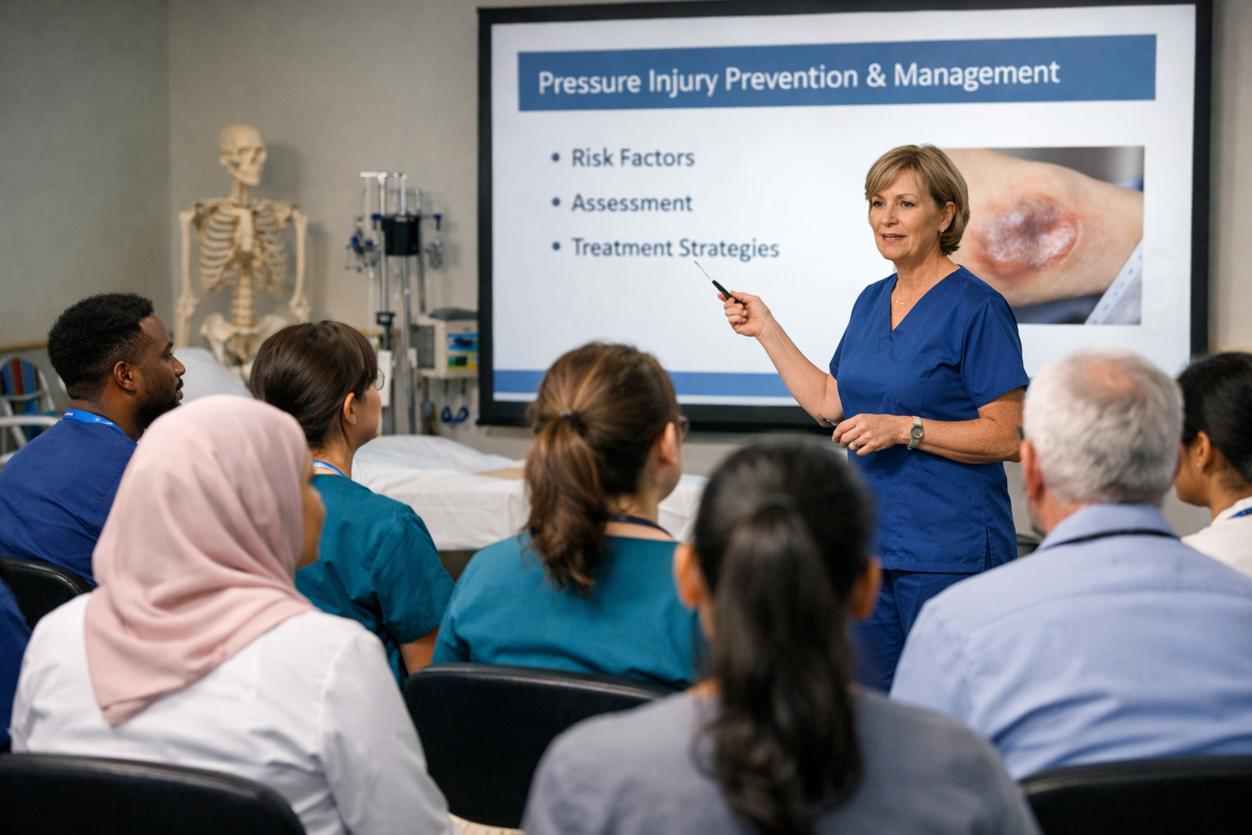
Today’s Session
PI Assessment and Staging
PI Reporting
PI Care and Prevention
Resident Engagement
PI Management Tools

Slide 3
Pressure Injury Impact on Residents
Pain
Sleep disturbance
Mood disturbance
Mobility
Infection
More pressure injuries
Hospital admission
Death

Slide 4
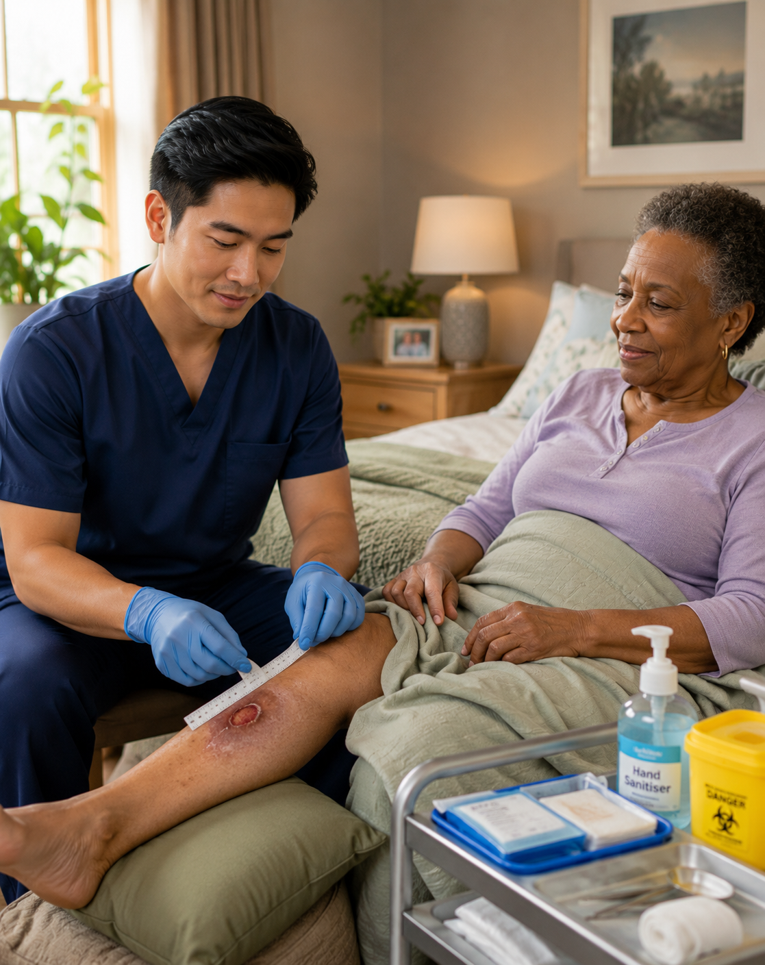
Assessment and Staging
IAD and PI
Risk Factors
Different stages of Pressure Injury

Slide 5
Pressure Injury VS IAD
Feature | Pressure Injury (PI) | IAD
Cause | Pressure, shear, friction | Urine/stool moisture & irritants
Location | Over bony prominences | Perineal, perianal, inner thighs, buttocks
Wound edges | Distinct, well-defined | Diffuse, irregular edges
Depth | May be deep (staged I–IV) | Superficial (epidermis only)
Appearance | Dark/purple discolouration or open wound | Erythema, redness, skin may be pink/red
Necrosis | May be present | Not present
Shape | Defined, often round/oval | Irregular, patchy distribution
Location on buttocks | Sacrum / coccyx area (bony) | Diffuse across buttock skin

Slide 6
Risk Factors of PI Development
Age
Wet/Dry
Skin
Recent hospital D/C
Deteriorating Health
Under/ Overweight
Mobility
Sensation: central vs periphery
Nutrition

Slide 7
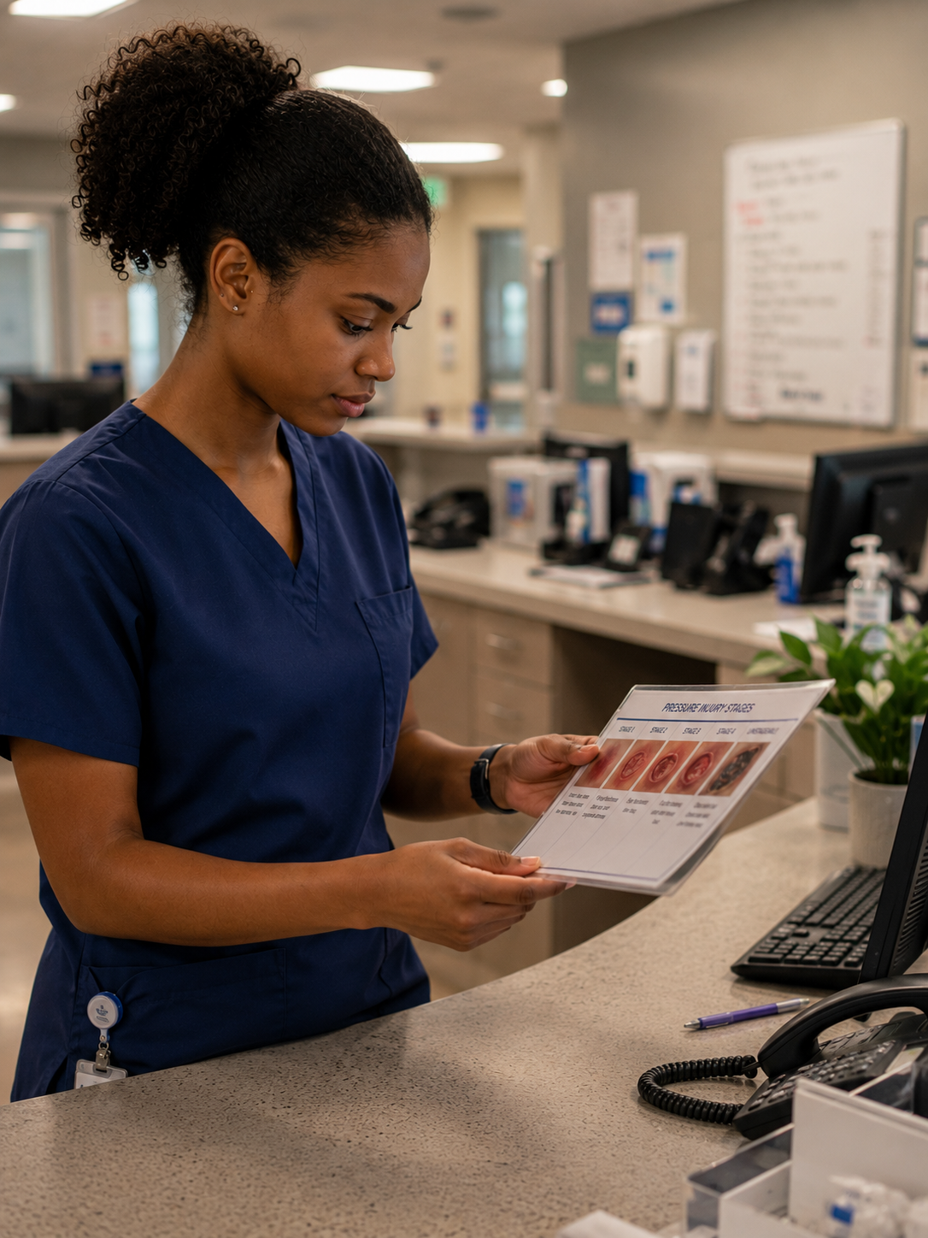
Different Stages of Pressure Injury
Stage 1
Stage 2
Stage 3
Stage 4
Unstageable
Suspected Deep Tissue Injury (SDTI)

Slide 8
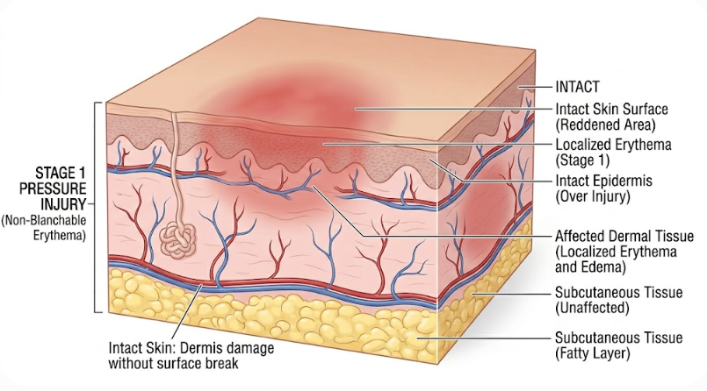
Stage 1 Pressure Injury – Tissue Structure
AI(Gemini) generated image

Slide 9
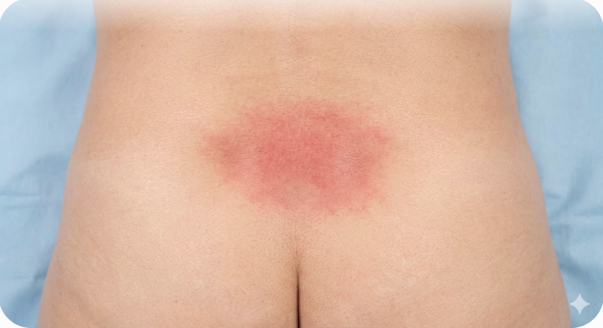
Stage 1 Pressure Injury - Description
Intact skin with non-blanchable redness of a localised area usually over a bony prominence.
Darkly pigmented skin may not have visible blanching, the colour may differ from the surrounding area.
The area may be painful, firm, soft, itchy, warmer or cooler than adjacent skin.
AI(Gemini) generated image

Slide 10
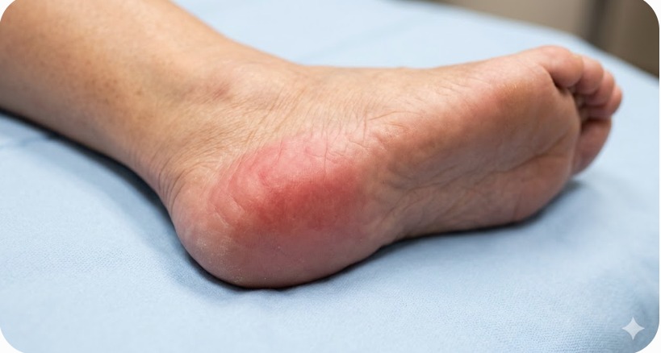
Stage 1 Pressure Injury - Example
AI(Gemini) generated image

Slide 11
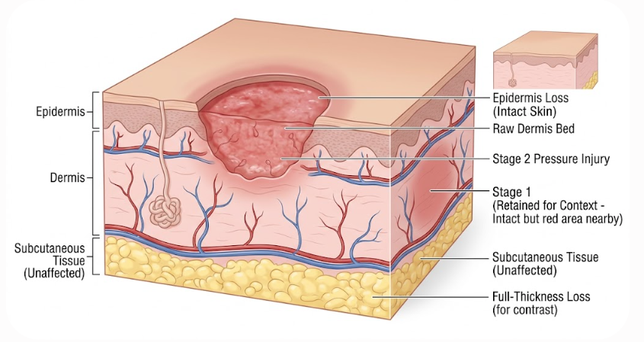
Stage 2 Pressure Injury – Tissue Structure
AI(Gemini) generated image

Slide 12
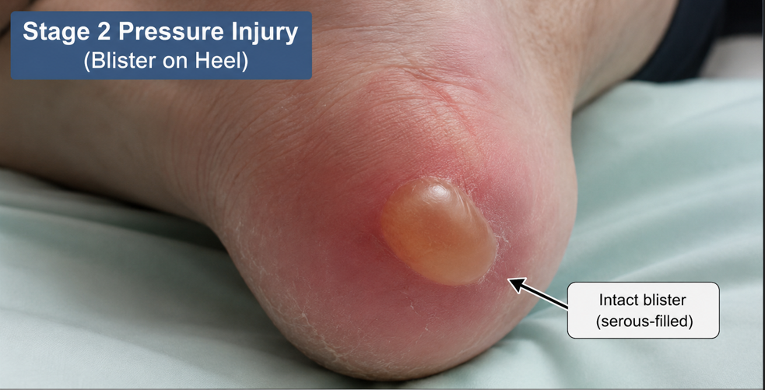
Stage 2 Pressure Injury - Description
Partial thickness skin loss presents as either:
  A shallow open ulcer with a red/pink wound bed, without slough.
  As an intact or ruptured clear fluid filled blister.
Ulcer is superficial without bruising.
AI(Gemini) generated image

Slide 13
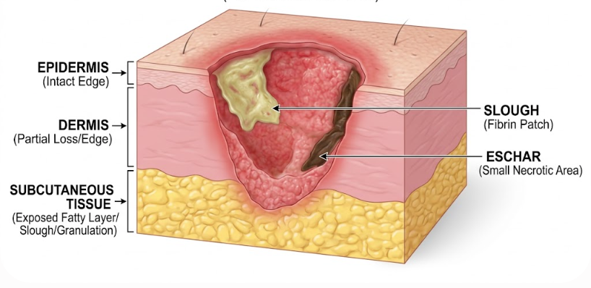
Stage 3 Pressure Injury – Tissue Structure
AI(Gemini) generated image

Slide 14
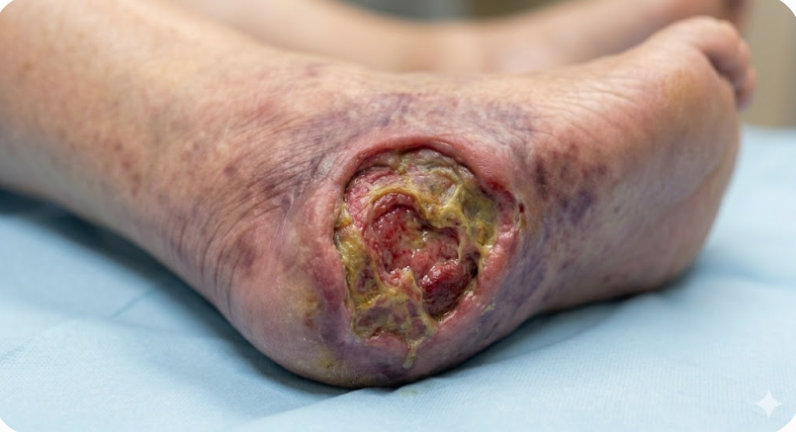
Stage 3 Pressure Injury - Description
Full thickness skin loss.
Subcutaneous fat may be visible, but bone, tendon and muscle are not exposed.
Slough may be present but does not obscure the depth of the ulcer.
May include undermining and tunnelling.
Stage 3 PI can be shallow e.g. nose, ears, ankles.
AI(Gemini) generated image

Slide 15
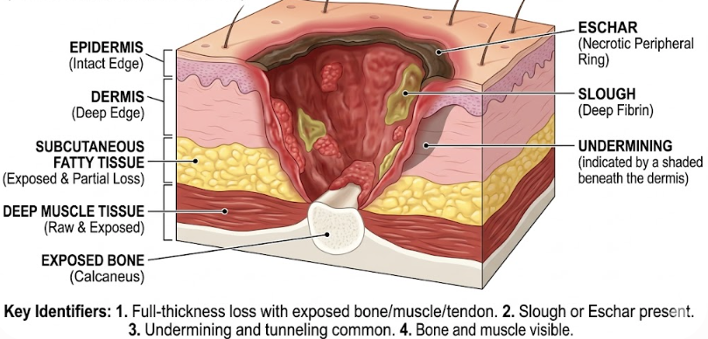
Stage 4 Pressure Injury – Tissue Structure
AI(Gemini) generated image

Slide 16
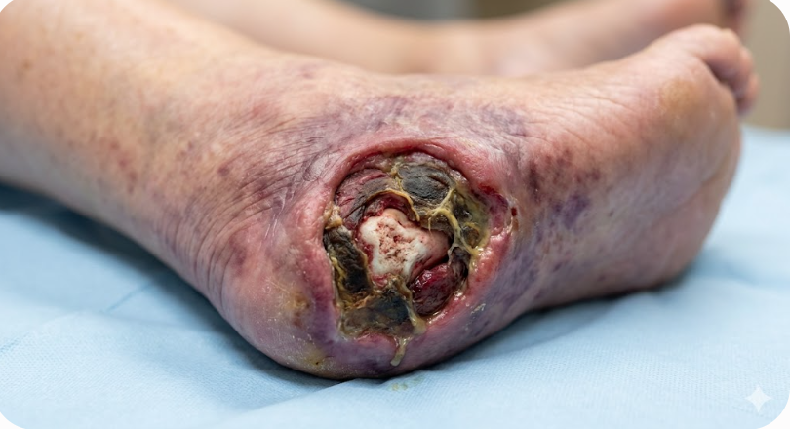
Stage 4 Pressure Injury - Description
Full thickness tissue loss with exposed bone, tendon (directly palpable or visible).
Slough or eschar may be present on some parts of the wound bed.
Often include undermining and tunnelling.
Can extend into the muscle and/or supporting structures (e.g. fascia, tendon or joint capsule).
AI(Gemini) generated image

Slide 17
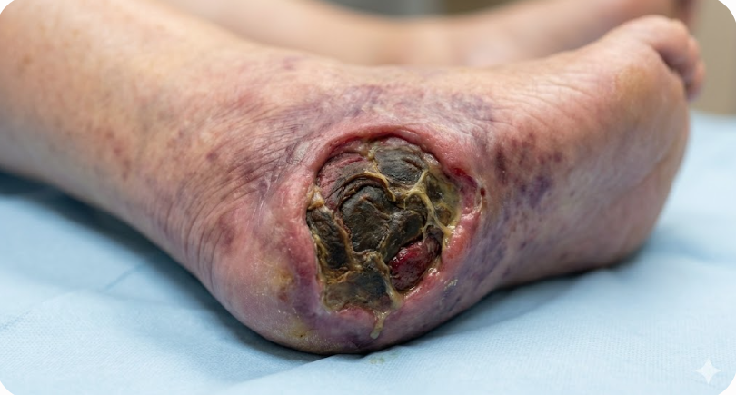
Stage Unstageable Pressure Injury - Example
AI(Gemini) generated image

Slide 18
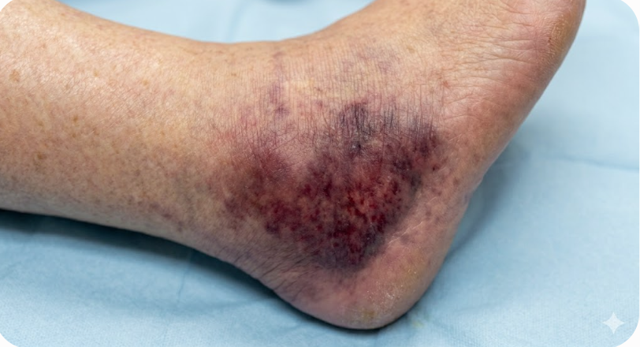
Stage Suspected Deep Tissue - Example
AI(Gemini) generated image

Slide 19

Reporting
New Injury and Incident report
Deterioration of PI
PI Register and Dashboard
iCare Wound Chart

Slide 20

iCare Forms
Incident Report
Braden scale
Skin assessment
Notes:
Air mattress: photo in the slide
Other Interventions: Bed cradle, Dermasaver heel elevator, Z-flex foam boot, Pillow, Dressings
Moisture and Skin barrier: Molicare Barrier cream, Sudocrem, Continence pads
Medical Devices: Urinary catheter, Nasal spec/prong for oxygen

Slide 21
Braden Risk Assessment Scale
High
Low
Risk level →
Abridged version • Score range: 6–23 • Higher score = lower risk
Domain
Score 1
Score 2
Score 3
Score 4
Sensory
Perception
1
2
3
4
Completely
limited
Very
limited
Slightly
limited
No
impairment
Moisture
1
2
3
4
Constantly
moist
Very
moist
Occasionally
moist
No
impairment
Activity
1
2
3
4
Bedfast
Chairfast
Walks
Occasionally
Walks
Frequently
Mobility
1
2
3
4
Completely
immobile
Very
limited
Slightly
limited
No
limitation
Nutrition
1
2
3
4
Very
poor
Probably
inadequate
Adequate
Excellent
Friction
& Shear
1
2
3
Problem
Potential
problem
No apparent
problem
Scoring Interpretation:
≤9 Very High Risk
10–12 High Risk
13–14 Moderate Risk
15–18 Mild Risk
19–23 No Risk

Slide 22

iCare Wound Chart
Location
Type
Review / Dressing change
Width and Length
PI Classification
Additional Information
Notes:
Air mattress: photo in the slide
Other Interventions: Bed cradle, Dermasaver heel elevator, Z-flex foam boot, Pillow, Dressings
Moisture and Skin barrier: Molicare Barrier cream, Sudocrem, Continence pads
Medical Devices: Urinary catheter, Nasal spec/prong for oxygen

Slide 23
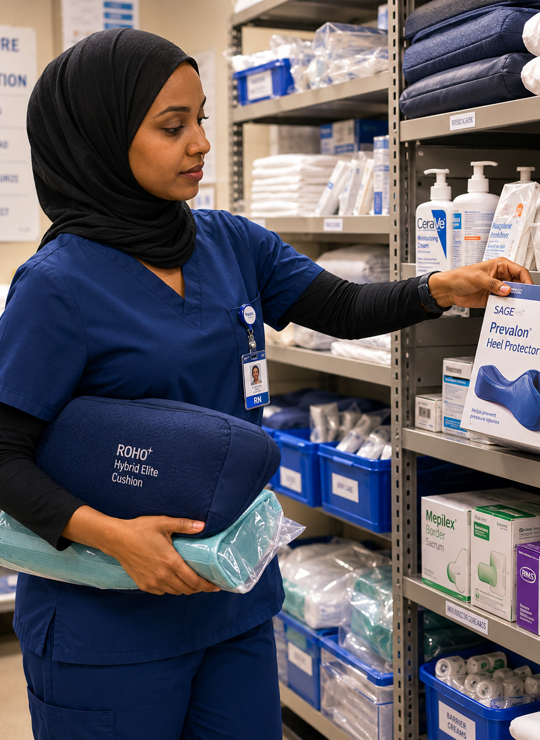
PI Care and Prevention (1/2)
Air mattress and pump
Other interventions
Moisture and skin barrier
Medical devices
Individualised reposition plan
Notes:
Air mattress: photo in the slide
Other Interventions: Bed cradle, Dermasaver heel elevator, Z-flex foam boot, Pillow, Dressings
Moisture and Skin barrier: Molicare Barrier cream, Sudocrem, Continence pads
Medical Devices: Urinary catheter, Nasal spec/prong for oxygen

Slide 24
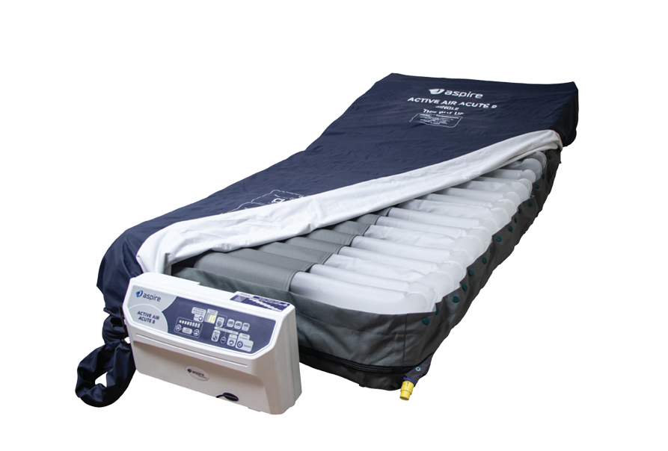
Air Mattress and Pump

Slide 25
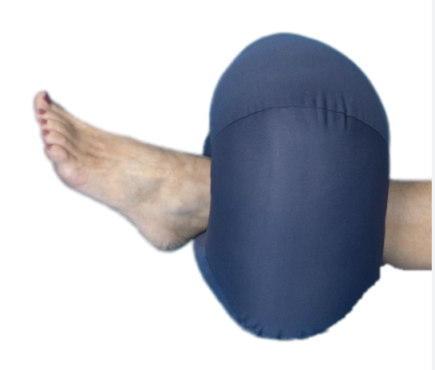
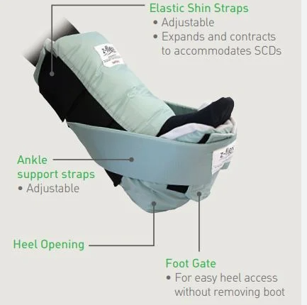
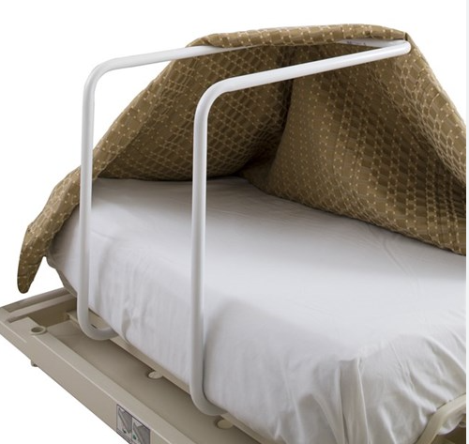
Pressure Injury Interventions/Preventions

Slide 26
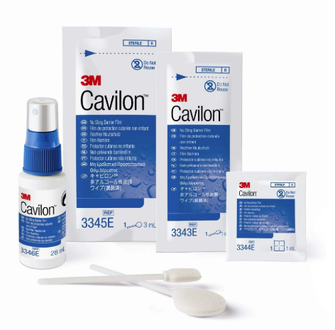
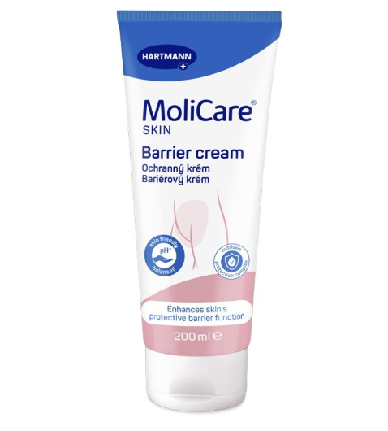
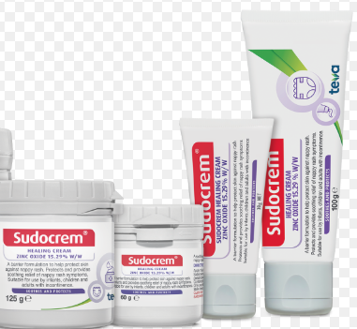
Skin Barriers

Slide 27
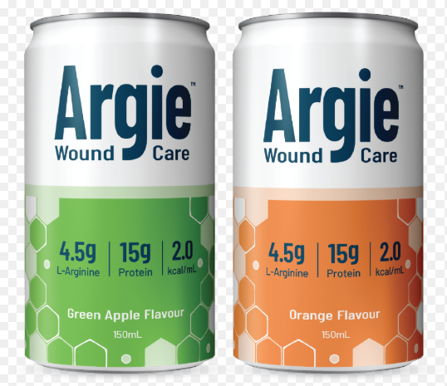
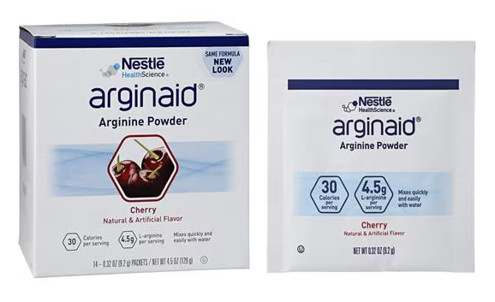
Supplements

Slide 28
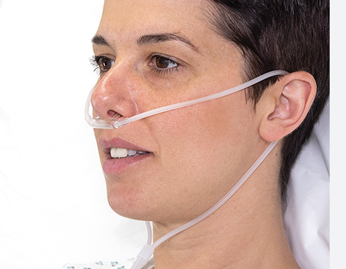
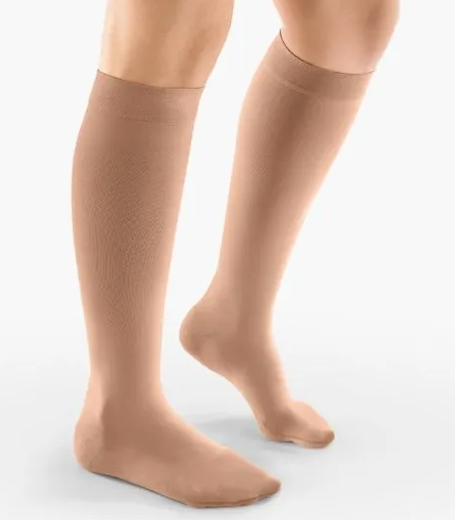
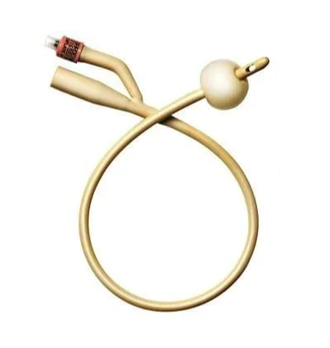
Medical Device Associated Pressure Injury (MDRPI)

Slide 29
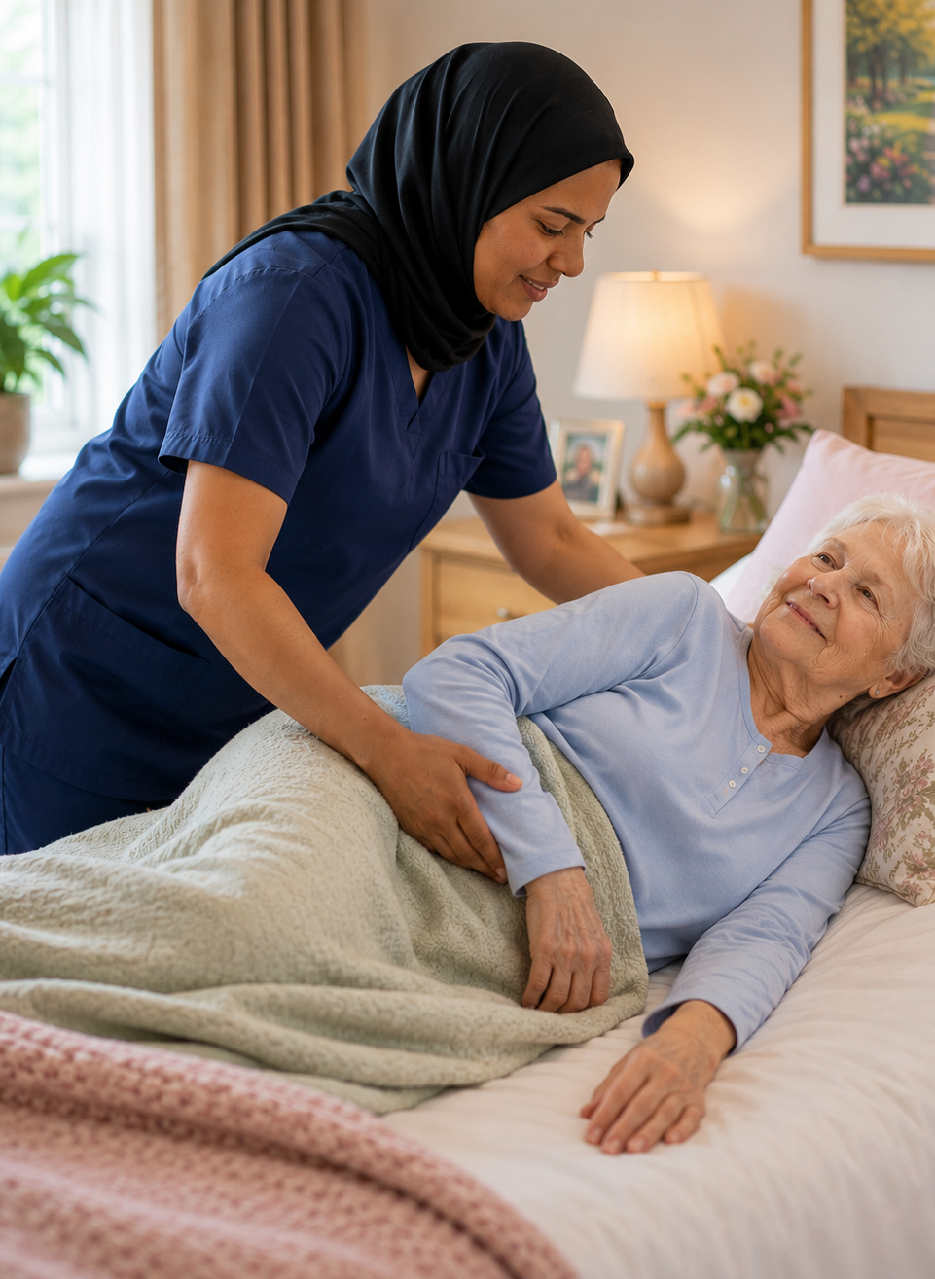


Indivisualised Reposition Plan
During The Day (0700-2100)
Up to 3 hours lying on healthy sides on air mattress
Limit to 2 hours on active pressure sites, unless advised to avoid completely by WNC
During the night (2100-0700)
Up to 4 hours unless specific regime prescribed by WNC/RNs

Slide 30
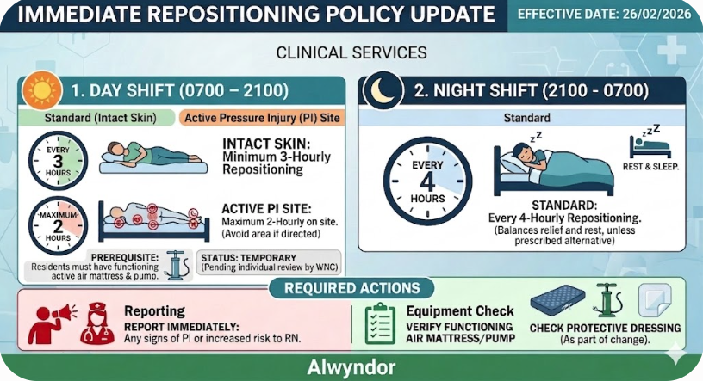

Slide 31

Sitting in a Chair with PI Risk
3 hour Rule : Residents should not sit for more than 3 hours at a time without a full "pressure relief" break (returning to bed or a standing transfer)
The “1- hour Micro-Shift": Every hour, staff should assist the resident to tilt the chair back further or adjust their position slightly to shift where the weight is concentrated.
Use Heel Protectors IF heels are in contact to the surface of chair.

Slide 32
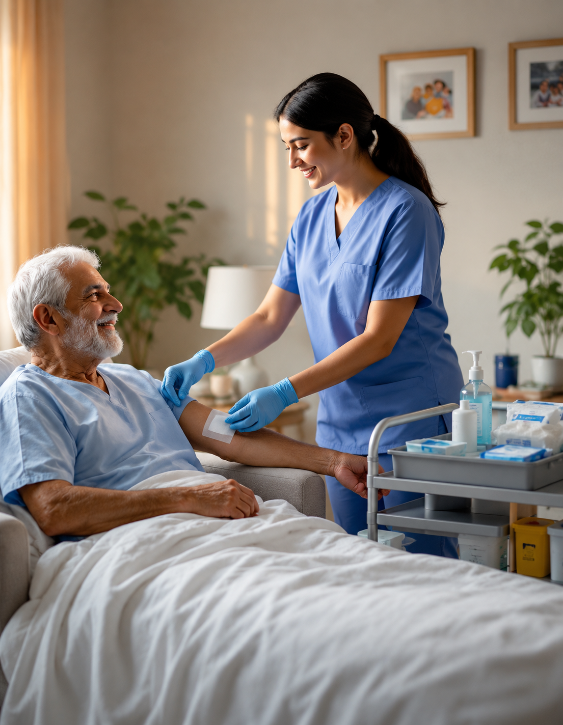
PI Care and Prevention (2/2)
Dressing choices
Biofilms, Slough, Debridement
Investigations and Referrals
PI Champions
Oversight and monitoring

Slide 33
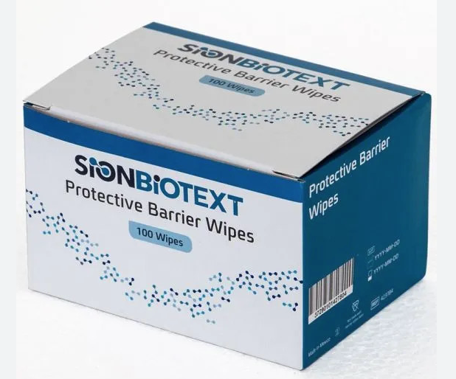
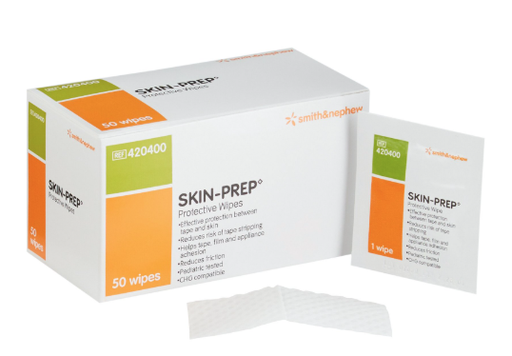
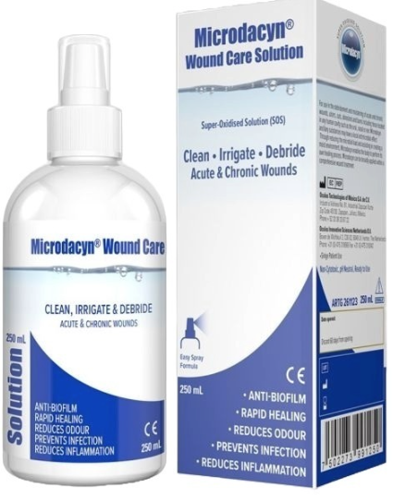
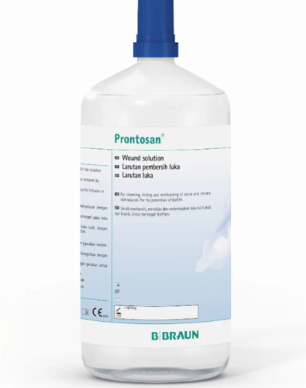
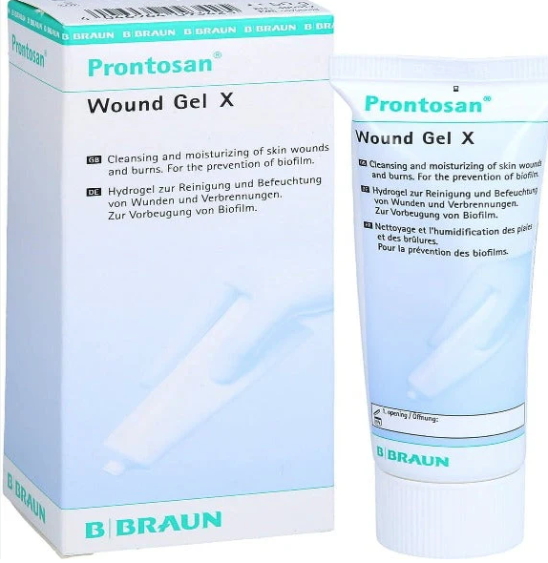
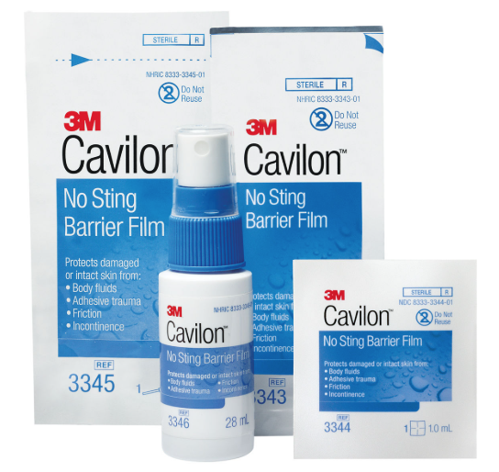
Skin and Wound Bed Preparation

Slide 34
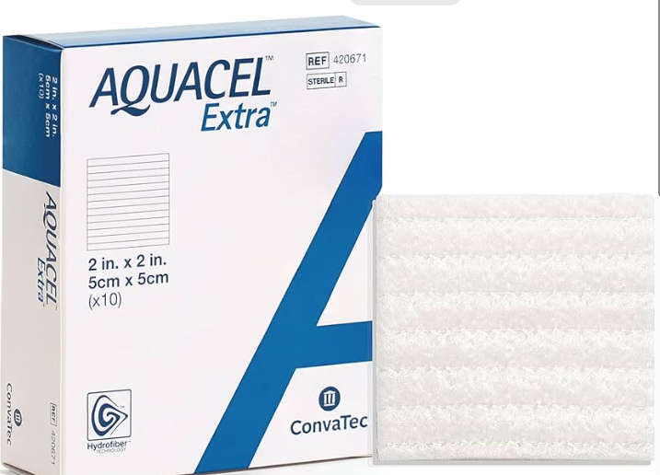
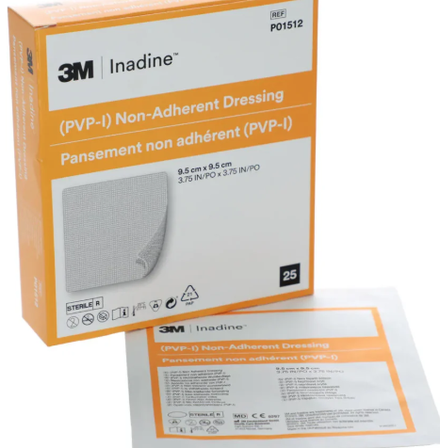
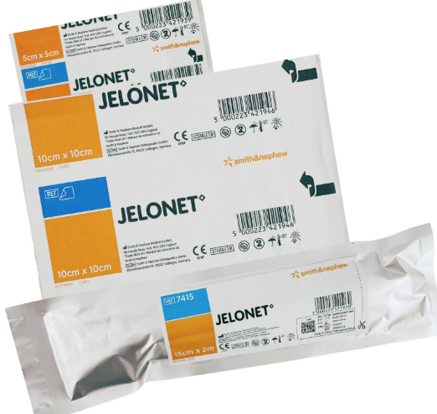
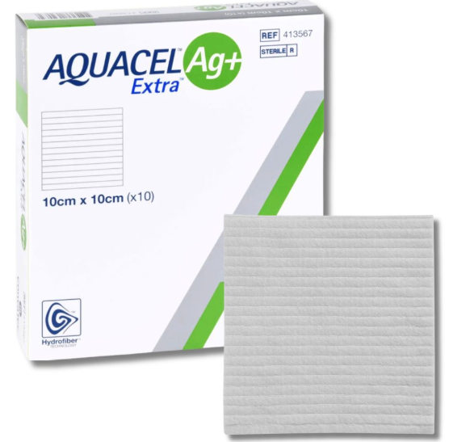
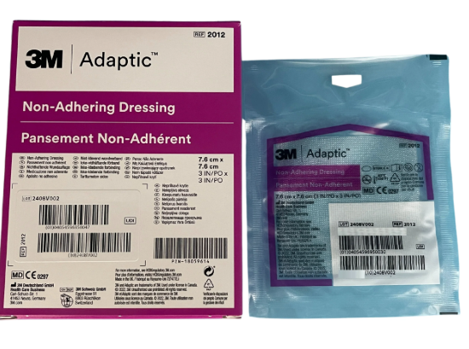
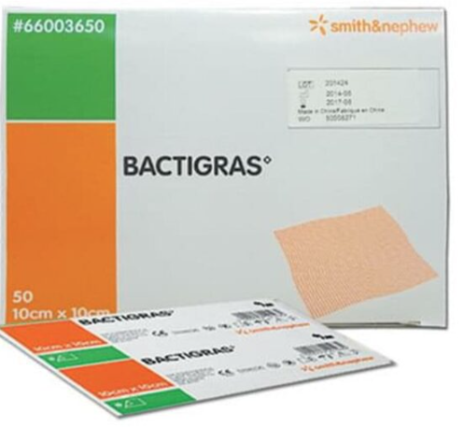
Primary Dressings

Slide 35
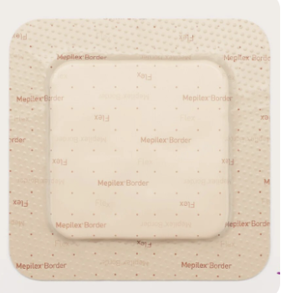
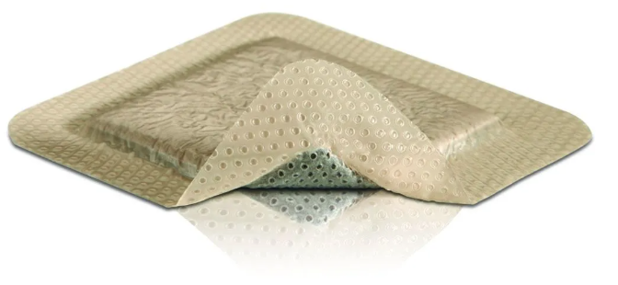
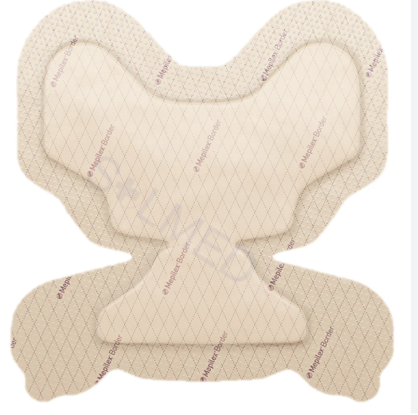
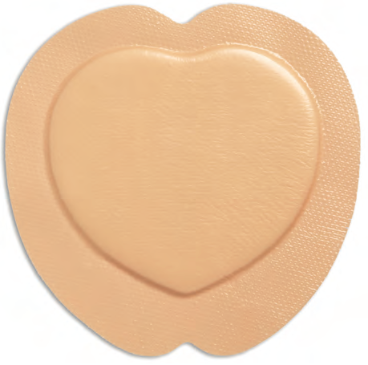
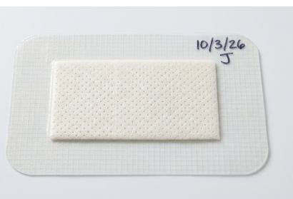
Secondary dressings

Slide 36
SLOUGH
pronounced
"sluf"
Wound Assessment | Dead Tissue Identification
DEFINITION
Dead (devitalised) host tissue mixed with fibrin and white blood cells that accumulates on the wound surface.
What it is
APPEARANCE
Yellow, tan, or grey in colour. Texture ranges from loose and stringy to thick and adherent. May cover part or the entire wound bed.
How it looks
CLINICAL IMPACT
Slough is a physical barrier to healing and a rich nutrient source for bacteria — increasing infection risk and delaying wound closure. Debridement is usually required.
Why it matters
Slough must be differentiated from eschar (dry, black necrotic tissue) — both require debridement but management differs.

Slide 37
BIOFILM
present in
>78%
of chronic wounds
Wound Microbiology | Chronic Wound Barrier
DEFINITION
A complex, microscopic colony of bacteria and/or fungi encased in a self-produced protective "slime" layer called Extracellular Polymeric Substance (EPS).
What it is
THE INVISIBLE THREAT
Biofilm cannot be seen with the naked eye. The EPS shield makes it up to 1,000× more resistant to antibiotics and highly evasive of the body's immune response.
Why it's hard to fight
CLINICAL IMPACT
Found in >78% of chronic wounds, biofilm is a primary driver of stalled healing. It triggers persistent inflammation, blocks new tissue formation, and dramatically raises infection risk.
Effect on wounds
Biofilm recurs rapidly after disruption — sustained antimicrobial wound care and regular debridement are essential for chronic wound management.

Slide 38
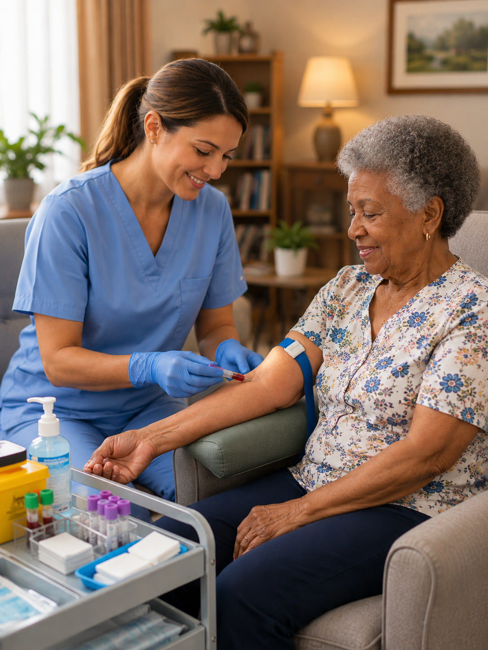
Investigations
Blood tests – checking FBE, Inflammatory markers (CRP & ESR), Nutritional markers, HbA1c, liver function.
Microscopy, Culture & Sensitivity (MCS)
Imaging (x-ray/MRI/Bone scan)

Slide 39
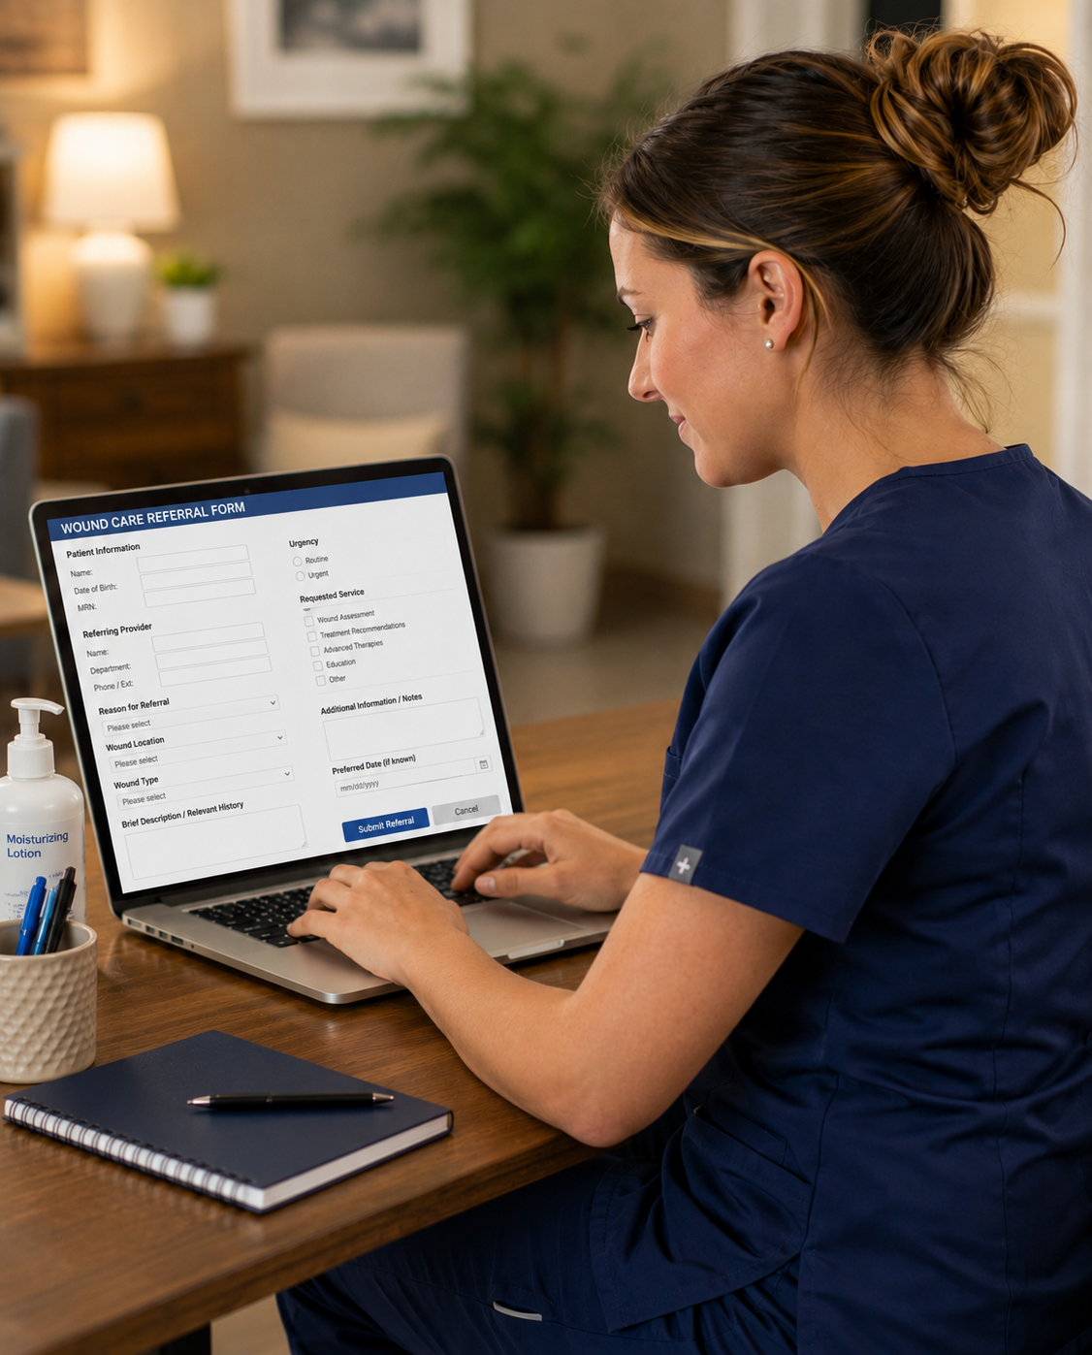
Referrals
GP
Dietitian
Occupational Therapy
Physiotherapy
Wound Clinic and Infectious Disease
Emergency Department
Wound Specialist

Slide 40

Pressure Injury Champions
Nurses
Anisha Adhikari
Bindu Mali
Bishnu Shyanbo
Dikshya Rai
Jin Song
Kanchan Mahat
Purum Go
Seema Malla
Johua Jang
Amita Joshi
Carers
Manisha Kandel
Ritika Khatri
Tania Blundell
Joyce Manero
Greg White

Slide 41
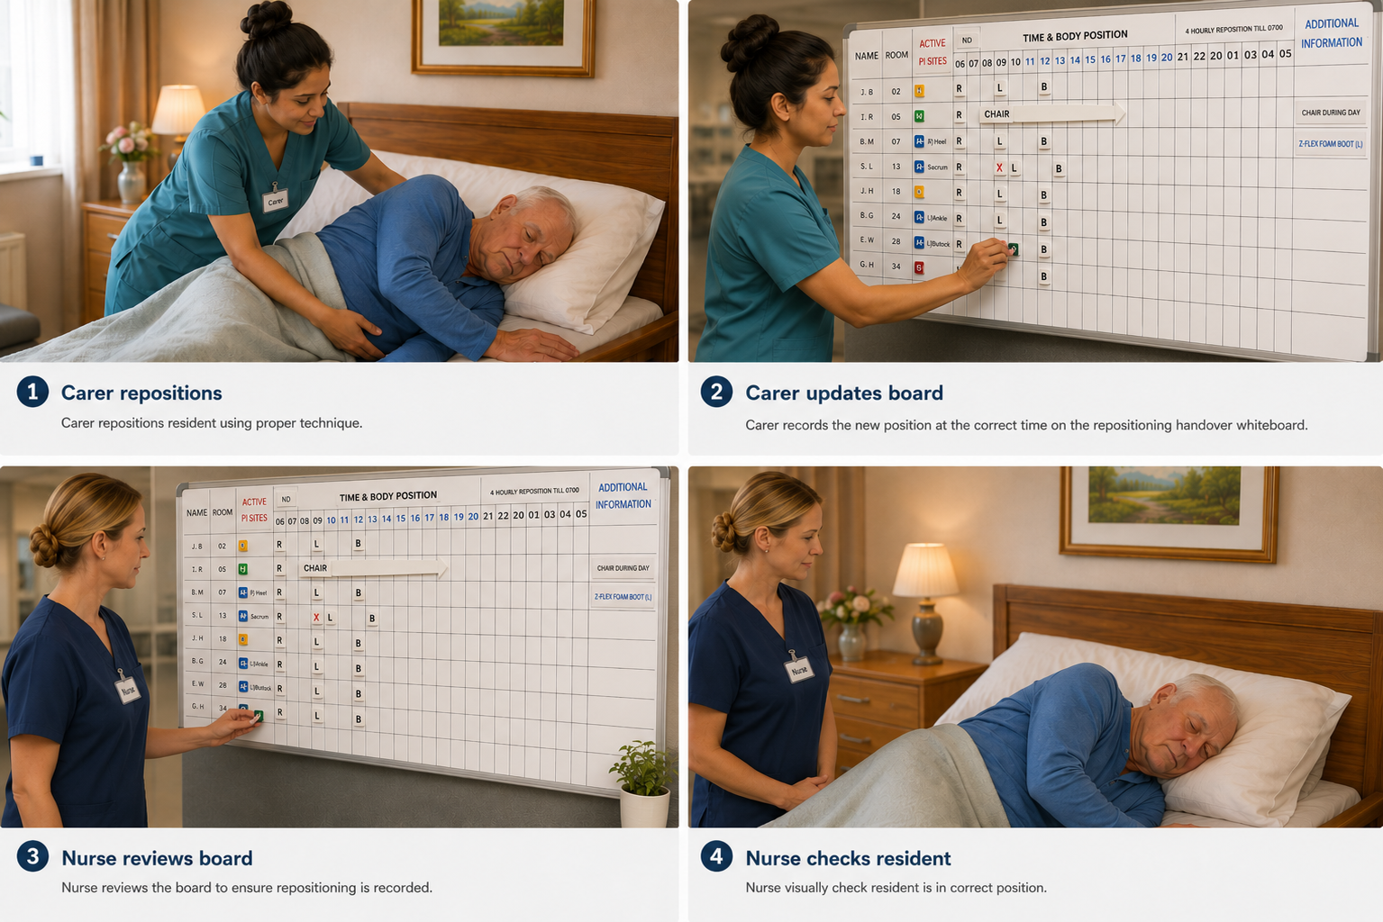
Oversight and Monitoring
Active Nurse Supervision:
PAC and repositioning adherence relies on continuous clinical leadership.

Slide 42

Resident Engagement
Communication with residents and NOKs
PI care needs
PI risks and causes
Risk of declining care
Self management
Notes:
1

Slide 43
PI Handover Whiteboards
Displays residents with Active PIs or at risk of PI
Provides clear, shift-to-shift visual prompt for consistent care
Updated by carers as soon as possible after each reposition
Carers move the magnets to reflect completed care
All care staff share responsibility for keeping it current
Keep three positions on board at all times
Refer to Checklist at shift handover discussion
Nurse in charge oversees accuracy each shift

Slide 44

PI Handover Whiteboards - Layout

Slide 45

Repositioning Magnets
Show last 3 positions
Mark if the resident declined repositioning
Use Chair magnet if resident spending extended time in chair

Slide 46

Adding Residents to Whiteboard
Whiteboard needs to show residents:
  requiring staff to reposition
  risk rating moderate and above
  active PI
Nurse responsibilities:
  compare whiteboard with PI Risk Register each shift
  update whiteboard with any changes to resident PI status and risk rating
  Add any residents missing from board
If resident is able to self reposition they do not go on the whiteboard
Notes:
Air mattress: photo in the slide
Other Interventions: Bed cradle, Dermasaver heel elevator, Z-flex foam boot, Pillow, Dressings
Moisture and Skin barrier: Molicare Barrier cream, Sudocrem, Continence pads
Medical Devices: Urinary catheter, Nasal spec/prong for oxygen

Slide 47

PI Visual Indicators
Colour coded tag displayed at resident’s room
Viewed when donning gloves
Provides visual cue of pressure injury status/risk
Reinforces information shown on the whiteboard
Supports prompt, consistent repositioning
All care staff escalate if tag does not match handover whiteboard
Nurse responsible for ensuring correct tag is in place

Slide 48
PI Risk Register
Electronic overview of all residents with a PI or identified risk in your area
Assessable via touch screen monitor in nurses station – no login required
Automatically updated from iCare data (incident reports, wound charts, skin assessments)
Refreshes every 2 hours
Provides detailed care information to support daily practice
Includes stage, location, pressure area care, equipment and dressing needs
Used by nurses and carers to guide consistent, individualised care
Nurses responsible to ensure information remains current and accurate

Slide 49


Slide 50


Slide 51

PI Dashboard
Consolidated view of pressure injury data across the service
Displays trends by stage, location, area and time period
Monitors incidence, prevalence and resolution rates
Supports identification of emerging risks and hotspots
Informs quality improvement actions and prevention strategies
Used by nurses, quality team and management for oversight
Reviewed regularly to guide clinical and operational decision-making
Picture example only – Dashboard is still being built by ICT

Slide 52
Thank You

