Slide 1
Pressure Injury Training - Carers

Slide 2
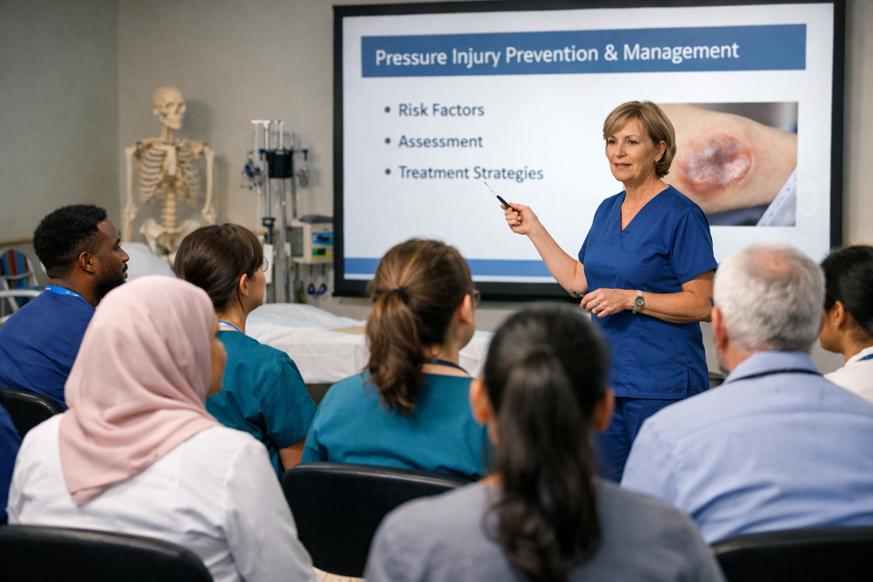
Today’s Session
PI Identification and Reporting
PI Care and Prevention
Resident Engagement
PI Management Tools

Slide 3
Pressure Injury Impact on Residents
Pain
Sleep disturbance
Mood disturbance
Mobility
Infection
More pressure injuries
Hospital admission
Death

Slide 4
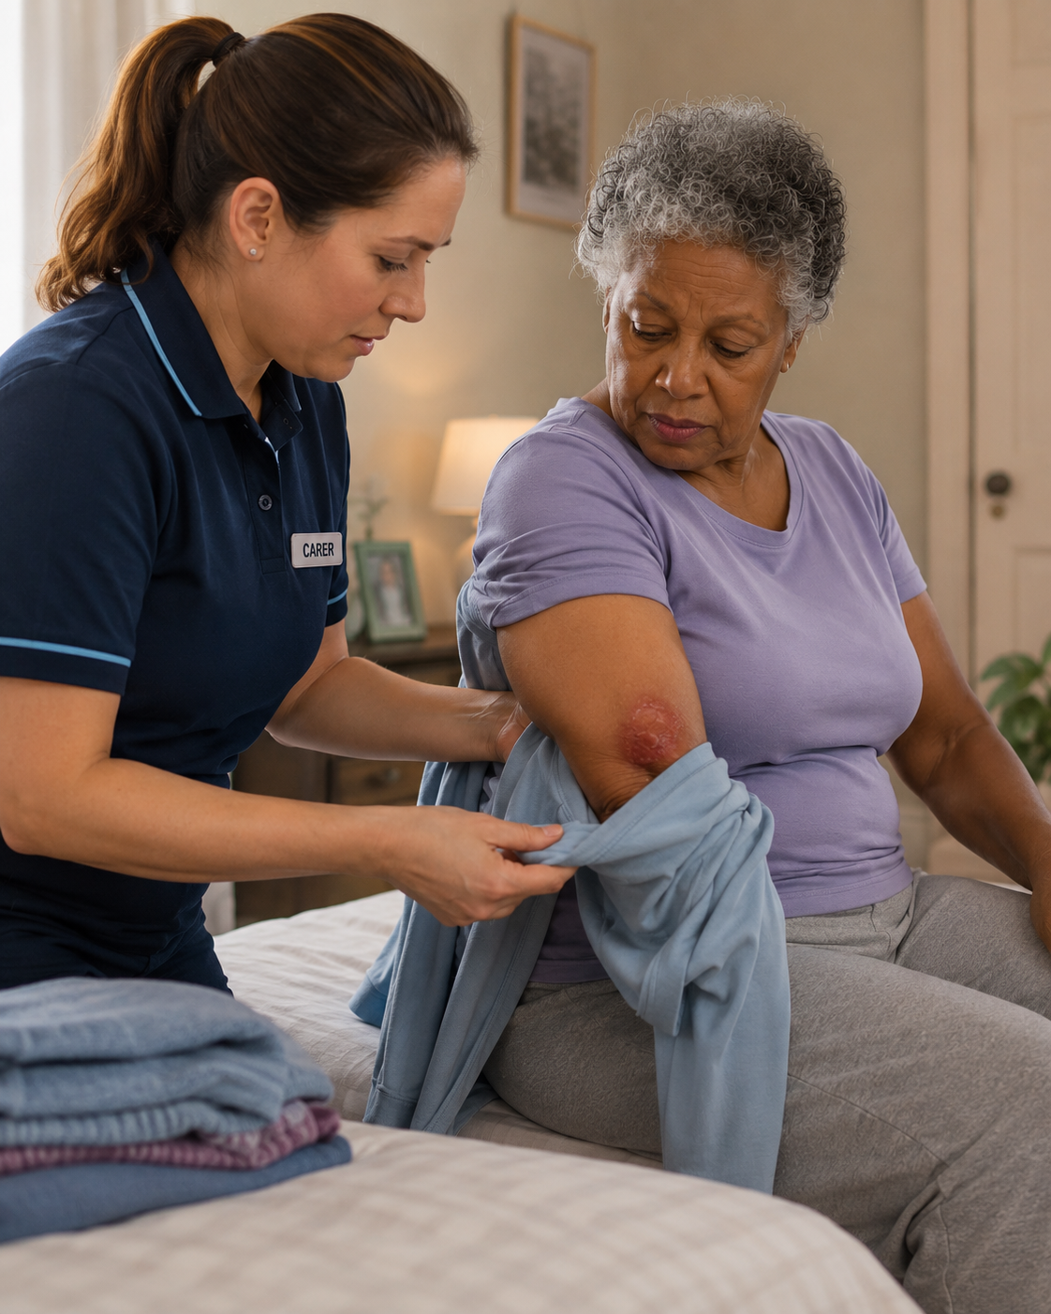
Identification and Reporting
IAD and PI
Risk Factors
Pressure Injury Stages
Friction and Shear
Blanching Test
Compromised Dressings

Slide 5
Pressure Injury VS IAD
Feature | Pressure Injury (PI) | IAD
Cause | Pressure, shear, friction | Urine/stool moisture & irritants
Location | Over bony prominences | Perineal, perianal, inner thighs, buttocks
Wound edges | Distinct, well-defined | Diffuse, irregular edges
Depth | May be deep (staged I–IV) | Superficial (epidermis only)
Appearance | Dark/purple discolouration or open wound | Erythema, redness, skin may be pink/red
Necrosis | May be present | Not present
Shape | Defined, often round/oval | Irregular, patchy distribution
Location on buttocks | Sacrum / coccyx area (bony) | Diffuse across buttock skin

Slide 6
Risk Factors of PI Development
Age
Wet/Dry
Skin
Recent hospital D/C
Deteriorating Health
Under/ Overweight
Mobility
Sensation: central vs periphery
Nutrition

Slide 7
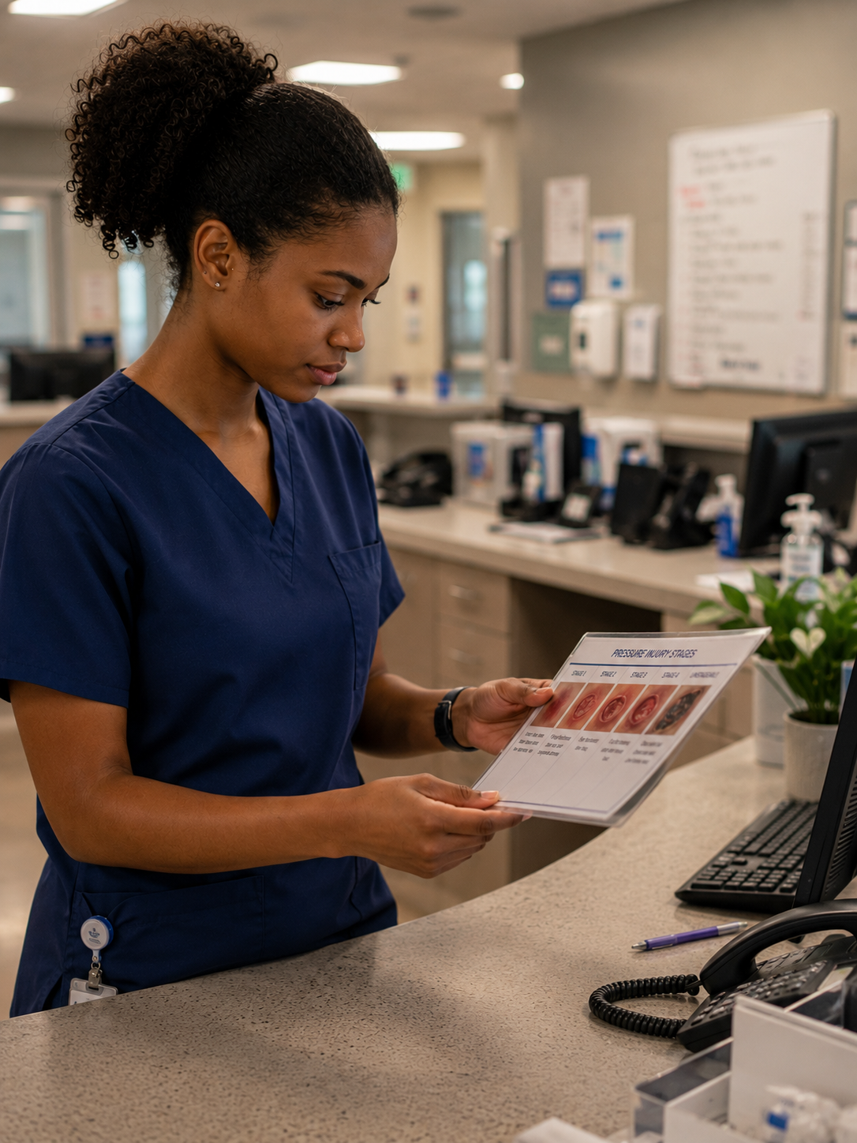
Different Stages of Pressure Injury
Stage 1
Stage 2
Stage 3
Stage 4
Unstageable
Suspected Deep Tissue Injury (SDTI)

Slide 8
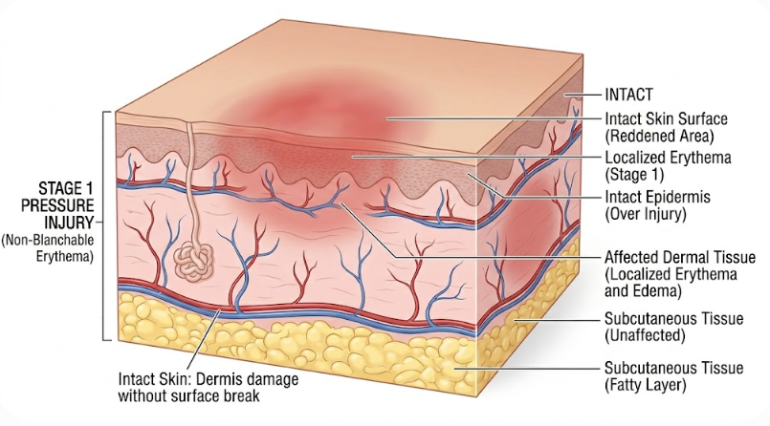
Stage 1 Pressure Injury – Tissue Structure
AI(Gemini) generated image

Slide 9
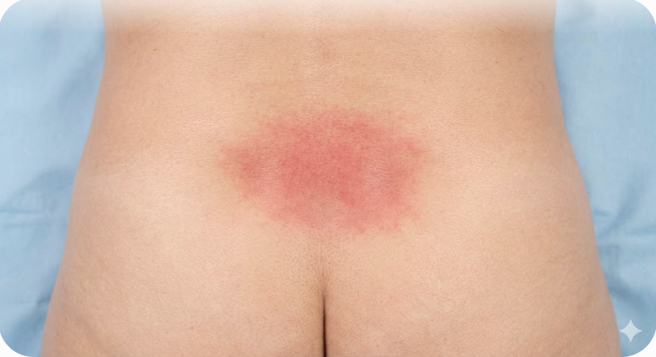
Stage 1 Pressure Injury - Description
Intact skin with non-blanchable redness of a localised area usually over a bony prominence.
Darkly pigmented skin may not have visible blanching, the colour may differ from the surrounding area.
The area may be painful, firm, soft, itchy, warmer or cooler than adjacent skin.
AI(Gemini) generated image

Slide 10
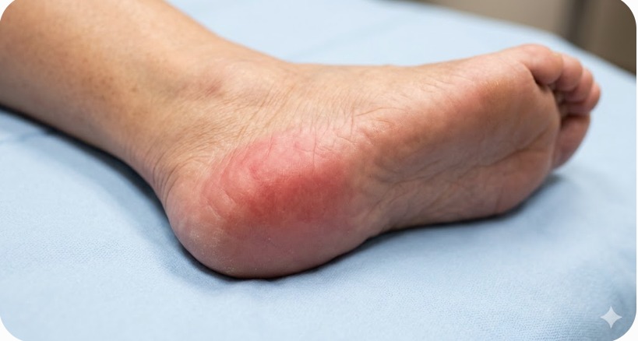
Stage 1 Pressure Injury - Example
AI(Gemini) generated image

Slide 11
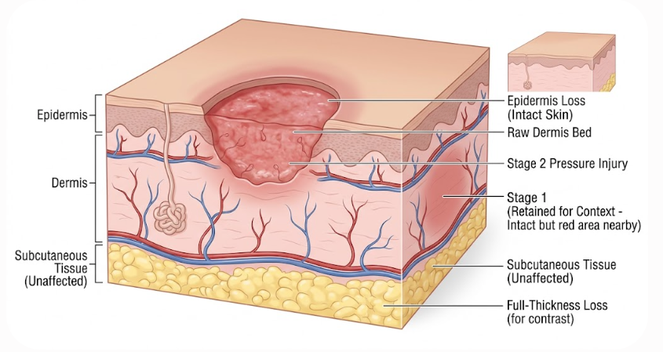
Stage 2 Pressure Injury – Tissue Structure
AI(Gemini) generated image

Slide 12
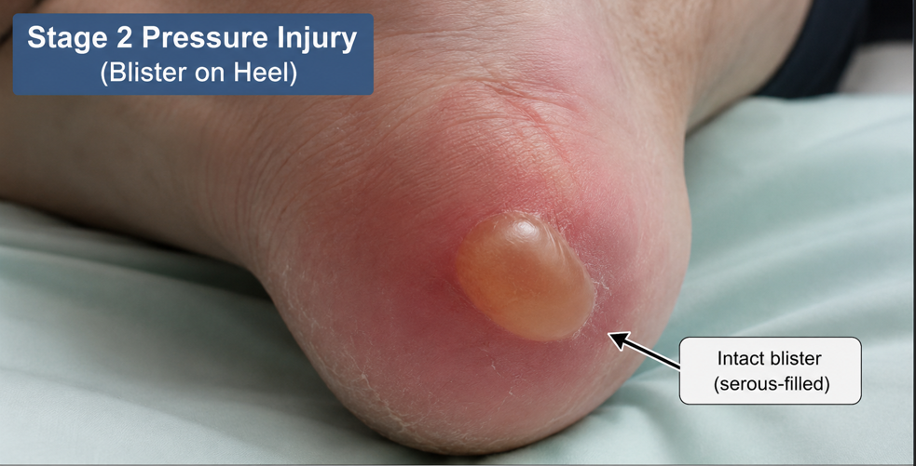
Stage 2 Pressure Injury - Description
Partial thickness skin loss presents as either:
  A shallow open ulcer with a red/pink wound bed, without slough.
  As an intact or ruptured clear fluid filled blister.
Ulcer is superficial without bruising.
AI(Gemini) generated image

Slide 13
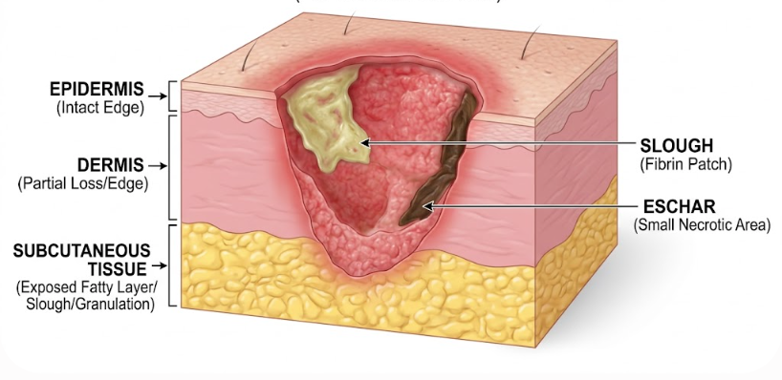
Stage 3 Pressure Injury – Tissue Structure
AI(Gemini) generated image

Slide 14
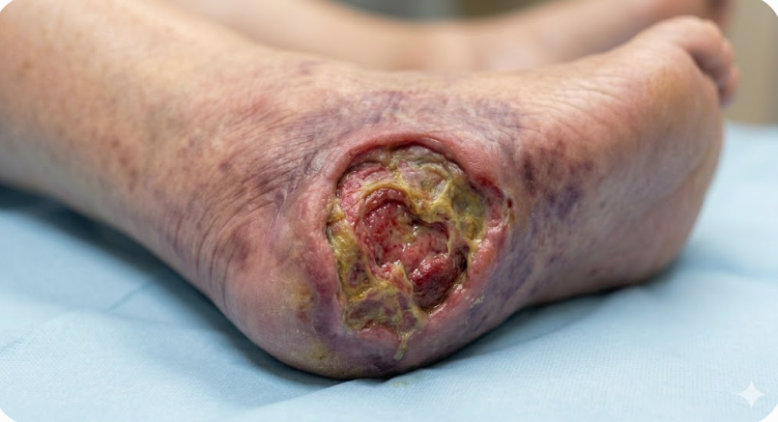
Stage 3 Pressure Injury - Description
Full thickness skin loss.
Subcutaneous fat may be visible, but bone, tendon and muscle are not exposed.
Slough may be present but does not obscure the depth of the ulcer.
May include undermining and tunnelling.
Stage 3 PI can be shallow e.g. nose, ears, ankles.
AI(Gemini) generated image

Slide 15
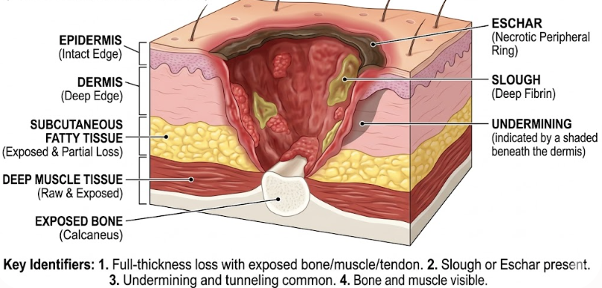
Stage 4 Pressure Injury – Tissue Structure
AI(Gemini) generated image

Slide 16
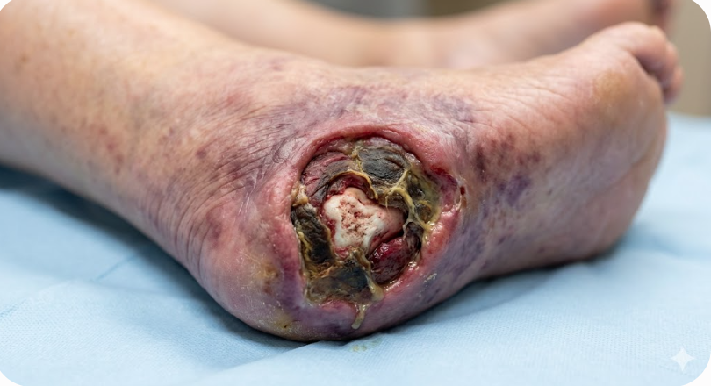
Stage 4 Pressure Injury - Description
Full thickness tissue loss with exposed bone, tendon (directly palpable or visible).
Slough or eschar may be present on some parts of the wound bed.
Often include undermining and tunnelling.
Can extend into the muscle and/or supporting structures (e.g. fascia, tendon or joint capsule).
AI(Gemini) generated image

Slide 17
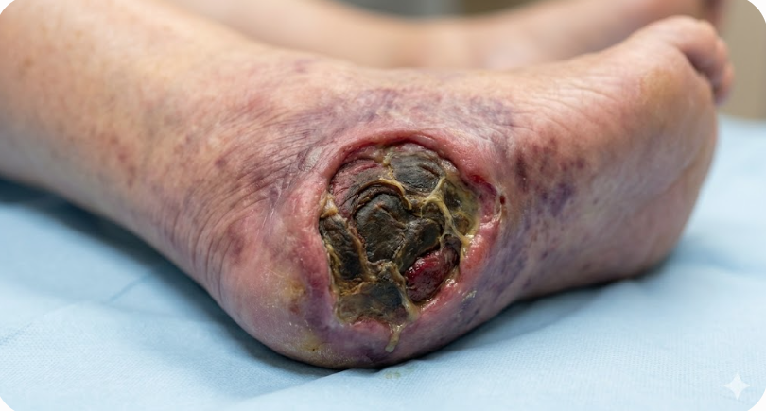
Stage Unstageable Pressure Injury - Example
AI(Gemini) generated image

Slide 18
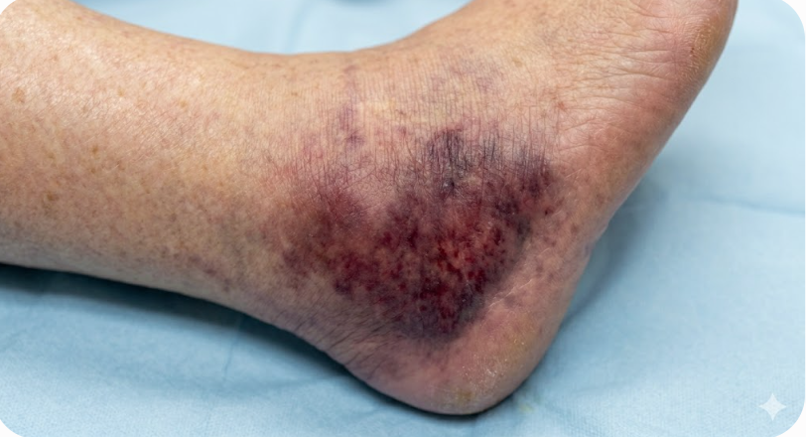
Stage Suspected Deep Tissue - Example
AI(Gemini) generated image

Slide 19
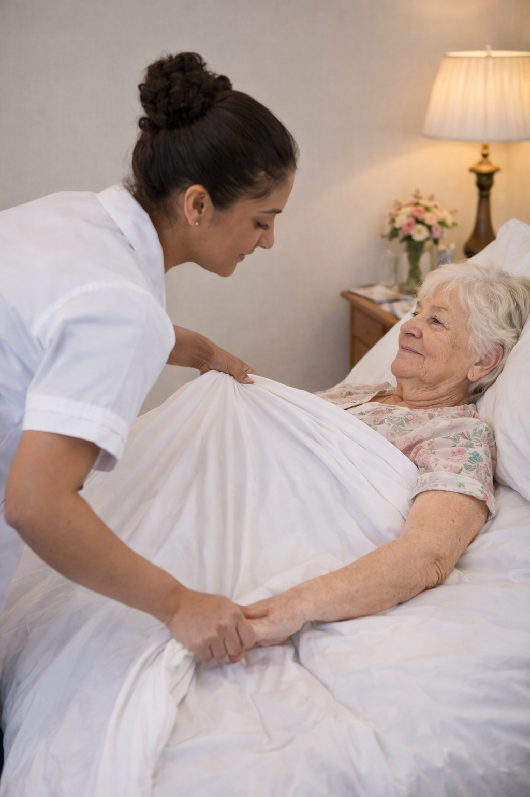
Friction
Definition: The resistance that occurs when skin rubs against another surface (like bed sheets or a chair).
Mechanism: It acts on the top layer of the skin (epidermis).
The Result: It creates a "sheet burn" or "strawberry" appearance. It strips away the protective top layer, making the skin more vulnerable to moisture and infection.
Common Cause: Dragging a resident up in bed rather than using a slide sheet or hoist.

Slide 20
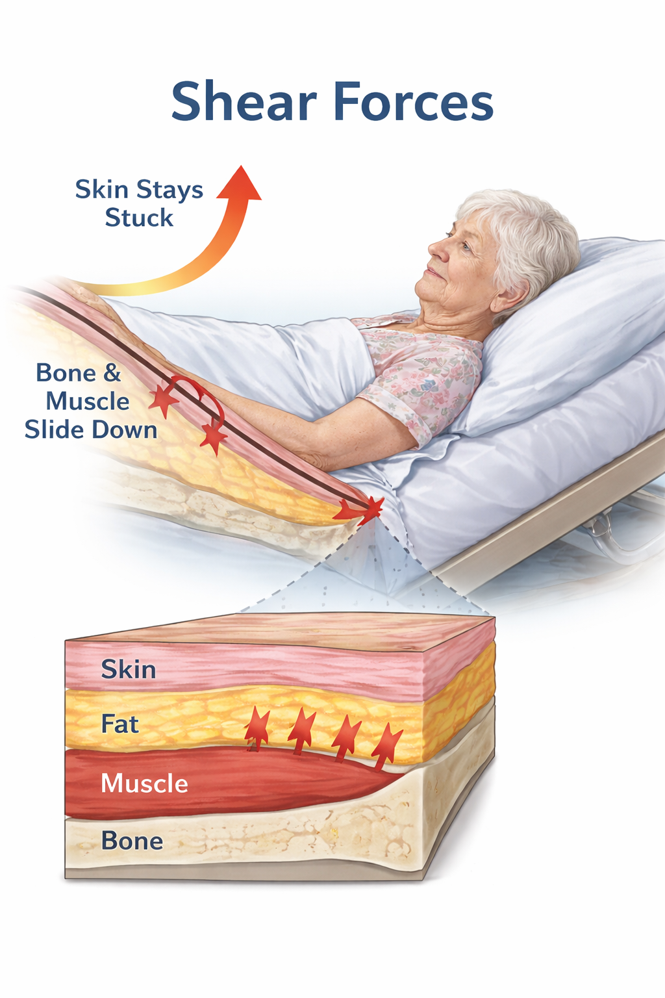
Shear – The “Deep Force”
Definition: A gravity-led force that occurs when the skin stays stuck to a surface while the underlying bone and muscle slide in the opposite direction.
Mechanism: It acts on the deep tissues and blood vessels.
The Result: It stretches, kinks, and tears the tiny blood vessels (capillaries) underneath the skin. This cuts off oxygen to the tissue, leading to deep "unstageable" injuries or "Deep Tissue Pressure Injuries" (DTPI).
Common Cause: Sliding down in bed when the head of the bed is elevated too high (> 30 degree)

Slide 21
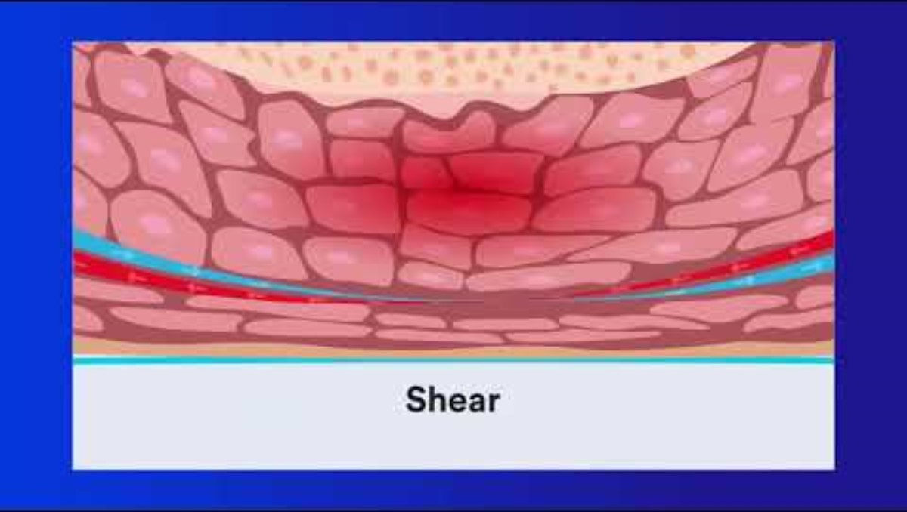

Slide 22
The 30-Degree Tilt Rule
❌ 90° Side-lying
Full weight on greater trochanter. High pressure, high injury risk.
✅ 30° Tilt
Weight spread across buttock and back. Pressure significantly reduced.
⚠ A 30° tilt looks smaller than you expect — use a pillow as a wedge to check your angle

Slide 23
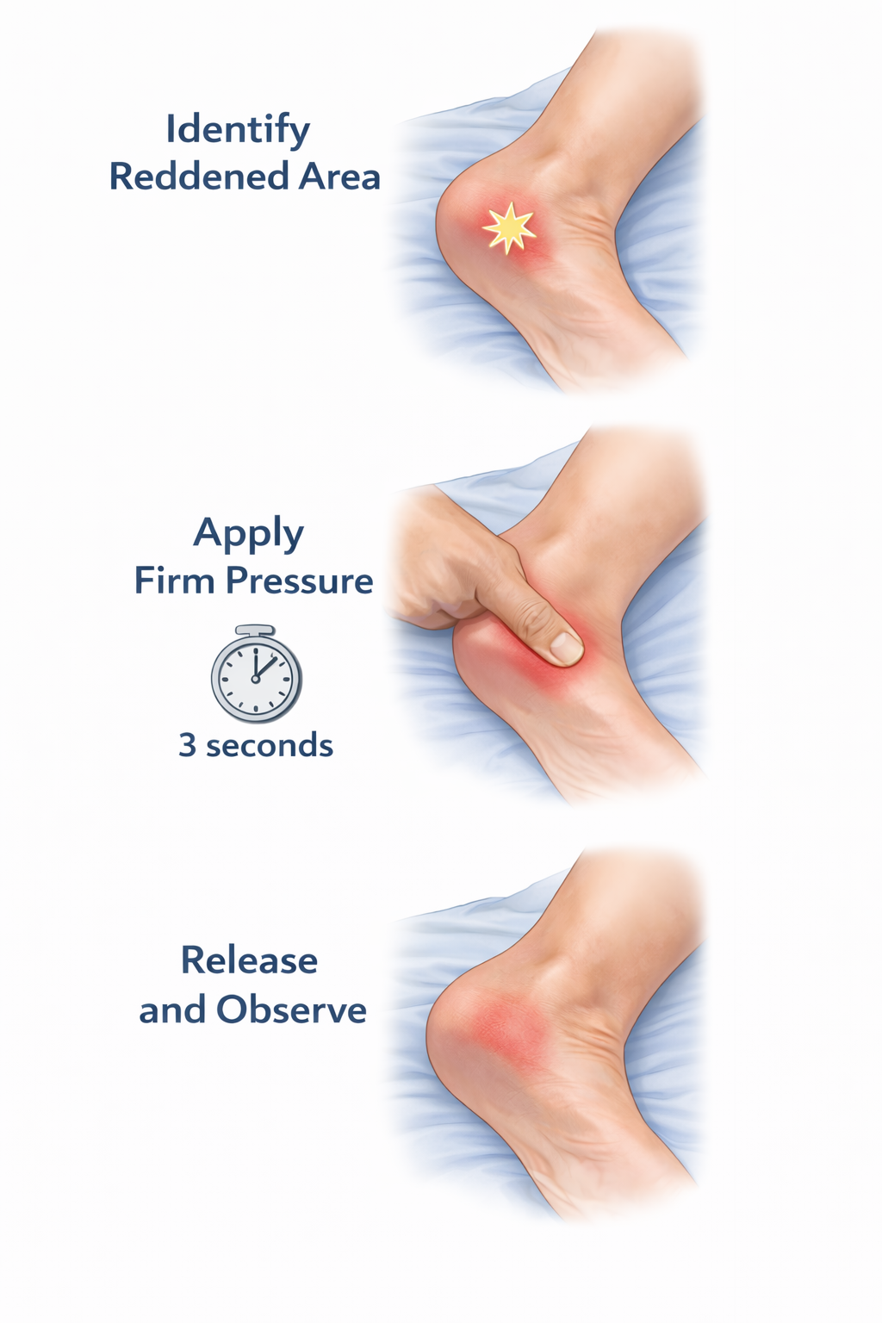
Blanching Test
Identify a reddened area on a bony prominence (e.g., heel, sacrum).
Apply Firm Pressure with a clean finger for 3 seconds.
Release and Observe the skin's reaction immediately.

Slide 24
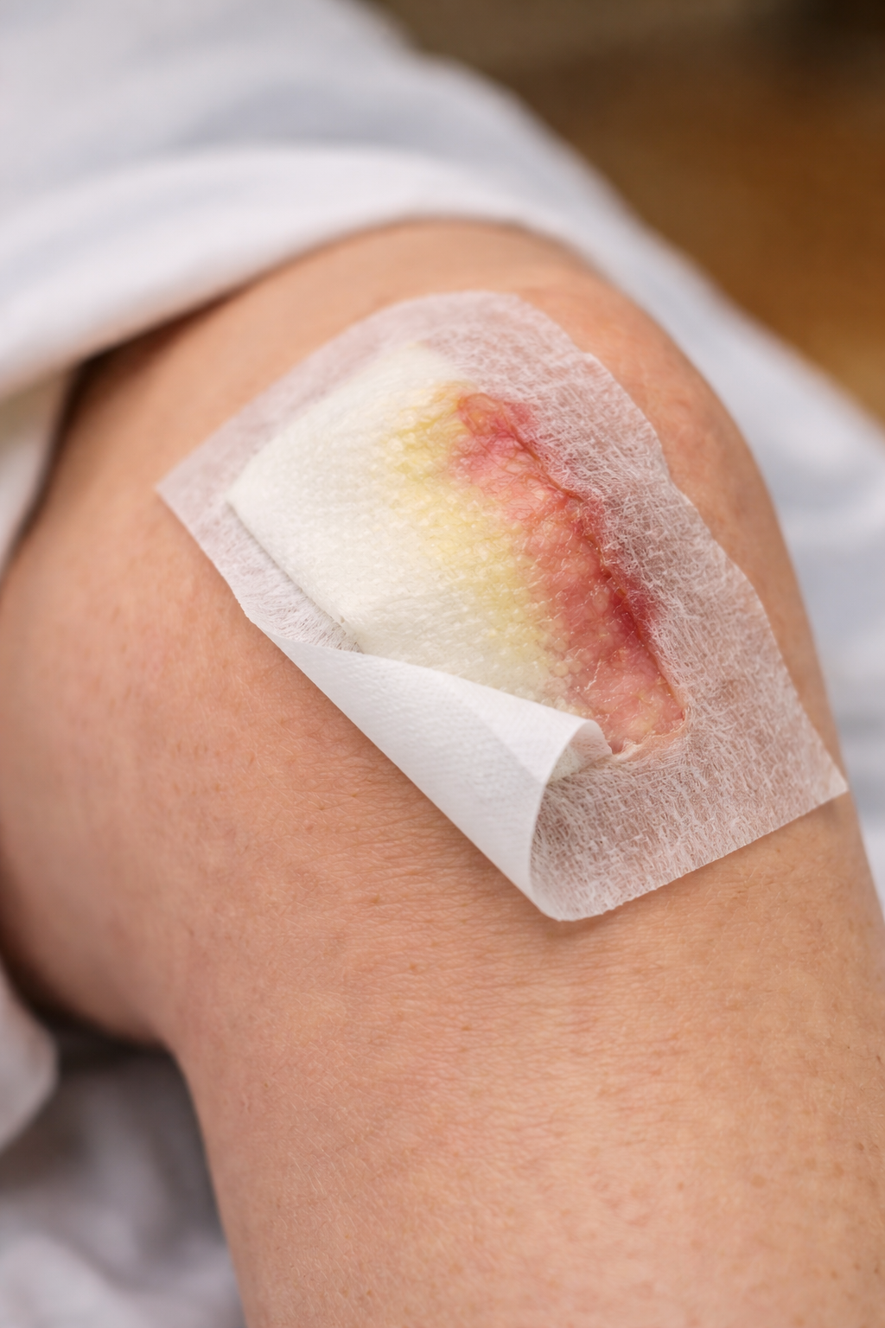
Compromised Dressings
Entry point for infection
Loss of Moisture balance
Maceration
Biofilm Reformation

Slide 25
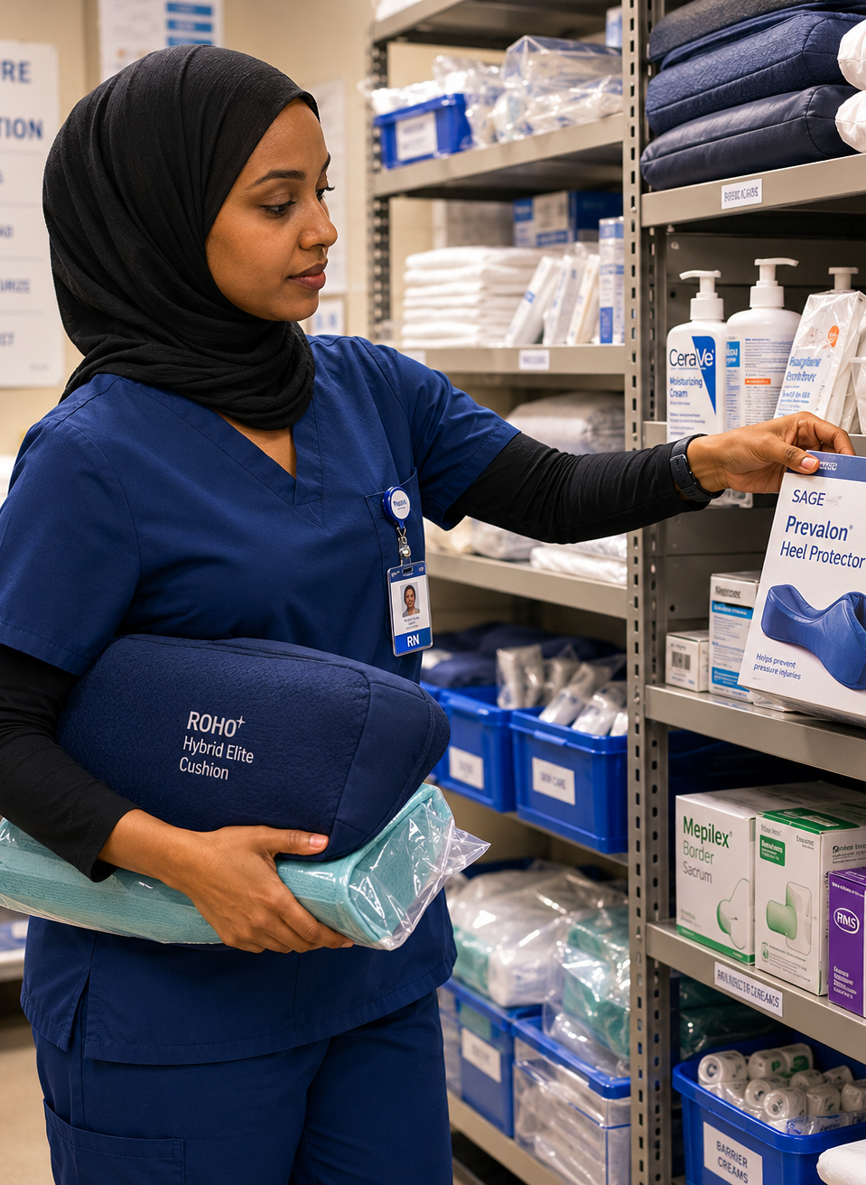
PI Care and Prevention
(1/2)
Air Mattress and pump
Other Interventions
Moisture and skin barrier
Medical devices
Individualised Reposition plan
Notes:
Air mattress: photo in the slide
Other Interventions: Bed cradle, Dermasaver heel elevator, Z-flex foam boot, Pillow, Dressings
Moisture and Skin barrier: Molicare Barrier cream, Sudocrem, Continence pads
Medical Devices: Urinary catheter, Nasal spec/prong for oxygen

Slide 26
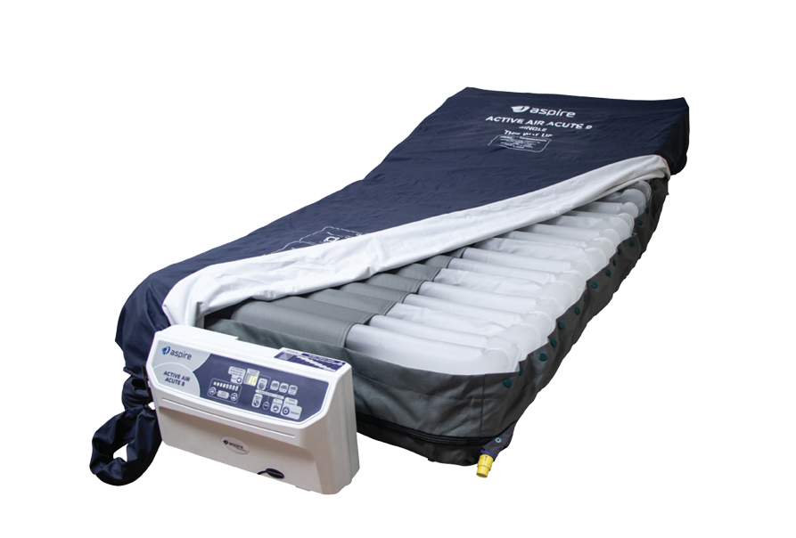
Air Mattress and Pump

Slide 27
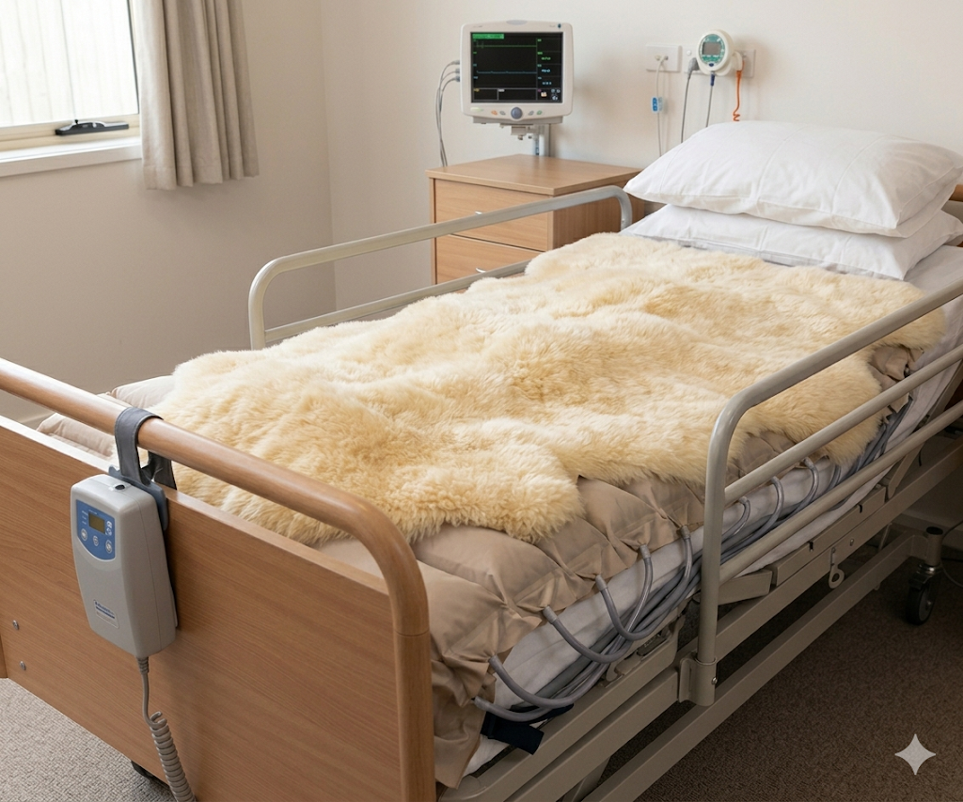
Sheepskin over air mattress

Slide 28
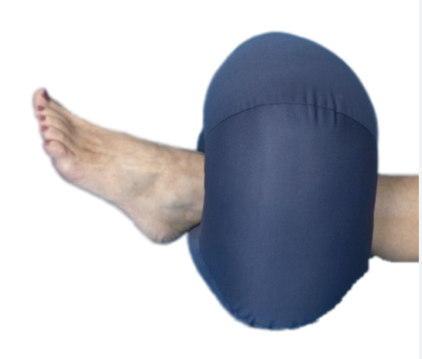
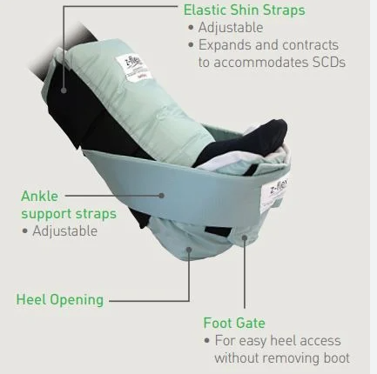
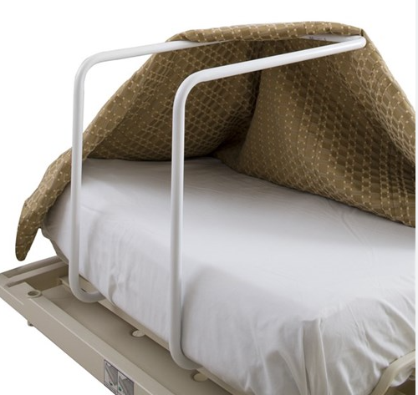
Pressure Injury Interventions/Preventions

Slide 29
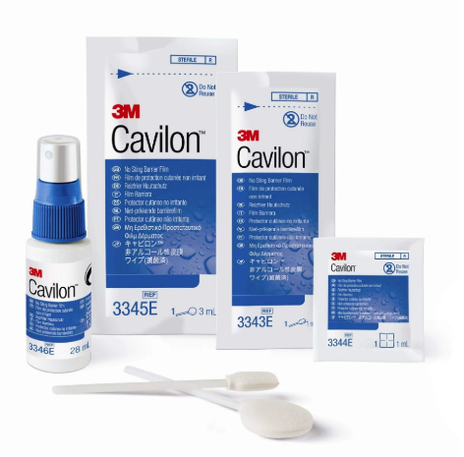
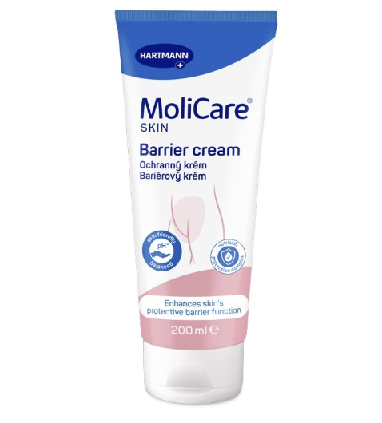
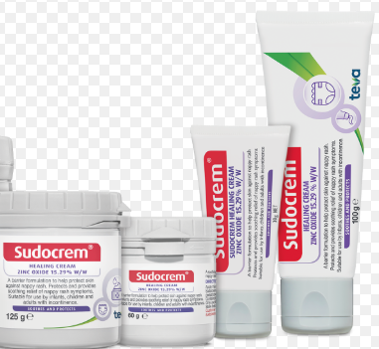
Skin Barriers

Slide 30
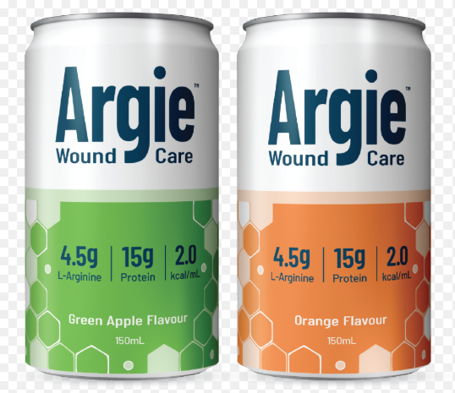
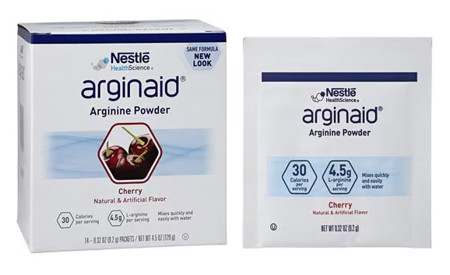
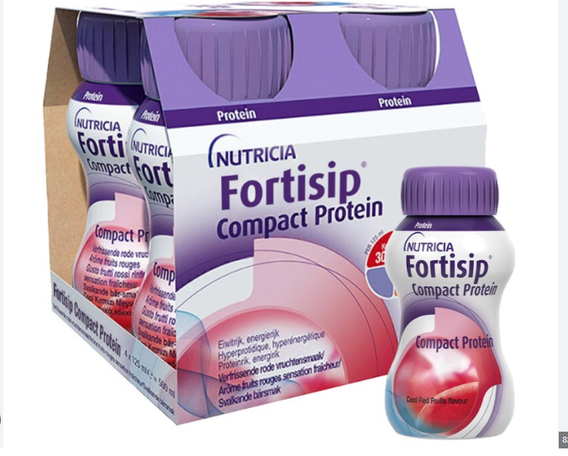
Supplements

Slide 31
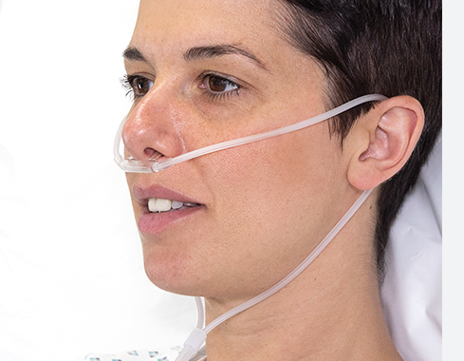
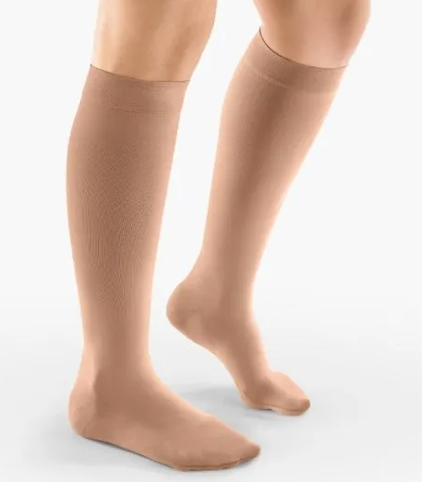
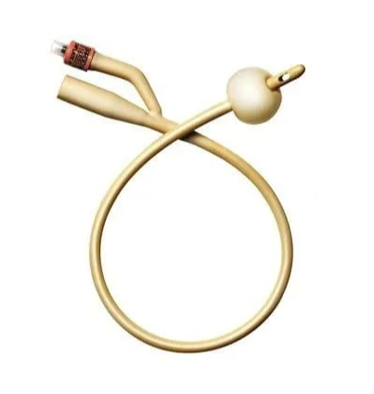
Medical Device Associated Pressure Injury (MDRPI)

Slide 32
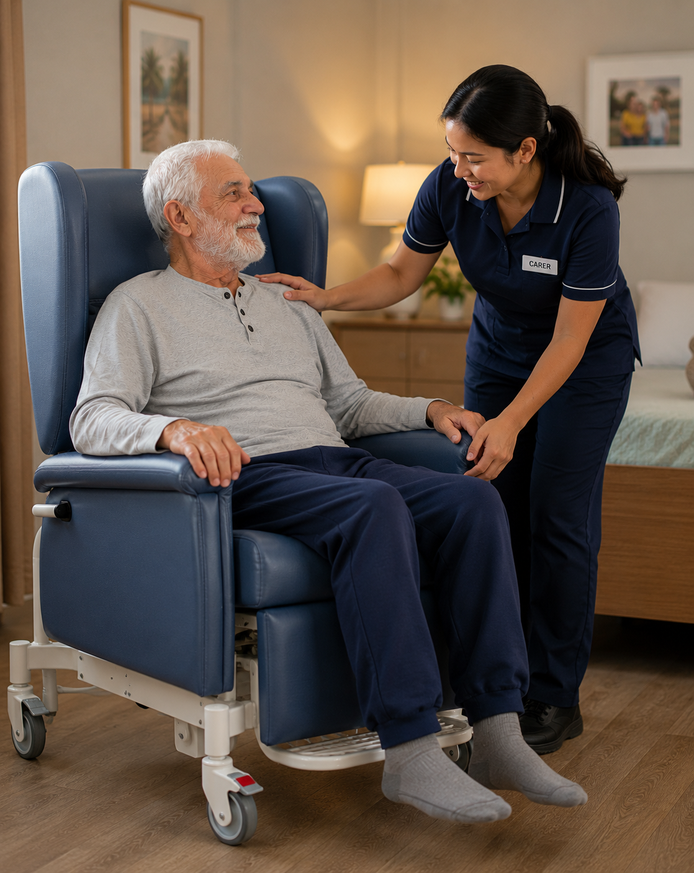
PI Care and Prevention
(2/2)
Indivisualised Reposition Plan
Sitting in a Chair
PI Champions

Slide 33
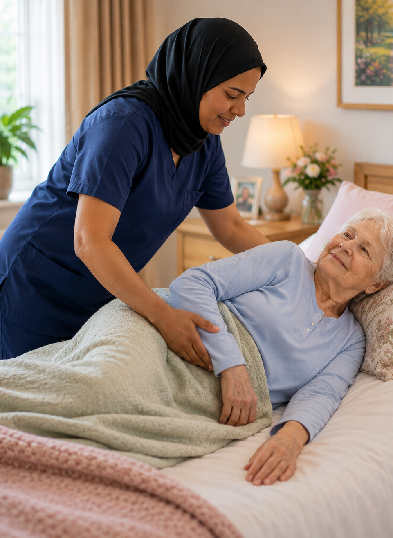


Indivisualised Reposition Plan
During The Day (0700-2100)
Up to 3 hours lying on healthy sides on air mattress
Limit to 2 hours on active pressure sites, unless advised to avoid completely by WNC
During the night (2100-0700)
Up to 4 hours unless specific regime prescribed by WNC/RNs

Slide 34
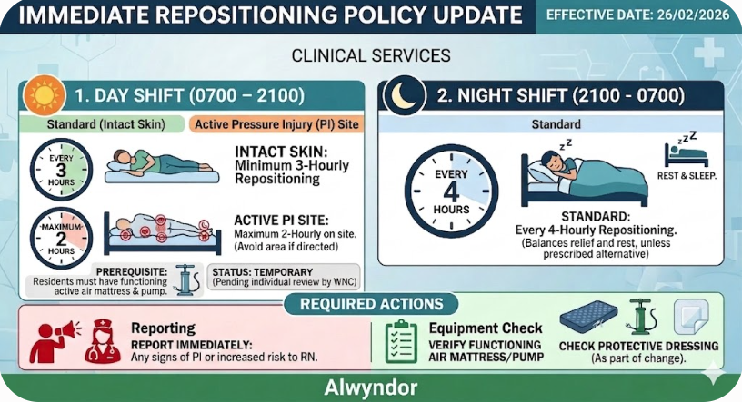

Slide 35

Sitting in a Chair with PI Risk
3 hour Rule : Residents should not sit for more than 3 hours at a time without a full "pressure relief" break (returning to bed or a standing transfer)
The “1- hour Micro-Shift": Every hour, staff should assist the resident to tilt the chair back further or adjust their position slightly to shift where the weight is concentrated.
Use Heel Protectors IF heels are in contact to the surface of chair.

Slide 36

Resident Engagement
Communication with residents and NOKs
PI care needs
PI risks and causes
Risk of declining care
Self management
Notes:
1

Slide 37
PI Handover Whiteboards
Displays residents with Active PIs or at risk of PI
Provides clear, shift-to-shift visual prompt for consistent care
Updated by carers as soon as possible after each reposition
Carers move the magnets to reflect completed care
All care staff share responsibility for keeping it current
Keep three positions on board at all times
Refer to Checklist at shift handover discussion
Nurse in charge oversees accuracy each shift

Slide 38
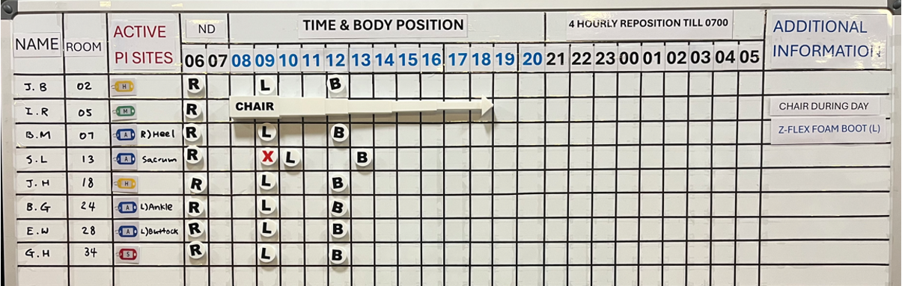
PI Handover Whiteboards - Layout

Slide 39
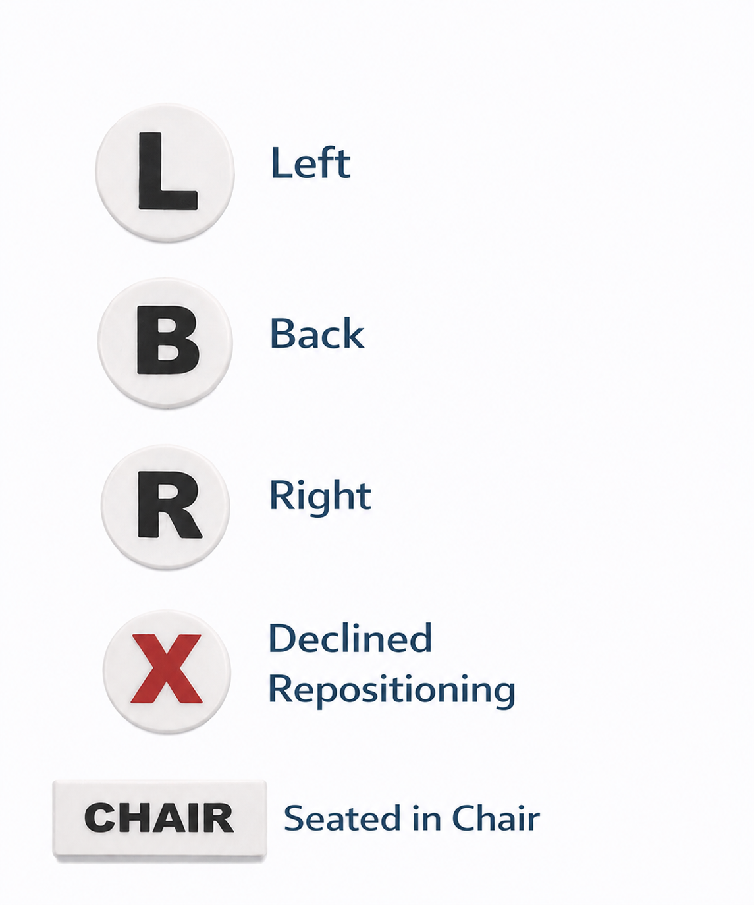
Repositioning Magnets
Show last 3 positions
Mark if the resident declined repositioning
Use Chair magnet if resident spending extended time in chair

Slide 40
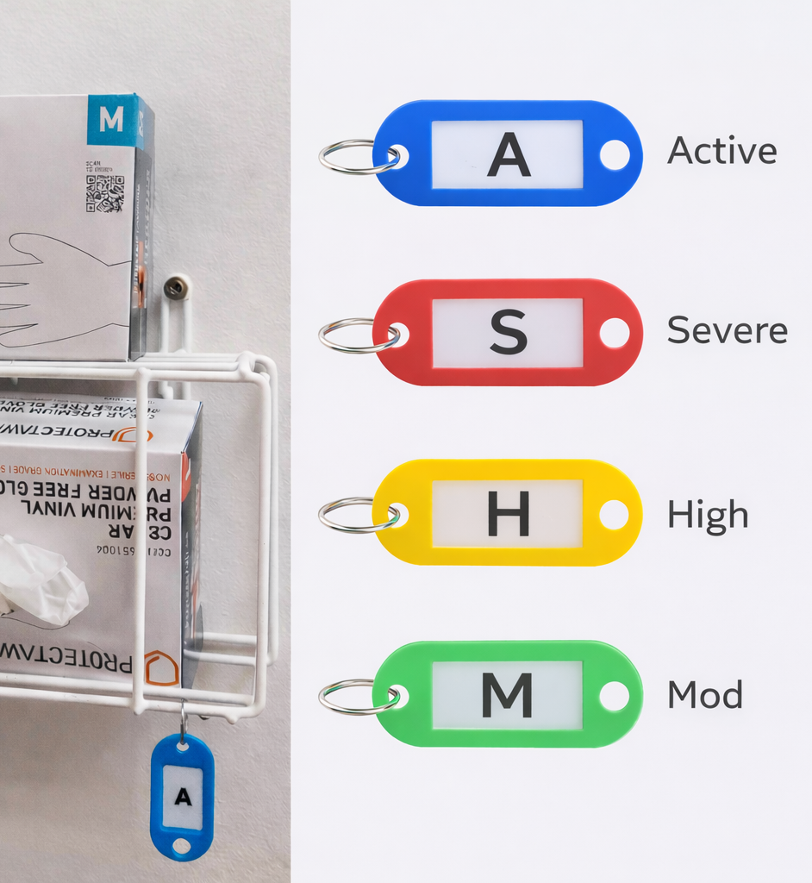
PI Visual Indicators
Colour coded tag displayed at resident’s room
Viewed when donning gloves
Provides visual cue of pressure injury status/risk
Reinforces information shown on the whiteboard
Supports prompt, consistent repositioning
All care staff escalate if tag does not match handover whiteboard
Nurse responsible for ensuring correct tag is in place

Slide 41
PI Risk Register
Electronic overview of all residents with a PI or identified risk in your area
Assessable via touch screen monitor in nurses station – no login required
Automatically updated from iCare data (incident reports, wound charts, skin assessments)
Refreshes every 2 hours
Provides detailed care information to support daily practice
Includes stage, location, pressure area care, equipment and dressing needs
Used by nurses and carers to guide consistent, individualised care
Nurses responsible to ensure information remains current and accurate

Slide 42
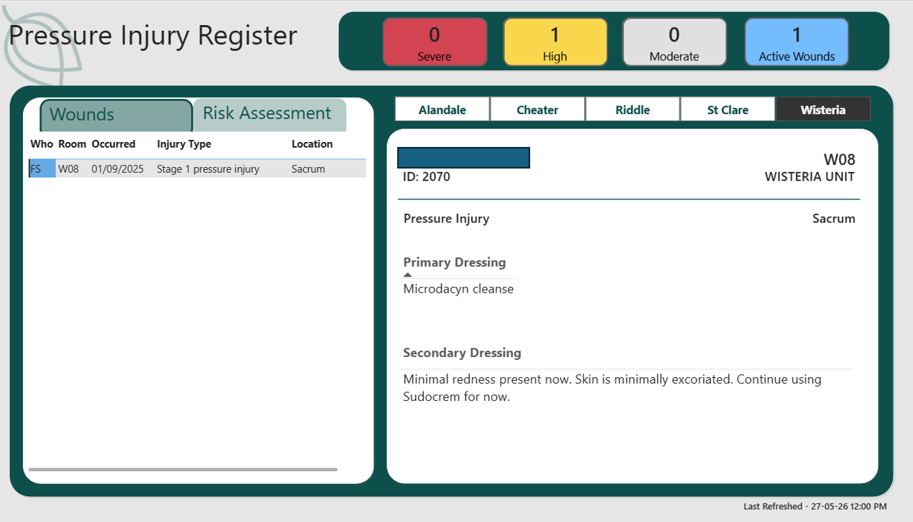

Slide 43
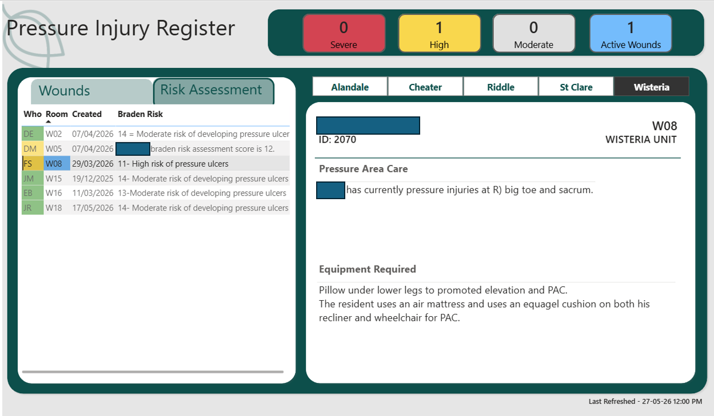

Slide 44
Thank You

