Slide 1


Piloting CQI (Continuous Quality Improvement)
Improving wound management and clinical excellence

Slide 2

Contents
This deck includes:
Guidance on using CQI
Getting started on using CQI
Workflow for Staff - summarised
Workflow for Champions - summarised
Workflow for Quality Manager/ Manager - summarised
Documenting outcomes
Things to consider for using CQI
Adding QPS to the home screen

Slide 3
Organisational Information
Please enter your relevant information here.

Slide 4
Guidance on using CQI

Slide 5
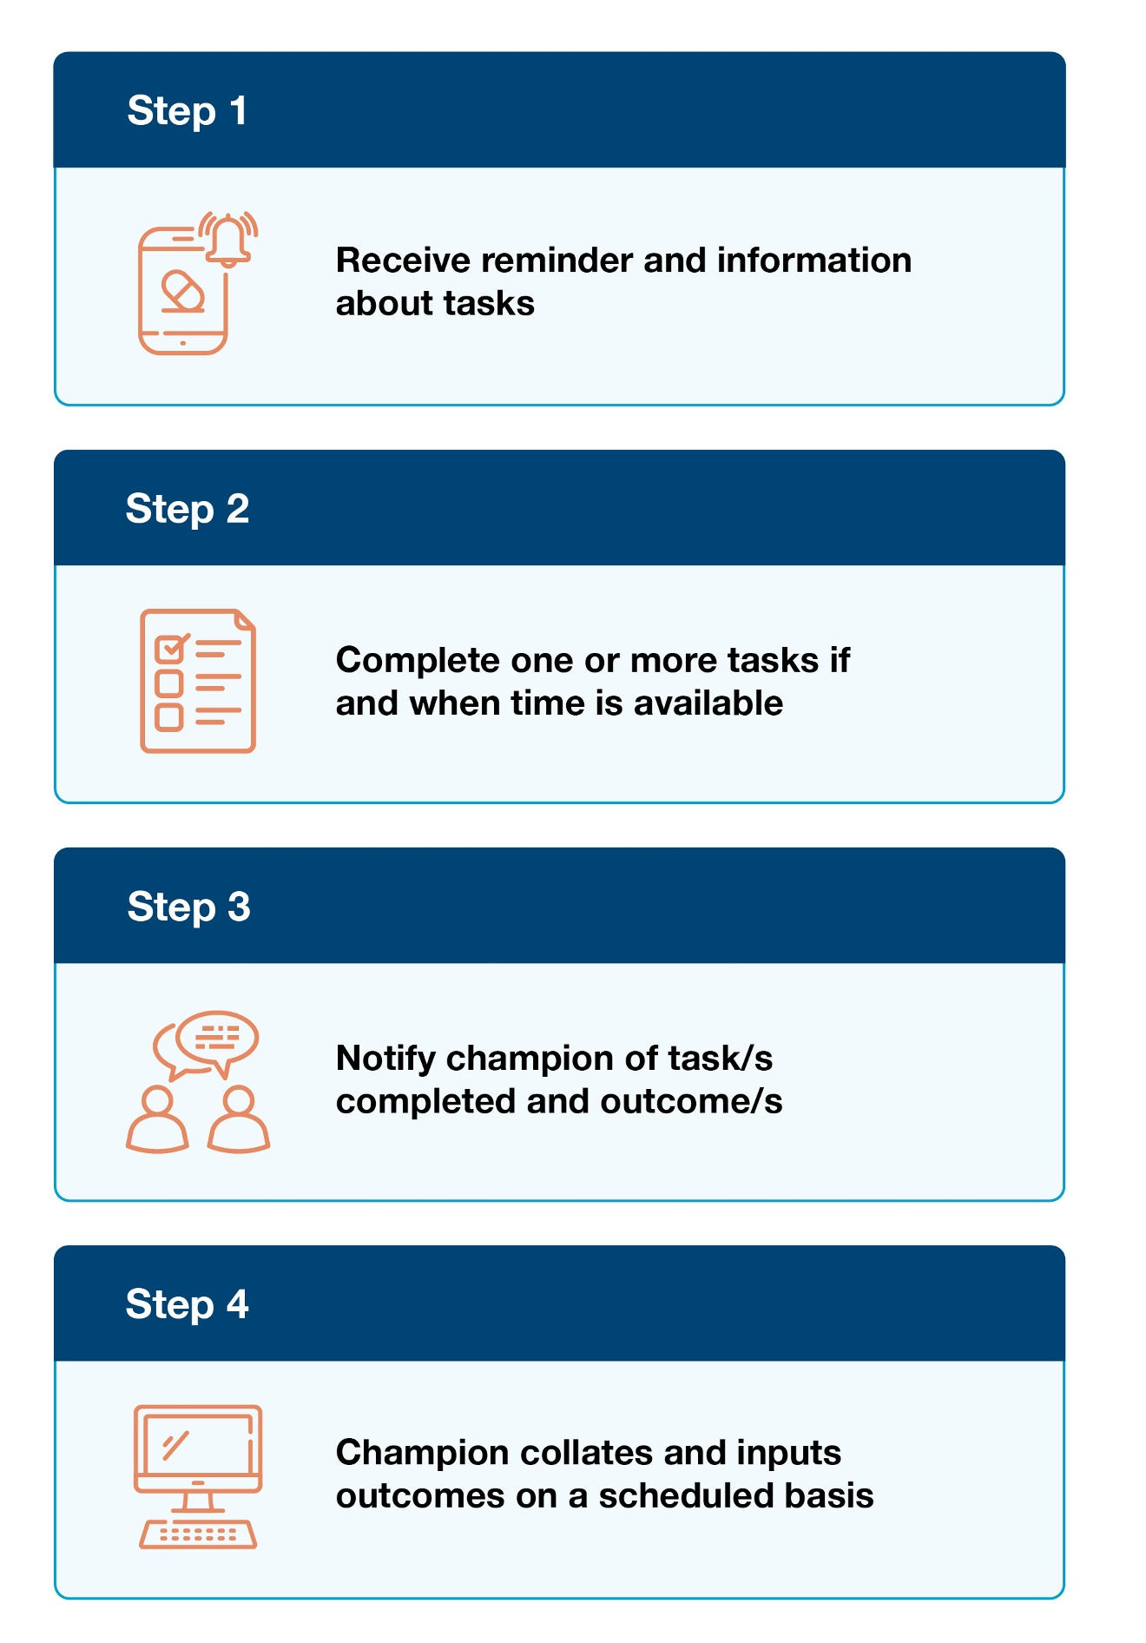
CQI process
There are four steps in the CQI process,
as described here in this chart.

Slide 6
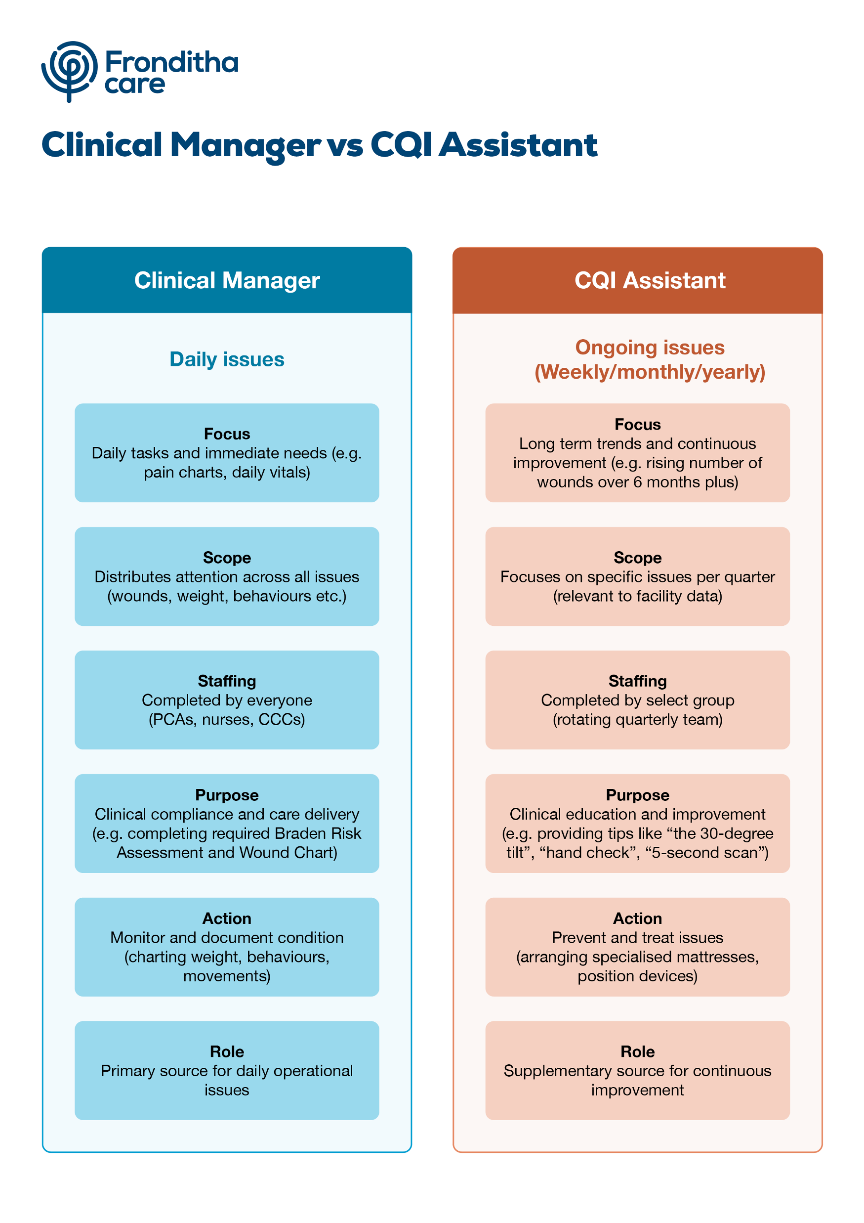
Clinical Manager vs CQI Assistant
The difference between a Clinical Manager addressing an issue, as opposed to the CQI Assistant is described in this chart.

Slide 7
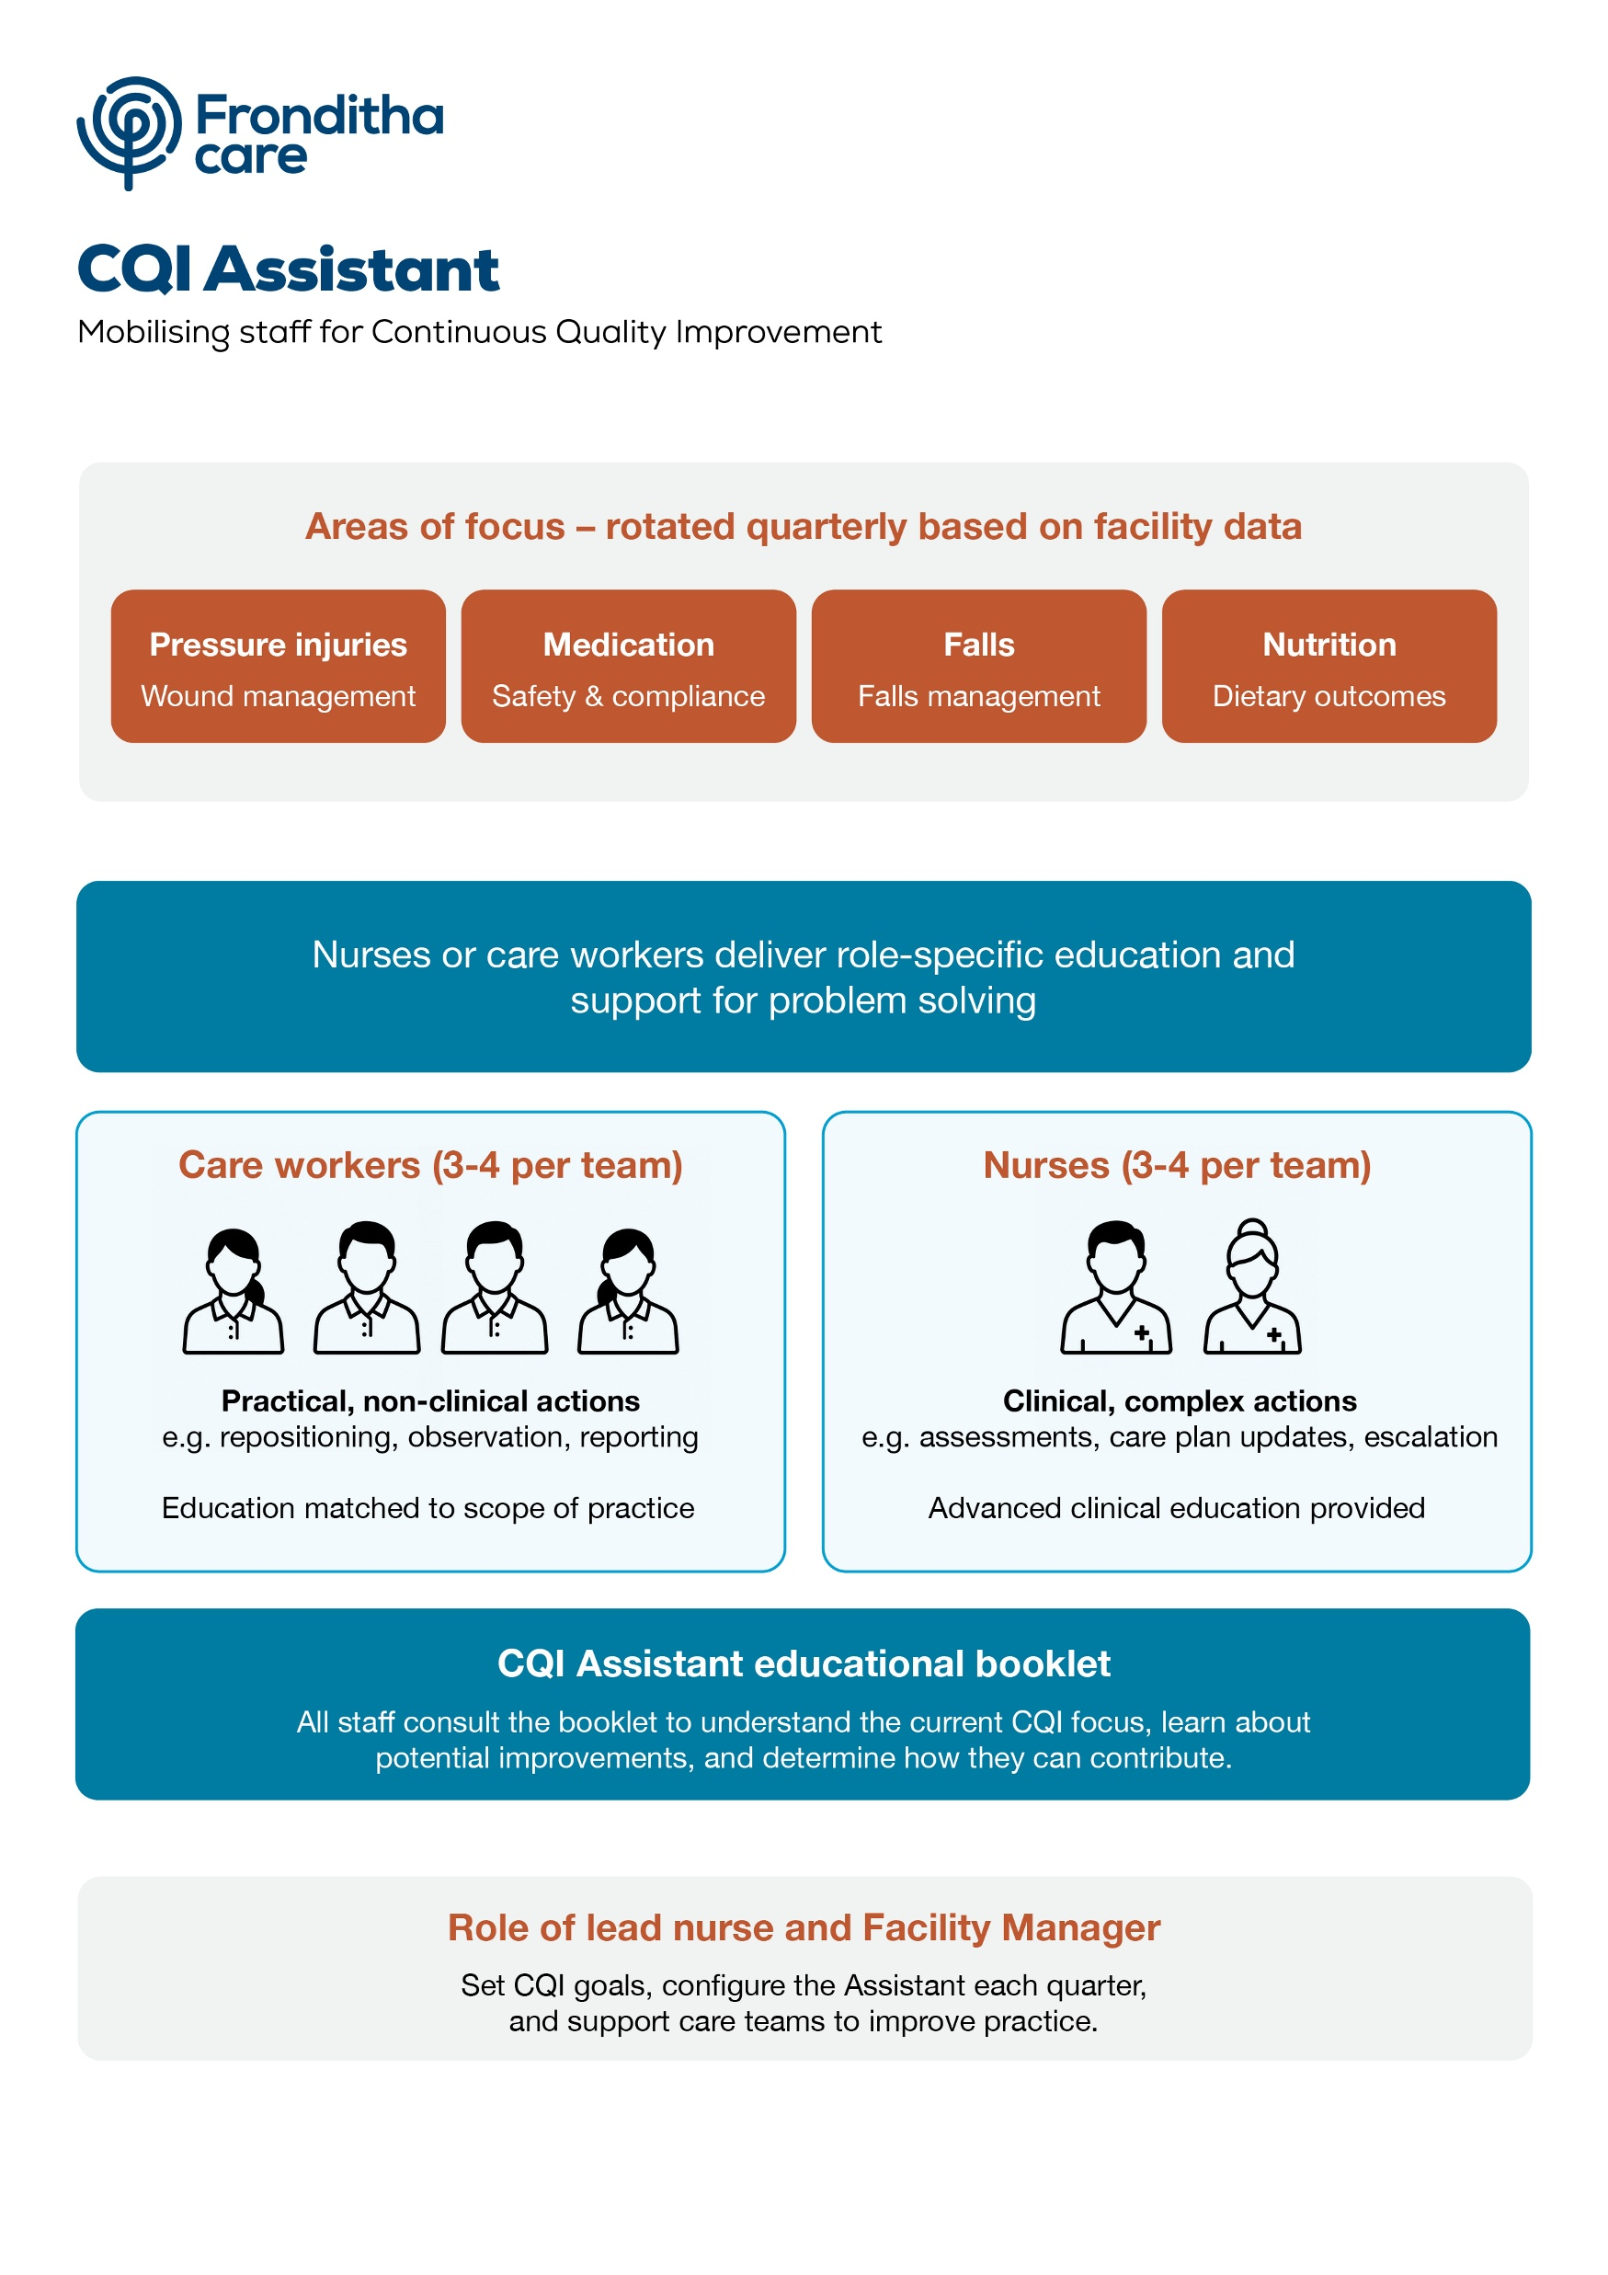
CQI assistant
This chart overviews the focus areas where the CQI Assistant can support better practice.

Slide 8
Getting started using CQI

Slide 9
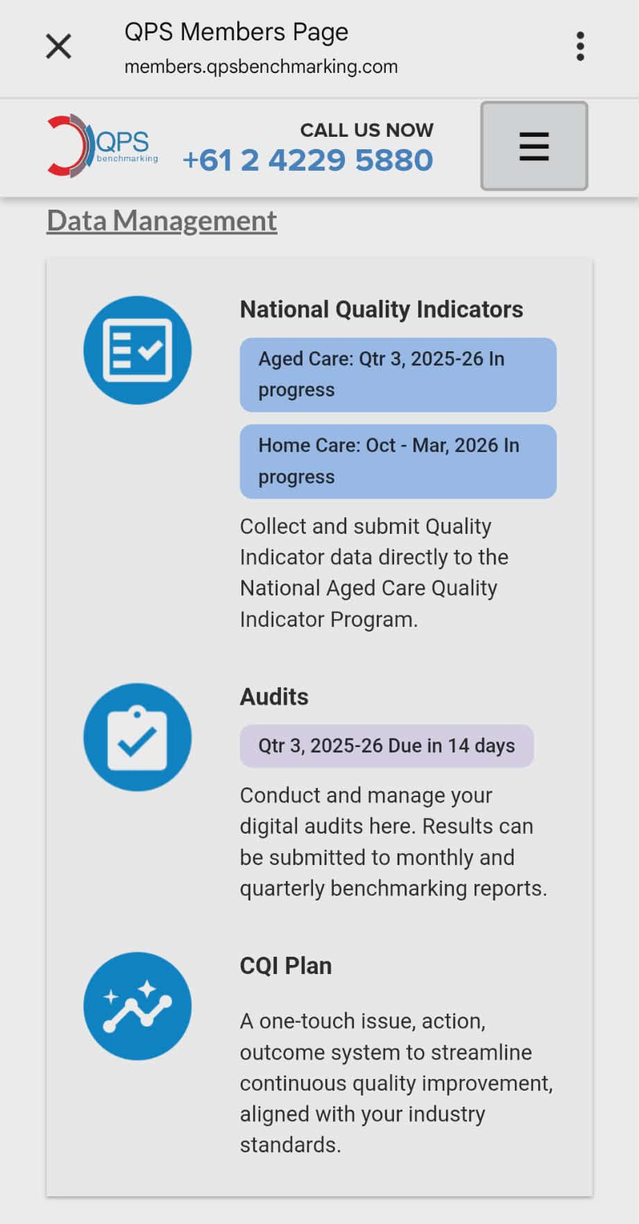
Step 1
Log in and select the CQI Plan.
Please note: Champions need to select Demo Site.

Slide 10
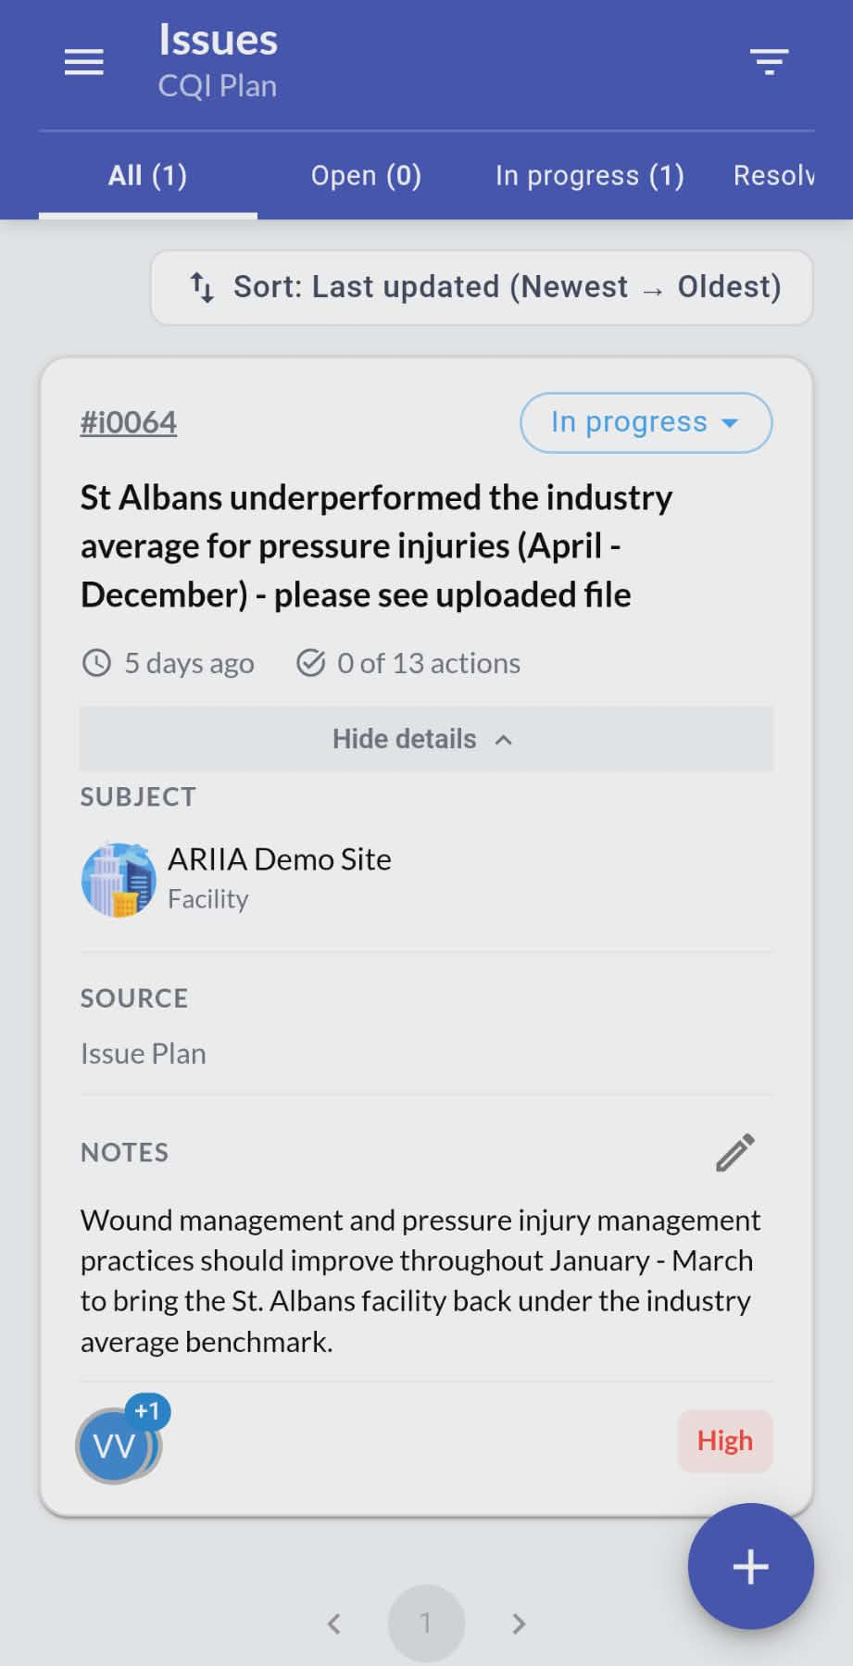
Step 2
The identified Issues for each site will display first.
Click on the #reference number (e.g.,#i0064) in the top left to open the relevant information for the flagged issue.
# reference number

Slide 11
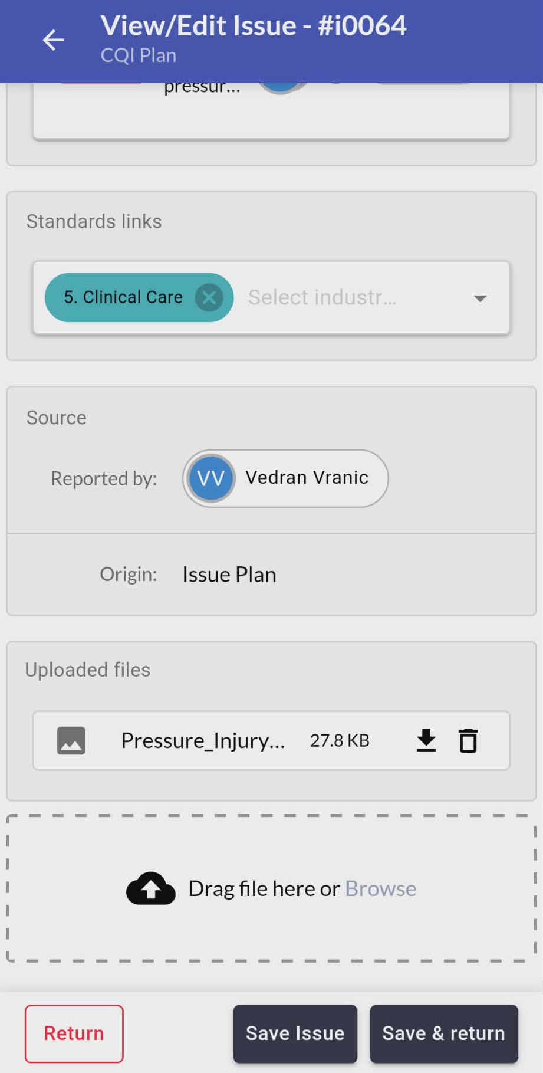
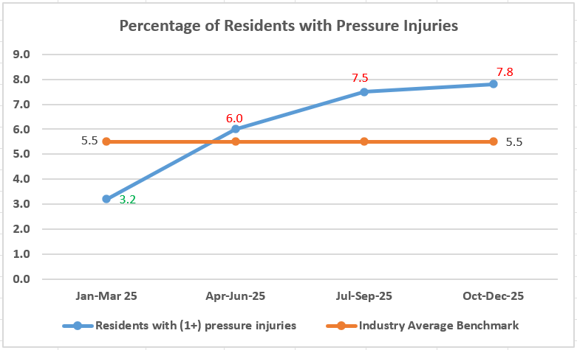
Step 3
To access details of the Issue, scroll down to Uploaded Files.
Click Return (red box in the bottom left) to open the file.
c. The file you have downloaded will give you evidence of the Issue flagged for the facility. This may change monthly or quarterly.
Evidence of an issue may look like this.
Uploaded Files

Slide 12
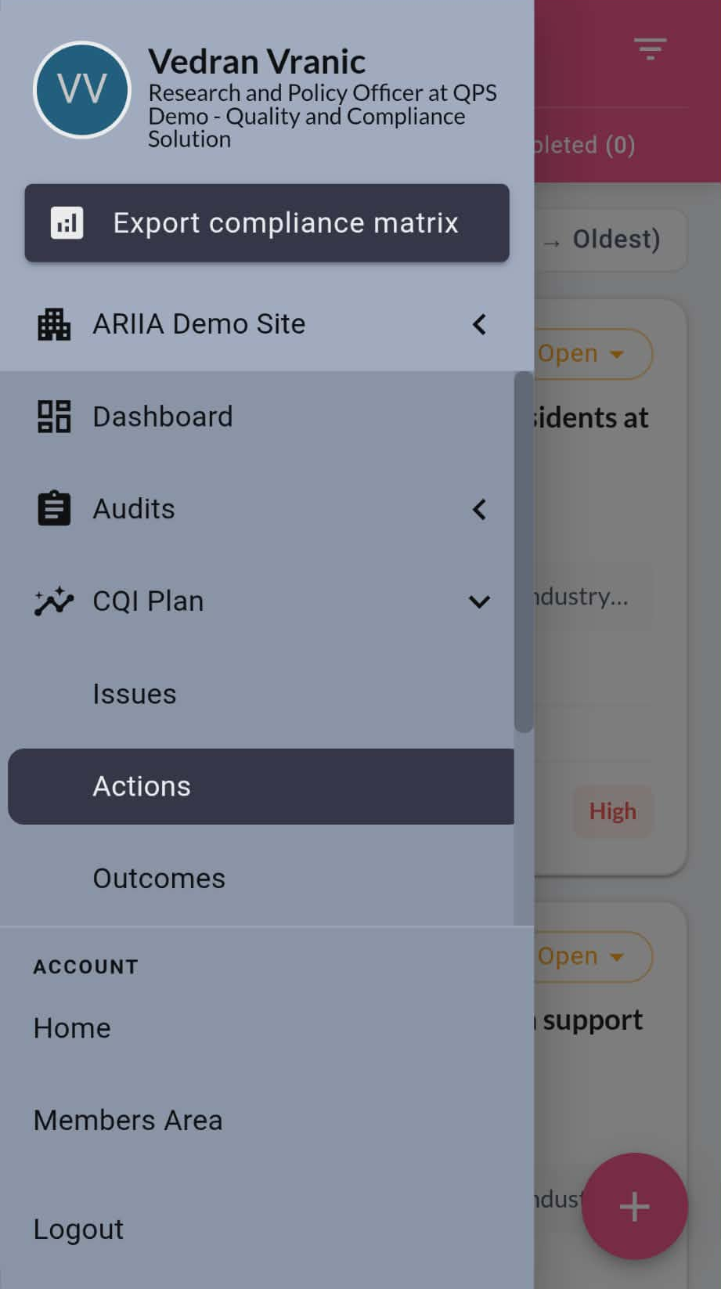
Step 4
Click on the three lines in the top right corner to access Actions.
Actions

Slide 13
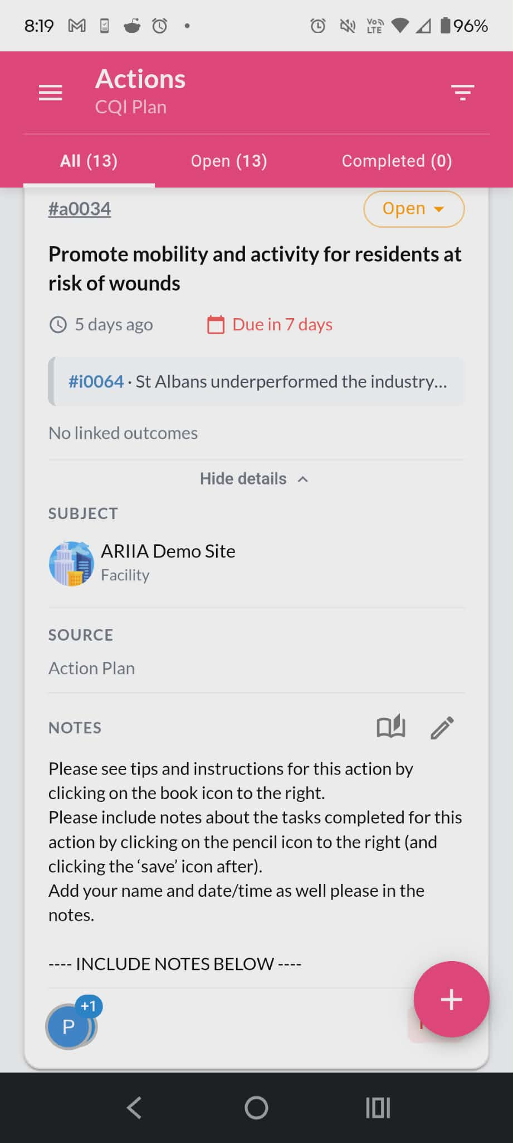
Actions
Do not click on the orange Open button, as this changes the Action to Completed or Cancelled.
This should only be used by a CCC/Champion.
The Actions section is identified by the pink header. All the work you need to complete is in this section.
Do not click on the pink plus button, as this creates a new Action.

Slide 14
Actions
The buttons relevant to you are:
the Show Details
the Book Icon
the Pencil Icon
Click Show Details to open the Notes.
Then click on the Book icon, located to the right, of the Notes title.
This opens Tips & Instructions for the Action you selected (refer to the next slide).
Show Details
Book Icon
Pencil Icon

Slide 15
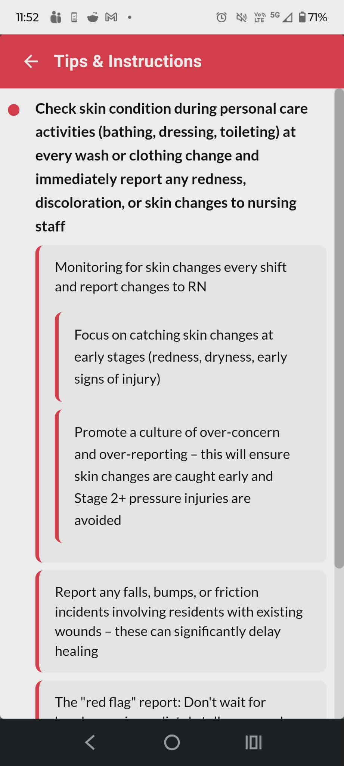
Tips & Instructions
This is an example of what the Tips & Instructions look like.
To address the Issue you will be prompted to take one or more of the Actions.
Choosing the relevant Actions:
That are most beneficial for residents at that time
That are not done regularly enough
That you may learn from, in improving your practice

Slide 16
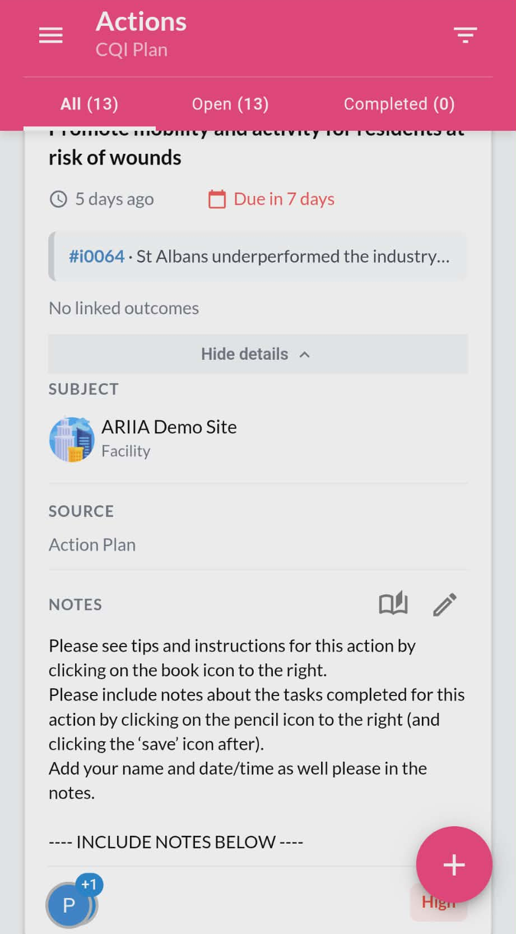
Actions
After you've completed one or more of the Actions you selected, click on the Pencil icon (next to the Book icon) to add your notes.
Pencil icon

Slide 17
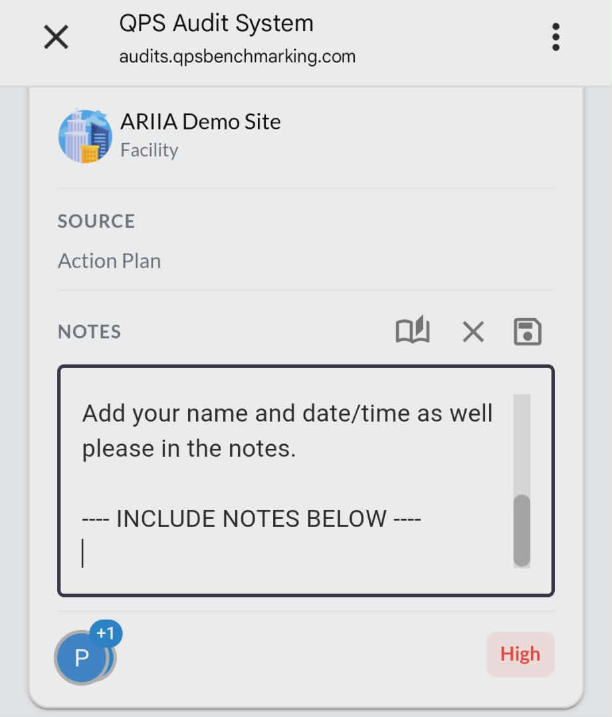
Adding your notes
Click on the Pencil Icon to add notes.
You need to add Notes for each Action you have completed. These should include:
What steps you took
Your name
Date/time
Any outcome/s
Any feedback about the pilot
Remember: Always click on the Save icon after entering notes to ensure your updates are recorded.
Save icon

Slide 18
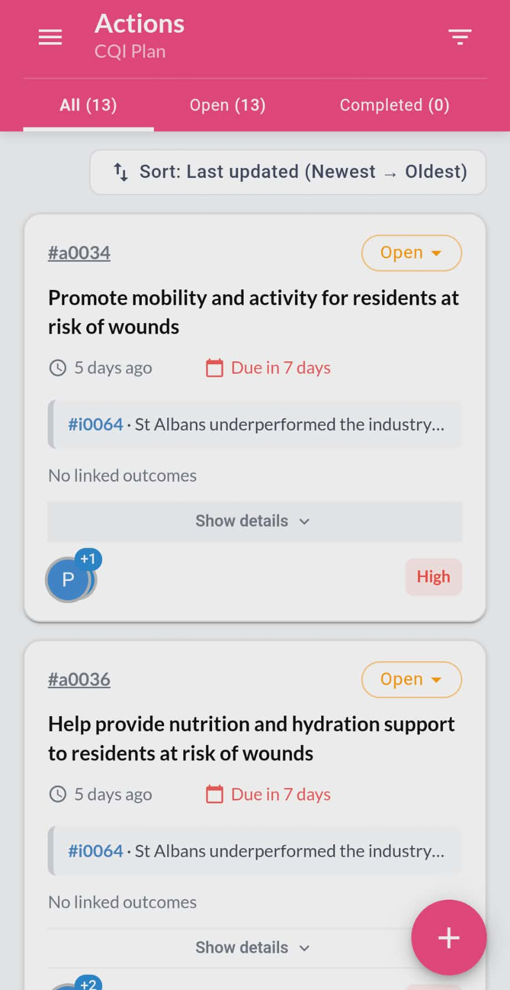
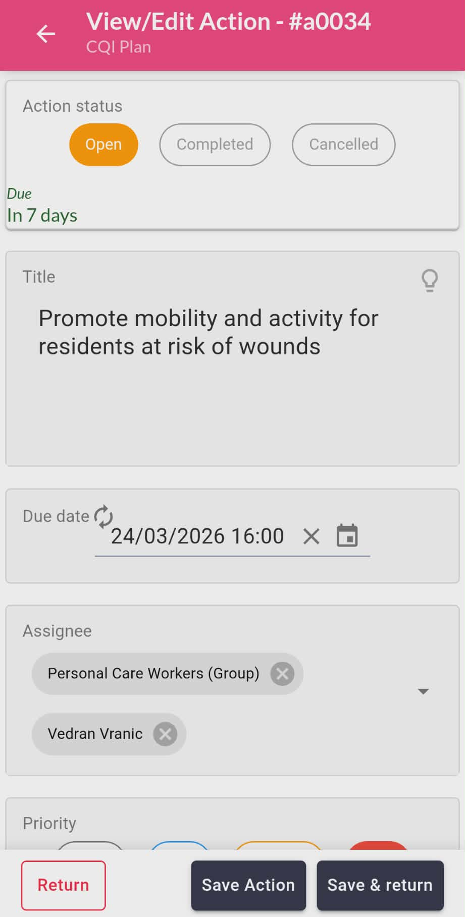
Checking your assigned Actions
To see if an Action has been assigned to you, click on the #reference in the top left corner (e.g., #a0034).
Once the Action is open (image 2) scroll down to Assignee.
If your work function is listed (e.g., Personal Care Workers, Nurses) you can contribute to the Actions.
Please note: Nurses will have more Actions assigned to them than PCWs but this can change.
Assignee
(image 1)
(image 2)

Slide 19
Workflow for Staff (summarised)

Slide 20
Workflow for Staff
Listed below are the steps you need to follow as a workflow:
Once you're logged in, click on CQI Plan.
Champions must first select the demo site when they log in.
In Issues you can read about the CI issue that we’re trialing
Next, click on the three lines in the top left corner and then go to Actions section
  a. The Actions section is the only section you will need to use in the CQI Plan
The other sections – Issues, Outcomes - are managed by the Quality Manager and CCC
Notified of CQI actions assigned to you via email – you’ll receive 12 actions
All Nurses have the same actions and all PCA’s have the same actions, but more clinical actions are assigned to Nurses and the less clinical actions to PCA’s
When looking at each action click on Show details to open Notes

Slide 21
Workflow for Staff (continued)
There is a Book icon right of the Notes section – this provides educational material and things you may do to contribute to each action
Please read carefully the Tips and Instructions provided under the Book icon and choose what you think might be most relevant or helpful to address the Issue
It will be up to you to decide which Action you want to contribute to and how you want to contribute
Choose what is most relevant to the Issue - you don’t need to contribute to every Action
When choosing which Action to contribute to, please consider a couple of things:
  a. What is most beneficial or most needed for the resident/s at that time?
  b. What isn’t being done at the facility regularly enough or well enough?
  c. What is new or most interesting for you to learn or try as an Action?

Slide 22
Workflow for Staff (continued)
When you contribute to an Action, it is important you take notes
Open the Show Details section of any action
Click on the Pencil icon to add notes (to the right of the Notes title)
In the Notes you should include:
  a. What you did for that action, your name, date and time
  b. Feedback you have for the pilot – maybe you think some of the tips and instructions are not helpful and should be removed or changed
  c. Anything else you think relevant – e.g., whether it was helpful/the outcome
After adding your notes, click on the Save icon.
Do not click on the yellow Open button or change this to completed or cancelled – this will be done together with the Champion at the end of one week

Slide 23
Workflow for Staff (continued)
All Actions are due for completion within a week at 4PM <include date here>
  a. Reminding that not all actions need to be completed – if some actions are not relevant or helpful, it's important for you to identify this in the Notes section
You need to schedule a 30-minute meeting as a group with the Champion, on the agreed date each week, to go over each action and then select if each Action is Completed or Cancelled <Confirming the date and time agreed>
Every Completed action will need to have an Outcome documented through discussion with the Champion during the meeting
If not Completed or Cancelled, all actions will auto-renew for a second week, with a due date, to allow everyone the opportunity to contribute what they may have missed in the first week.
On the agreed date you will meet with the Champion to document all Outcomes.

Slide 24
Workflow for Champions (summarised)

Slide 25
Workflow for Champions
The Champion is responsible for organising the weekly meeting with the CQI team. If someone does not attend, the Champion is responsible to follow-up
During the meeting, the Champion should navigate to the Actions section, click on the #references for each action, read them out and look at the Action notes noted by staff
If no one completed an Action, under Action Status, the Champion should select Cancelled
If someone or many people completed it, Champion should select Completed
If neither of these Actions are clear, the Champion, will ask the group during the meeting for all Completed Actions, (a pop-up will appear to Assess Outcome)
All Completed Actions will need to be assessed with the group and completed through the Outcomes section of the CQI. Should the group run out of time, this needs to be done in a follow-up meeting.

Slide 26
Workflow for Champions
Champions need to include the following details for Outcomes of an Action:
  Under Outcome Notes the Champion will include any Issues or Outcomes for all work that was completed on that Action
  Under Outcome Status the Champion will discuss whether the tasks they completed were effective, partially effective or ineffective
  Under Due Date include the same date as the meeting
  Under Assignee the Champion should select their name
  To save the outcome, the Champion will select Save and Return
  Once all Completed Actions have an Outcome included or saved, the Issue will be automatically be resolved in the system

Slide 27
Workflow for Quality or Facility Managers (summarised)

Slide 28
Workflow for Quality or Facility Managers
The facility Manager or Quality Manager creates a monthly or quarterly CI issue
The issue created is the most important clinical issue in the facility for that month or quarter
The Manager selects facility-wide issue as opposed to resident-specific
The Manager uploads a file to the Issue providing evidence of the issue (e.g., image of the number of falls rising over the last 6 months)
The Manager adds the champion/CCC to the Issue under Assignee
The Manager adds all available Linked Actions (lightbulb symbol), associated Due Dates (end of the week), and Priority for every action (e.g., high)
The Manager adds Assignees – either PCW Group, Nurse Group or both Groups depending on type of action; whether more clinical or less clinical.

Slide 29
Documenting outcomes

Slide 30
Documenting outcomes
The meeting with the Champion at the end of the week is important to document Outcomes for each Completed Action. This will be guided by the Champion who will go through each Action with the group.
The Champion will ask anyone who included their name under the Notes section their view on whether the Outcome was effective, partially effective or not effective.
The pilot finishes on <Insert date>
The second co-design session will be organised <Insert date>

Slide 31
Things to consider for using CQI

Slide 32
Performance and usability
These are things you need to consider when you are running your trial:
Load times for the app and individual screens
Performance on older/lower-spec devices
Behaviour on unstable Wi-Fi connections
Ease of logging in/out
Font size and readability
One-handed usability
Contrast and visibility in different lighting conditions
Does it crash or freeze under normal use? How does it behave when switching between the app and other phone functions? How quickly the session times out when idle?
User - friendliness — can a new staff member use it without training?

Slide 33
The information content
Trialing the application to test:
Are the actions clear and easy to understand?
Are the actions specific enough to act on, rather than vague or generic?
How much duplication is there with existing actions done through iCare? And where exactly?
Is enough detail provided to carry out the actions safely and correctly?
Are there any actions suggested that are high risk and may require supervision or sign off?
Are there any actions suggested that are not relevant or useful for the facility?
Is there any missing content you think we could add in there for educational or practice purposes?

Slide 34
The CQI process
Looking at the CQI process from start to finish:
CQI actions assigned to staff
CQI actions viewed, chosen and completed by staff
Champion informed of completed actions
Champion and staff documenting Outcomes together in the system
  How often should Champion meetings take place?
  How often should we rotate staff who are part of the continuous improvement team?
  Could Health & Wellbeing Officers or other staff be involved?
  Is there any information or resources we could provide to make it easier for the monthly CQI teams?

Slide 35
Additional questions
Anything else that might be improved with the application?
Anything else that might be improved with the CQI process?
For Champions ONLY:
  any issues with the weekly CQI meeting from team members about actions completed?
  any issues with documenting outcomes into the system each week?
  any improvement suggestions?

Slide 36
Adding QPS to the home screen

Slide 37
Adding QPS to the home screen
Open internet browser and enter www.qpsbenchmarking.com in the address bar
To the right of the address bar click the 3 dots and select Add to Home Screen -> Install
On other phones you can tap the Share button, scroll down, and select Add to Home Screen
On some phones you might need to save the website as a bookmark and then add the bookmark as a widget on the screen. A QPS icon will then be added to the home screen like an app
For more information on this process, click on the video below: https://cloud.qpsbenchmarking.com/index.php/s/LdzgJX53kT8zGYm

Slide 38
For any questions email
comms@fronditha.org

