Slide 1

Wound management and clinical excellence
Piloting a digital assistant (CQI)

Slide 2

Trial considerations – Performance
and usability
Load times for the app and individual screens
Performance on older/lower-spec devices
Behaviour on unstable Wi-Fi connections
Ease of logging in/out
Font size and readability
Contrast and visibility in different lighting conditions
Does it crash or freeze under normal use
Can a new staff member use it without training?
Anything else on performance/usability

Slide 3
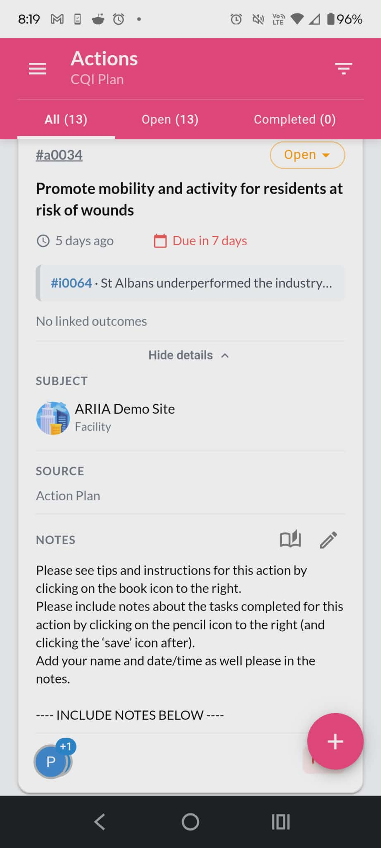
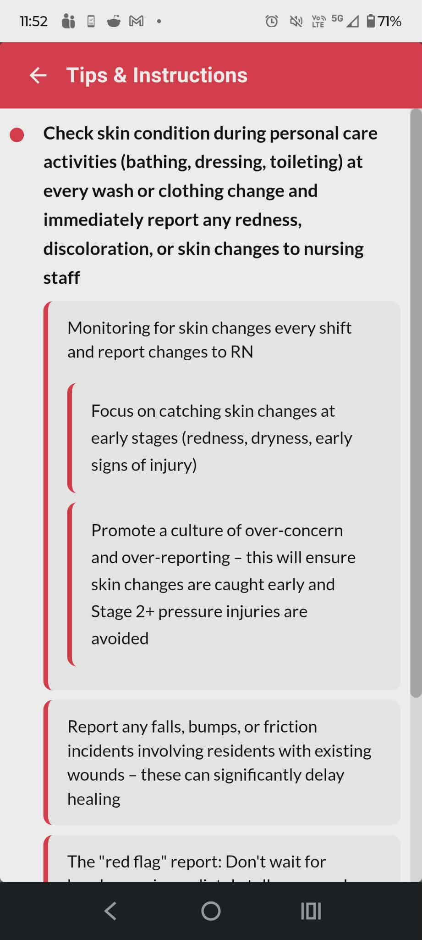
Educational and instructional booklet

Slide 4
Trial considerations – Educational and instructional booklet
Are suggestions in the educational booklet clear and easy to understand?
Is there enough detail provided to carry out the actions safely and correctly?
Is anything suggested that is not relevant or useful?
Is anything suggested that is high risk or requires supervision or sign off?
Is there any important information or suggestion missing (for wound management)?
Are there any other clinical issues, apart from wounds, you would find helpful to have information about?

Slide 5
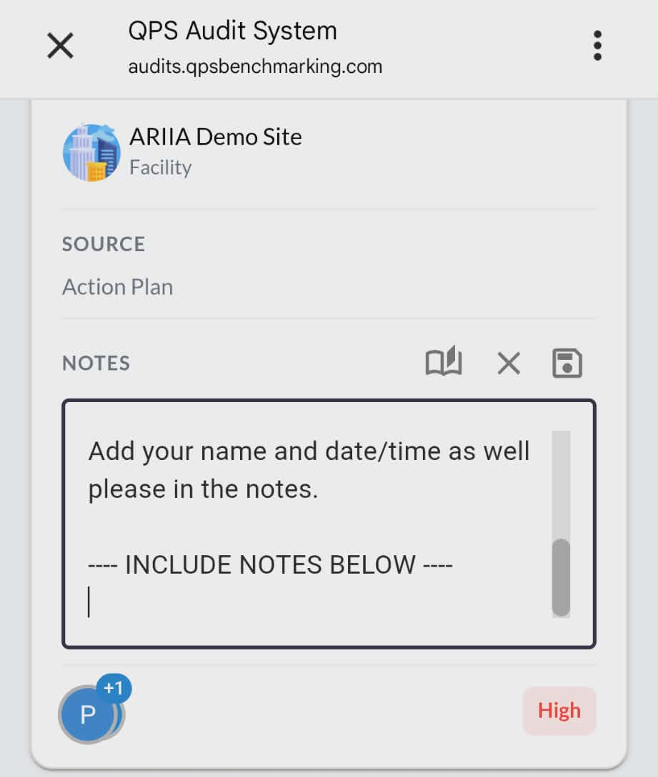
Actions and note-taking

Slide 6
Trial considerations – Actions and note-taking
The number of actions you could choose from – did it feel like too many?
Is it easy and simple to take notes in the Actions section?
  Is it clear what should be written?
Would you make any changes to what is written in the notes?
Would you make any changes to the process of making notes? (e.g., clicking pencil icon, adding notes, selecting save)
What gets in the way of contributing more to the CQI actions?
When thinking about all the different Actions in the CQI, how much duplication or similarity is there with work done through iCare? (1 = minimal, 5 = significant)

Slide 7
Trial considerations – Documenting outcomes
The meetings to document outcomes –
How did they go?
Any learnings or suggestions about how to run these meetings in the future?
How often should CQI meetings take place – weekly, fortnightly, monthly?
Any other feedback about meetings?
Documenting outcomes –
Aakanksha / Andrie – how was documenting outcomes for each action? What would you change or improve?

Slide 8
Trial considerations – The CQI process
Could the CQI assistant be used in a different or better way?
Should staff in the CQI team be changed sometimes or should it always be the same staff?
  If they should be changed - how often should they be rotated - fortnightly, monthly, quarterly?
Should other staff (e.g., Maintenance, Lifestyle) be involved in CQI in any way?
If you had to teach a co-worker to use the CQI assistant, what is the main thing you would want them to know?
Is there any information or resources that would make the process easier for the CQI team?

Slide 9
Trial considerations – Rewards/incentives
How should people in CQI teams be rewarded? (1 = least, 5 = most)
Free education and training
(e.g., seminars of special interest, such as dementia, exchanging practice with other providers, learning resources to take home)
Leisure
(days off work)
Higher pay
Career development opportunities
Recognition
(simple thank you, invitation to lunch)
Support to reduce workload or strain
Input in decision-making
Other

Slide 10
Next steps - CCCs
Champions to teach two new trainees how to use the CQI assistant – include date here
  These new trainees will be the CQI “rotation staff” – purpose is to trial one rotation and a smaller CQI team
  Can use the slides from our last meeting to assist with training
The two new trainees undertake same trial, but only for one week, and incorporating changes made from feedback collected today
Champions to meet and document outcomes with new trainees incorporating changes made from today’s feedback
Champions to provide feedback on training and associated issues

Slide 11
Next steps - Group
CQI profiles of nurses will be expanded to include Auditing
Training session organised for this – include date here
Nurses will undertake auditing until date, provide any feedback, and then fill a short survey
Today, everyone should have received a voucher as token of appreciation from the office of CEO
Please complete a short survey about the trial – include link here

Slide 12

For any questions email
comms@fronditha.org

